Slide 1

Topic: Traditions and Customs
Plan :
The importance and meaning of traditions and customs
Examples of Japanese traditions and customs

Slide 2
Introduction:
Traditions and customs are an important part of every country’s identity.
They represent the history, values, and way of life of people.
Traditions are special activities or celebrations that are passed down from generation to generation, while customs are everyday behaviors that show respect, kindness, and culture.
They help people feel connected to their community and remind them of their roots.

Slide 3
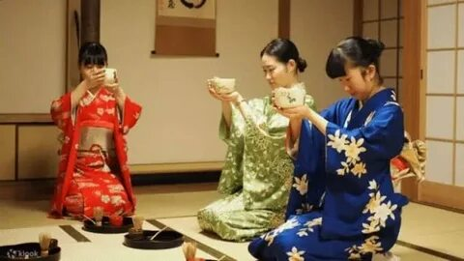
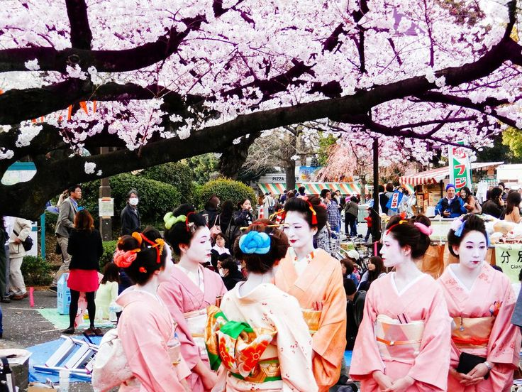
Japanese Traditions and Customs:
Japan is one of the most traditional countries in the world, where ancient customs still live in modern society.
One of the most famous traditions is the Tea Ceremony, which symbolizes peace, purity, and respect.
Another beautiful tradition is Hanami, when people gather under cherry blossom trees in spring to enjoy the beauty of nature.

Slide 4
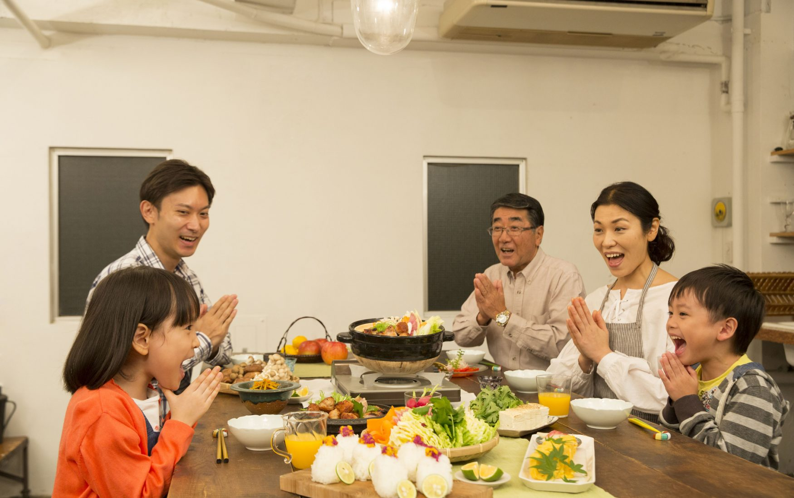
Japanese customs also show politeness and discipline.
For example, people bow to greet each other instead of shaking hands.
They remove their shoes before entering a house to keep it clean.
Before eating, they say “Itadakimasu” to show gratitude for the food, and after finishing, they say “Gochisosama deshita.”

Slide 5
These traditions and customs reflect Japan’s love for harmony, respect, and simplicity.
They make Japanese culture unique and admired all over the world.
Conclusion:
Traditions and customs are not only old habits — they are a bridge between the past and the present.
By keeping them alive, people protect their cultural identity and learn to respect other cultures as well.

Slide 6
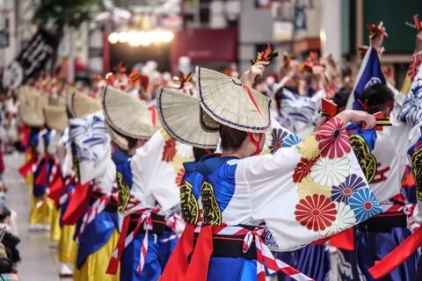
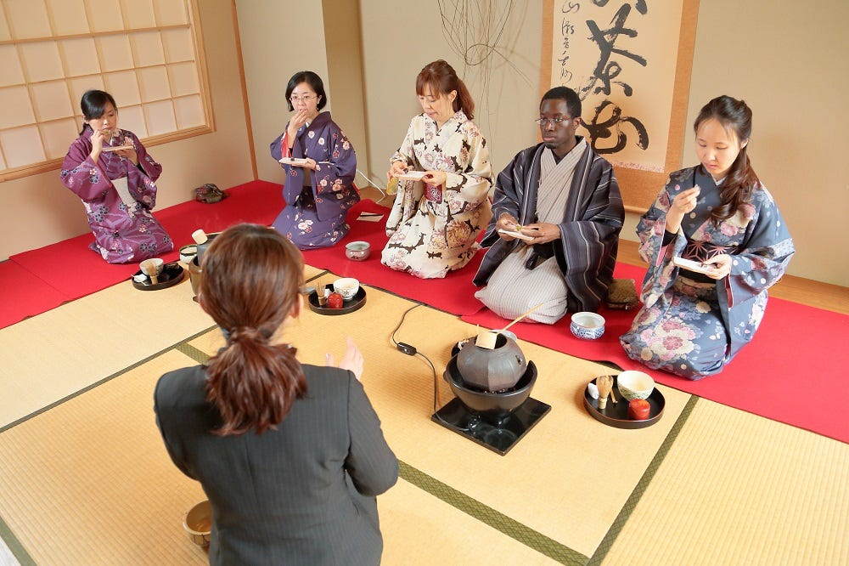
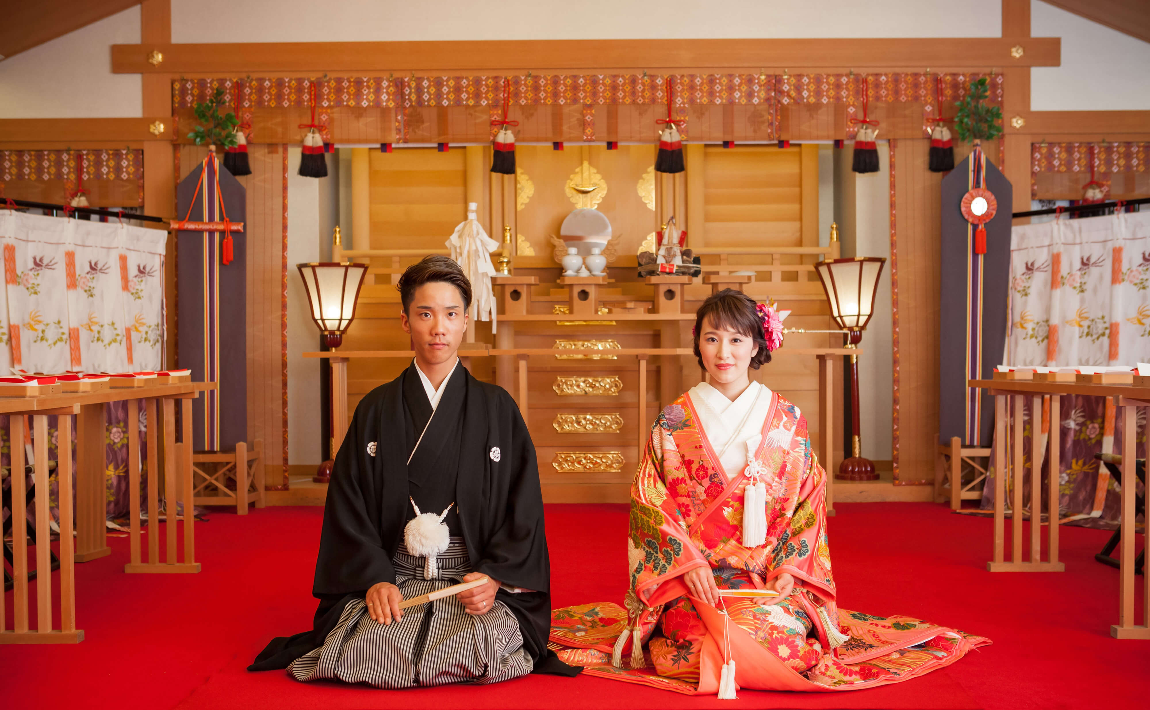
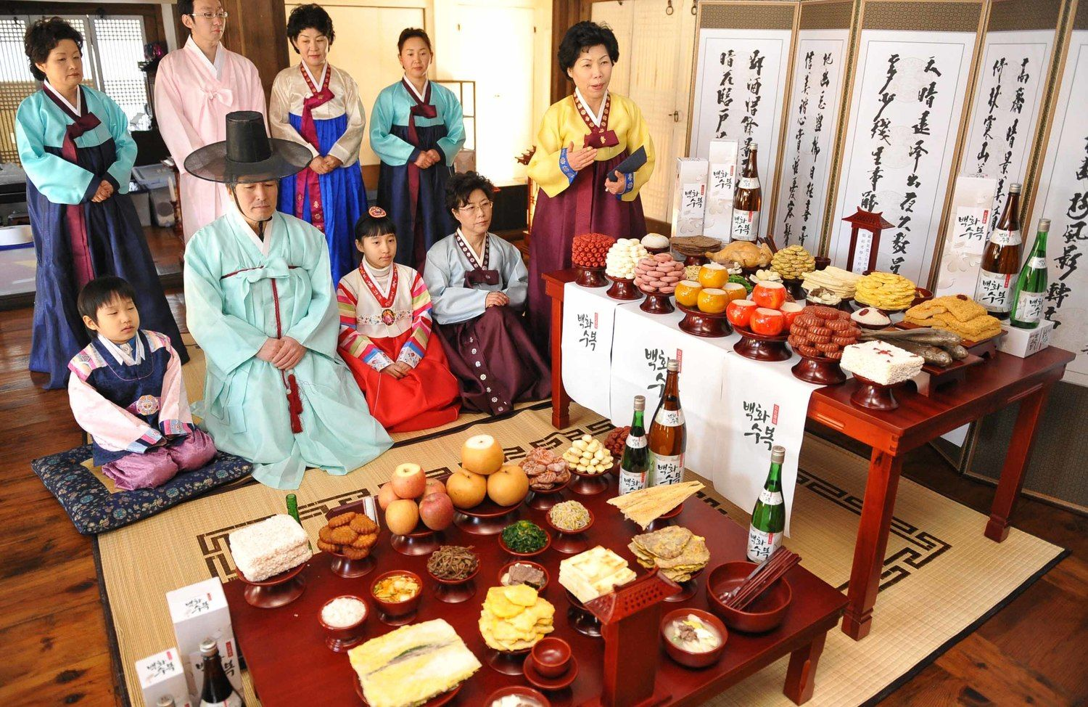

Slide 7
THANK YOU FOR YOUR ATTENTION!!!

