Slide 1

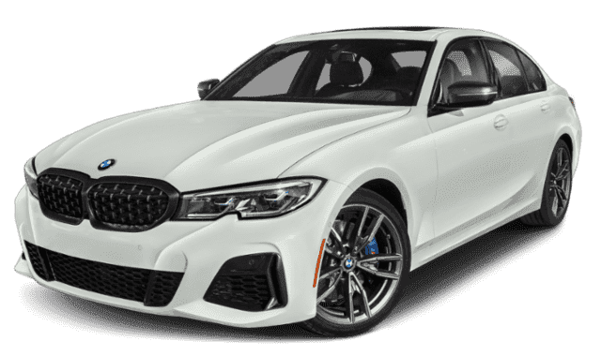
Bmw
Rolls-royce
Bugatti

Slide 2

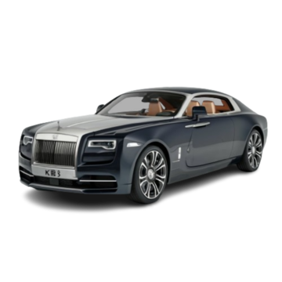

Bmw
Rolls-royce
Bugatti

Slide 3

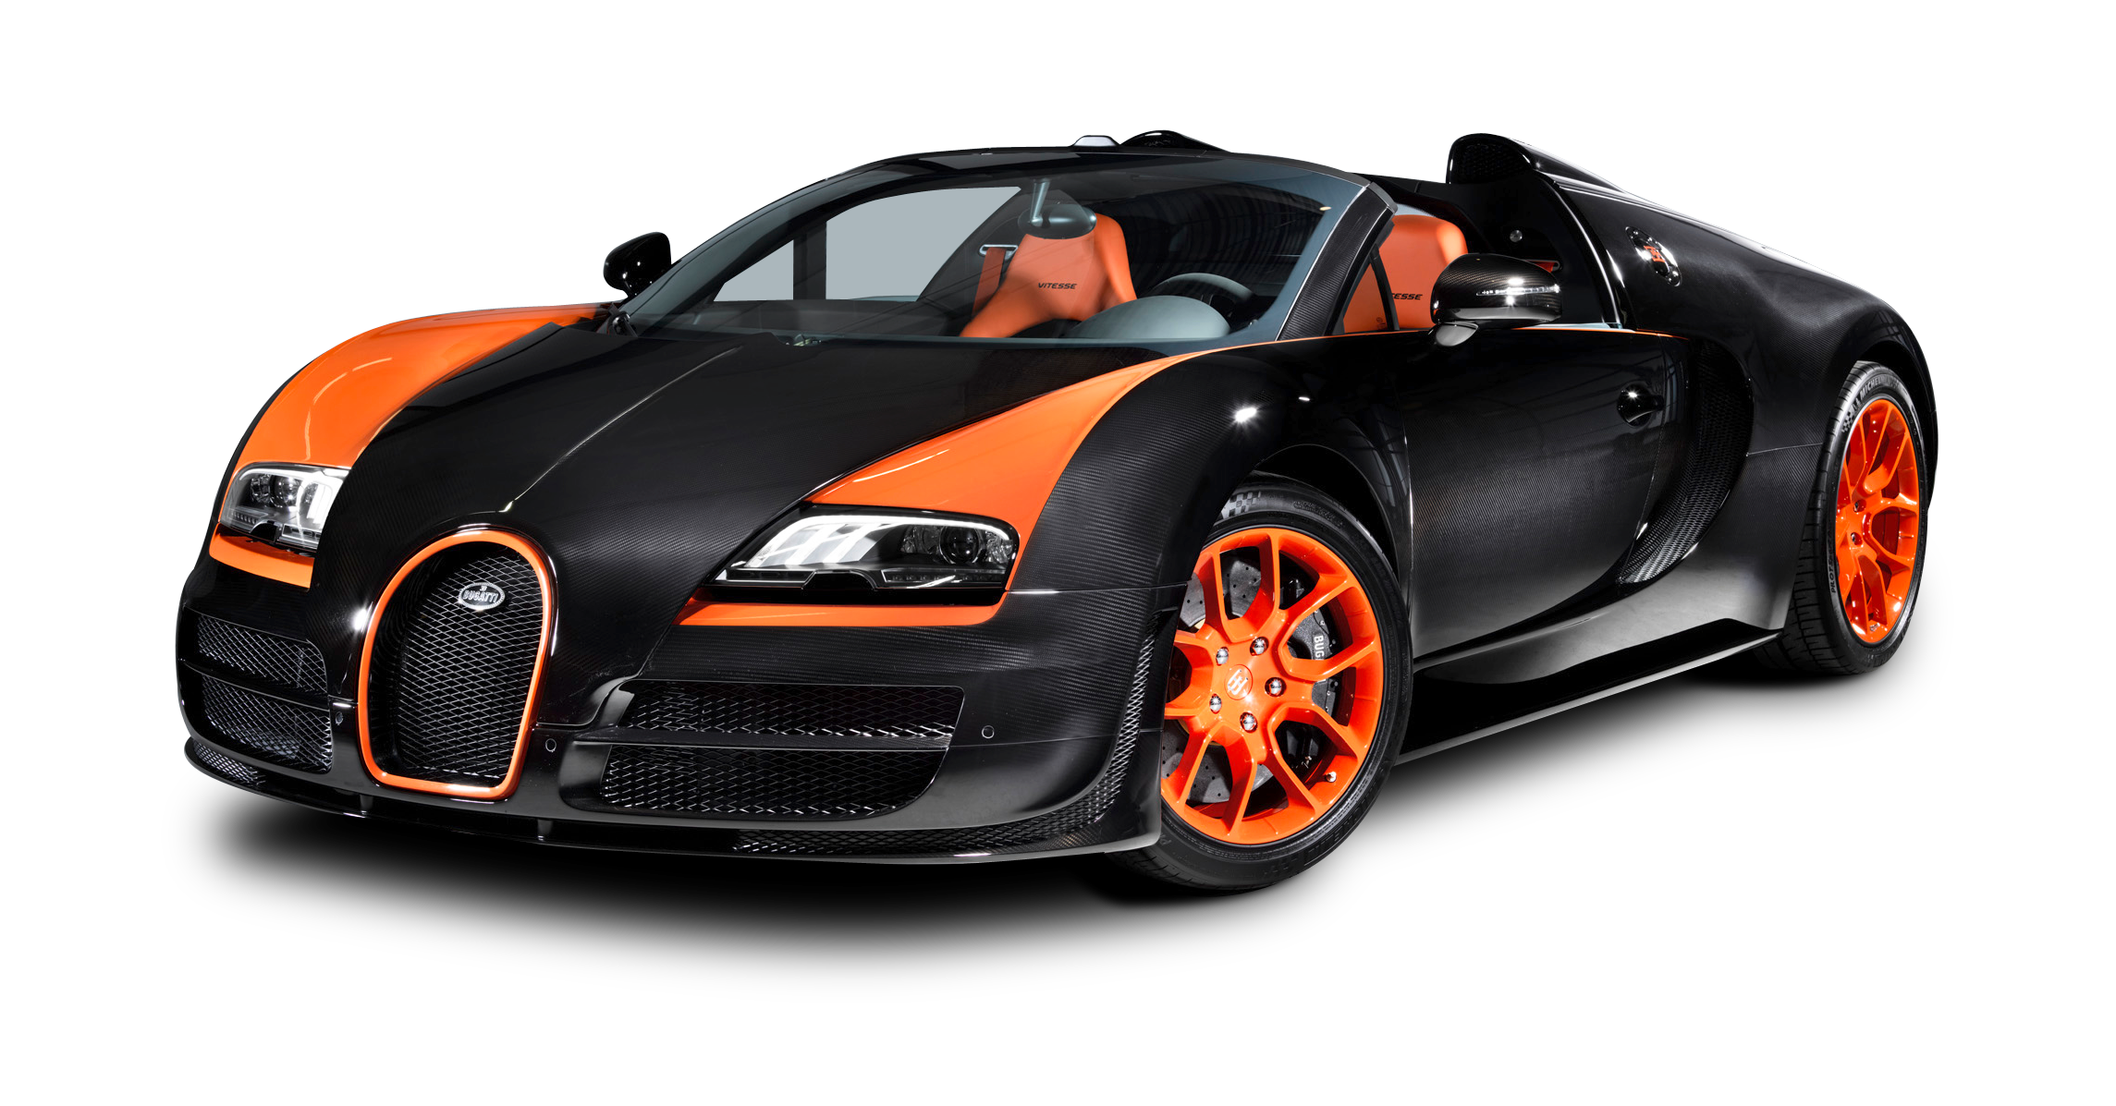
Bmw
Rolls-royce
Bugatti

