Slide 1
UzNPU named after Nizmiy
Faculty of Innovation Pedagogy Joint Higher Education school
Subject: Home reading
Group:201-UK
Independent work topic: Daniel Defoe . About the Author and his books.
Presented By : Kaldibayeva Aida
Checked by : Makhsudova Oysara Nishonovna

Slide 2
Plan:
Daniel Defoe: Life, Work, and Literary
Early Life
Family and Background
Business Career and Challenges
Political Writing
Robinson Crusoe
Captain Singleton
Moll Flanders
Roxana
Legacy and Influence

Slide 3
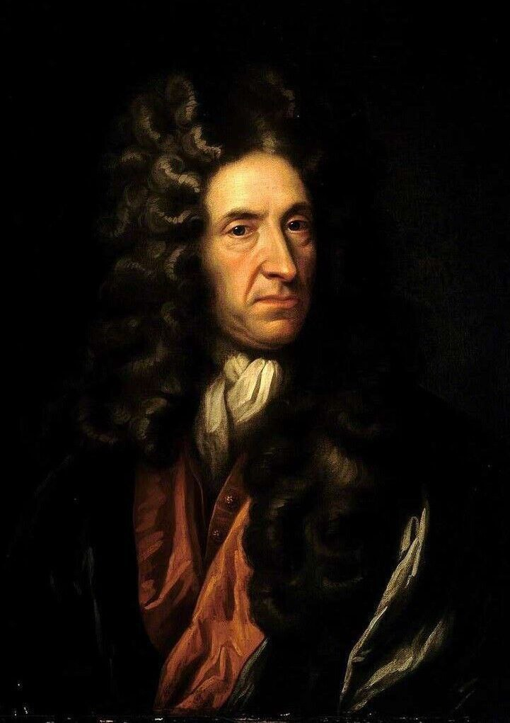
Daniel Defoe: Life, Work, and Literary Contribution
Daniel Defoe is considered one of the founders of the English novel. His long, adventurous life, combined with his talent for observation, helped him create realistic and exciting fiction. Known mainly for Robinson Crusoe, he also wrote political essays, travel books, and economic analyses. This presentation explores his biography, major works, writing style, and long-lasting influence on world literature.

Slide 4
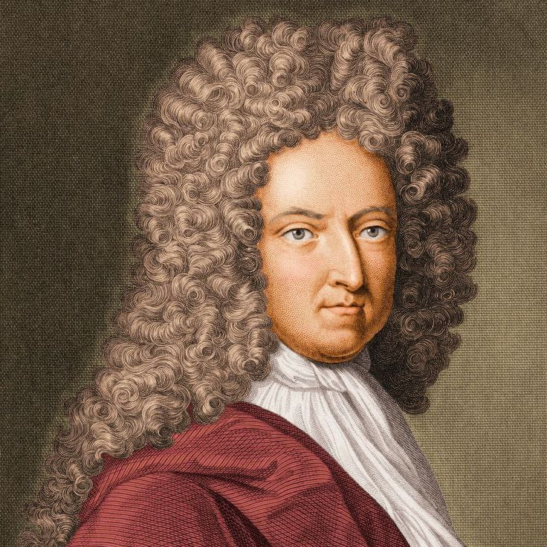
Introduction
Daniel Defoe (1660–1731) was a journalist, trader, traveler, spy, and novelist. His wide life experience allowed him to write stories that felt real and believable. Defoe published more than 500 works, covering topics such as politics, religion, economics, travel, and crime. His novels combined facts with imagination and helped create the modern realistic novel. Today, his books remain important for their storytelling, historical insight, and powerful characters.

Slide 5
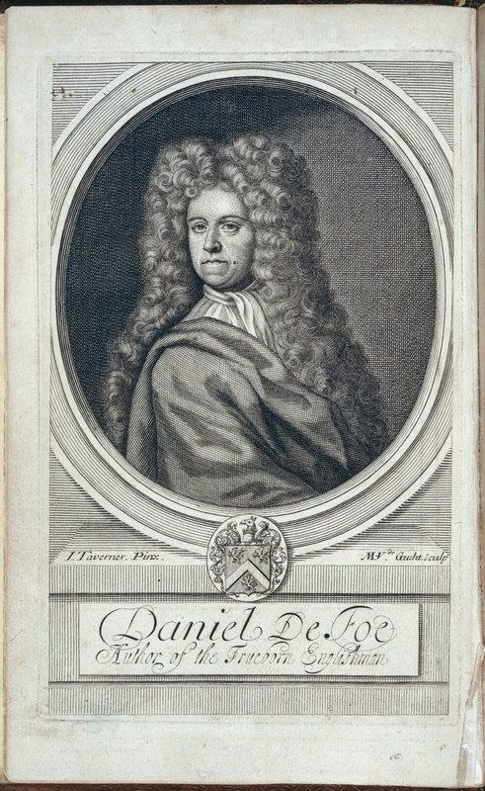
Early Life
Daniel Defoe was born in London into a hardworking Presbyterian family. At a young age, he survived two major historical events: the Great Plague of 1665 and the Great Fire of 1666, which destroyed much of the city. These dramatic events left a deep impression on him. Defoe received an excellent education in languages, business, and writing, which later shaped his writing career. His early experiences taught him resilience and curiosity about human life.

Slide 6
Family and Background
Defoe’s father was a tallow chandler, making candles and storing household goods. Although his father wished him to become a minister, Defoe chose a career in trade. His business activities allowed him to travel widely across Europe, learning about different cultures and economic systems. These travels later gave him materials for his adventure stories and realistic descriptions. His middle-class upbringing also helped him understand ordinary people’s struggles, which became central in many of his novels.

Slide 7
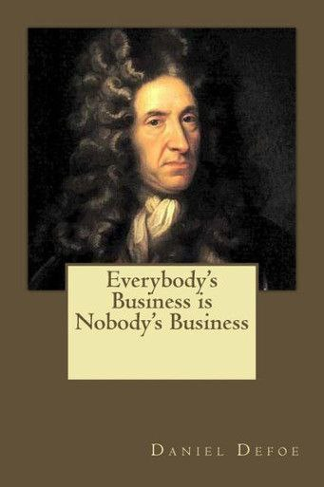
Business Career and Challenges
Before becoming a full-time writer, Defoe worked as a merchant dealing in clothing, wine, and tobacco. Though intelligent and energetic, he often took risky business decisions, which led to several bankruptcies. His financial difficulties forced him to rethink his career and eventually drove him to write more seriously. These struggles influenced many of his characters, especially those who face poverty, debt, and survival challenges. His experiences created a strong connection between his life and his fiction.

Slide 8
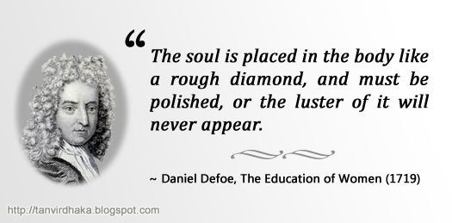
Political Writing
Defoe became well-known for his political journalism. He wrote essays on government, religion, public life, and social injustice. He strongly supported religious tolerance and defended the rights of the middle class. His writing style was sharp, logical, and persuasive. One of his most famous works, The Shortest Way with the Dissenters, was a satirical text that many readers misunderstood as serious. This controversy increased his popularity but also brought him serious problems with the government.

Slide 9
Imprisonment and the Pillory
  In 1703, Defoe was arrested for the controversial satirical pamphlet mentioned earlier. He was imprisoned in Newgate, one of London’s most dangerous prisons. Later, he was punished by being placed in the pillory, a wooden structure for public humiliation. Surprisingly, instead of attacking him, crowds threw flowers and cheered, showing their admiration for his bravery and wit. This experience strengthened his reputation and convinced him to focus more on writing that reached a wide audience.

Slide 10
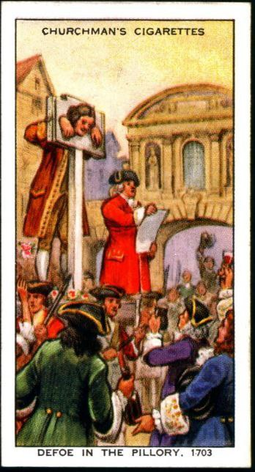
Turn Toward Fiction
After his release, Defoe shifted from political writing to fiction and journalism. He realized that stories could attract more readers and communicate ideas in a more memorable way. His novels often looked like true stories because he used detailed descriptions, dates, and realistic characters. Defoe blended adventure, psychology, and everyday life, creating books that appealed to both ordinary people and intellectuals. His new direction changed English literature by making novels more realistic and emotionally engaging.

Slide 11
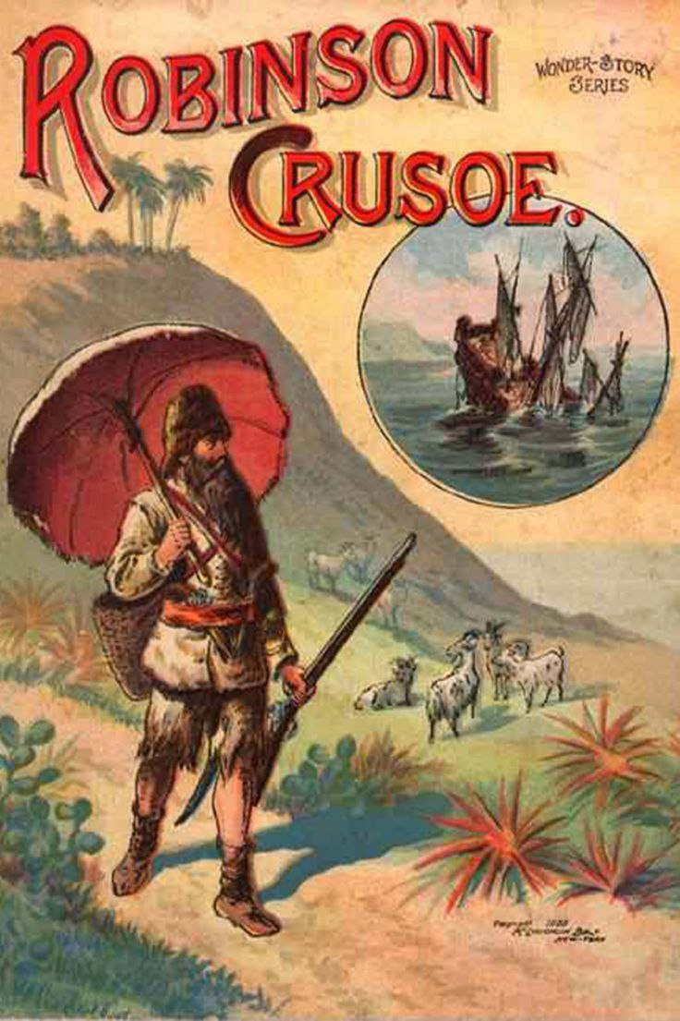
Robinson Crusoe
Robinson Crusoe tells the story of a shipwrecked man who survives alone on a tropical island for nearly three decades. Inspired partly by the real-life sailor Alexander Selkirk, the novel explores themes such as survival, faith, responsibility, and colonial attitudes. Defoe describes how Crusoe builds shelter, grows food, and protects himself. The arrival of Friday introduces cultural and moral questions. The book became a huge success and is considered one of the first true English novels

Slide 12
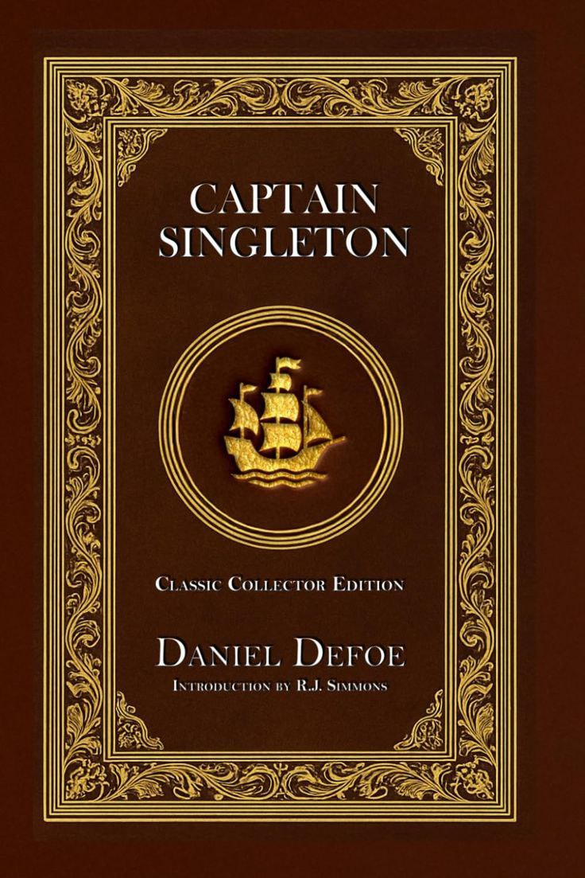
Captain Singleton
This adventure novel follows the life of Bob Singleton, who is kidnapped as a child and eventually becomes a pirate. The story includes vivid descriptions of sea voyages, African landscapes, and dangerous encounters. Defoe uses the novel to explore human greed, courage, and the search for identity. Singleton travels across continents, facing both moral and physical challenges. The novel shows Defoe’s talent for mixing adventure with realistic detail, making readers feel as if they are part of the journey.

Slide 13
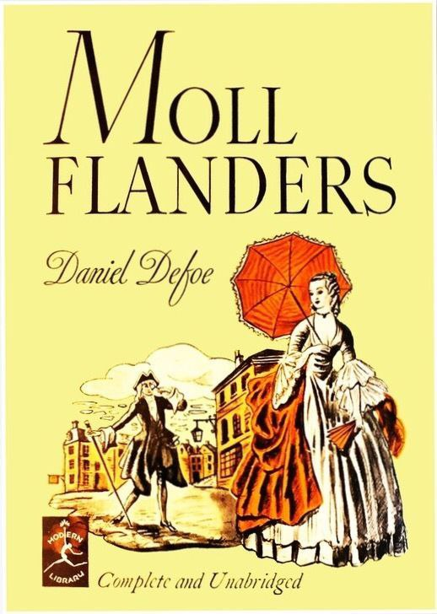
Moll Flanders
Moll Flanders is a fictional autobiography about a woman born in prison who spends her life fighting poverty, loneliness, and moral dilemmas. She marries several times, turns to theft, and later seeks redemption. Defoe uses her story to examine the position of women in eighteenth-century society and the difficulties they faced. The novel is bold because it presents a flawed but human character whose life is shaped by choices and circumstances. It remains one of Defoe’s most powerful works.

Slide 14
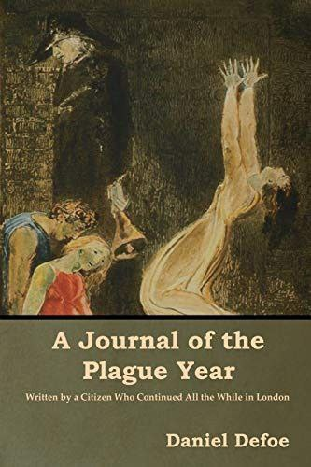
A Journal of the Plague Year
This novel is written as if it were a real diary describing the Great Plague of London in 1665. Defoe combines historical facts, eyewitness accounts, and storytelling to create a realistic picture of fear, isolation, and survival. The book includes descriptions of empty streets, quarantined houses, and the behavior of ordinary citizens during crisis. Readers often feel as if they are living through the plague themselves. The novel also shows Defoe’s journalistic skills and attention to detail

Slide 15
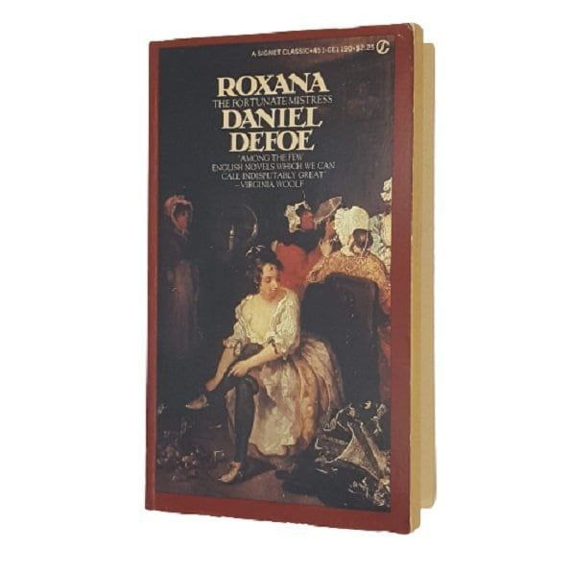
Roxana
Roxana is the story of a woman who becomes wealthy through relationships and clever decisions, but later faces emotional and moral consequences. The novel explores themes such as freedom, identity, ambition, and guilt. Roxana struggles with her inner fears and desires, making the story psychologically rich. Defoe presents her life as a series of opportunities and mistakes, showing how society judges women differently from men. This novel highlights Defoe’s interest in complex female characters and social criticism.

Slide 16
Writing Style
Defoe’s writing style is known for its clarity, simplicity, and strong sense of reality. He used journalistic techniques such as factual detail, dates, numbers, and geographical accuracy. His characters often speak in first person, making readers feel closely connected to their experiences. Defoe did not use dramatic language; instead, he focused on believable emotions and everyday problems. This style made his novels easy to read and highly convincing, even for readers who doubted fiction.

Slide 17
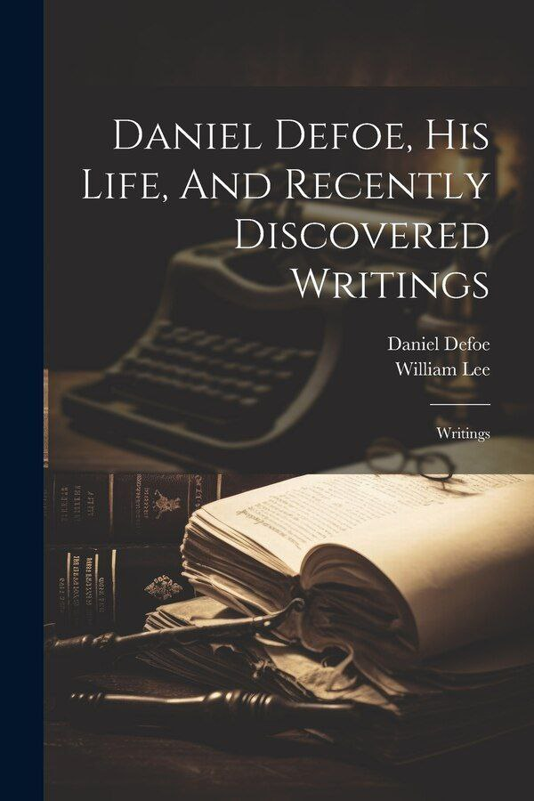
Legacy and Influence
Daniel Defoe’s influence on literature is enormous. He helped establish the English novel as a major literary form. Many later writers, including Charles Dickens and Robert Louis Stevenson, admired his ability to combine adventure with everyday detail. Robinson Crusoe inspired countless films, plays, and adaptations around the world. Economists even use the term “Crusoe economy” to describe simple survival situations. Defoe’s focus on realism and human struggle continues to inspire modern storytelling.

Slide 18
Daniel Defoe lived a challenging but extraordinary life that shaped his writing. His works explore survival, morality, society, and human nature in a way that still speaks to modern readers. Through his clear language and realistic style, he turned everyday experiences into exciting stories. By blending journalism and fiction, he created novels that feel alive and believable. Defoe remains a central figure in English literature, and his books continue to be read and studied worldwide.
Conclusion

Slide 19
Match the Headings
A. Robinson Crusoe | 1. A woman fights poverty and survives through difficult choices.
B. Political Writing | 2. A survival story based partly on real events
C. Moll Flanders | 3. Defoe wrote essays supporting tolerance and criticizing government.
D. Imprisonment | 4. Defoe was punished in Newgate Prison and the pillory.

Slide 20
True/False Questions
  1. Daniel Defoe published more than 500 works during his lifetime. — True/False
2. Defoe’s writing style was extremely poetic and unrealistic. — True/False
3. Roxana explores identity, ambition, and guilt. — True/False
4. Defoe is considered one of the founders of the English novel. — True/False
5. A Journal of the Plague Year describes events of 1665. — True/False

Slide 21
Resources
1. Britannica — Daniel Defoe
A trusted encyclopedia with detailed biography and analysis. https://www.britannica.com/biography/Daniel-Defoe
2. Encyclopedia.com — Daniel Defoe
Provides rich background on his life, career, and works. https://www.encyclopedia.com/people/literature-and-arts/english-literature-1500-1799-biographies/daniel-defoe
3. London School of Economics — Defoe Archives
Historical materials, political writing, and biography. https://archives.lse.ac.uk/people/609/defoe-daniel

