Slide 1
HISTORY OF INTERNET CLASS FOR COLLEGE
Here is where your presentation begins

Slide 2
CONTENTS OF THIS TEMPLATE
Here’s what you’ll find in this Slidesgo template:
A slide structure based on an education template, which you can easily adapt to your needs. For more info on how to edit the template, please visit Slidesgo School or read our FAQs.
An assortment of graphic illustrations that are suitable for use in the presentation can be found in the alternative resources slide.
A thanks slide, which you must keep so that proper credits for our design are given.
A resources slide, where you’ll find links to all the elements used in the template.
Instructions for use
Final slides with:
The fonts and colors used in the template.
A selection of illustrations. You can also customize and animate them as you wish with the online editor. Visit Storyset to find more.
More infographic resources, whose size and color can be edited.
Sets of customizable icons of the following themes: general, business, avatar, creative process, education, help & support, medical, nature, performing arts, SEO & marketing, and teamwork.
You can delete this slide when you’re done editing the presentation.

Slide 3
WHOA!
This can be the part of the presentation where you introduce yourself, write your email…

Slide 4
INTRODUCTION
01
INTERNET HISTORY
02
NETWORKS
03
GOVERNANCE
04
CONCLUSIONS
05
You can describe the topic of the section here
You can describe the topic of the section here
You can describe the topic of the section here
You can describe the topic of the section here
You can describe the topic of the section here

Slide 5
01
INTRODUCTION
You can enter a subtitle here if you need it

Slide 6
ABOUT THIS TOPIC
You can give a brief description of the topic you want to talk about here. For example, if you want to talk about Mercury, you can say that it’s the smallest planet in the entire Solar System

Slide 7
THE ORIGINS OF THE INTERNET
COLD WAR
Saturn is a gas giant and has several rings. It's composed mostly of hydrogen and helium
1990
Neptune is the farthest planet from the Sun. It's also the fourth-largest object

Slide 8
HOW THE INTERNET WORKS
FEATURES
The Sun is the star at the center of the Solar System
FEATURE 01
FEATURE 02
FEATURE 03
FEATURE 04
Mercury is the smallest planet
Venus has a beautiful name
Earth is the third planet from the Sun
Mars is actually a cold place

Slide 9
A LINK TO COMPUTER SCIENCE
Do you know what helps you make your point clear?
Lists like this one:
They’re simple
You can organize your ideas clearly
You’ll never forget to buy milk!
And the most important thing: the audience won’t miss the point of your presentation

Slide 10
LIFE AND DEATH OF THE ARPANET
1958
1969
1973
1990
Mercury is the smallest planet
Venus has a beautiful name
Earth is where we all live
Mars is actually a cold place

Slide 11
02
INTERNET HISTORY
You can enter a subtitle here if you need it

Slide 12

A PICTURE IS WORTH A THOUSAND WORDS

Slide 13
INTRODUCTION TO BROWSERS
BROWSER | RESULTS | GROWTH | USERS
Mercury | 900 | 298.40% | 139,875,242
Venus | 1500 | 789.20% | 1,016,799,076
Earth | 458 | 376.45% | 500,723,686
Mars | 996 | 35.60% | 77,020,995
TOTAL | 3854 | 1,499.65% | 2.235.142.685

Slide 14
AWESOME WORDS

Slide 15
INTERNET AROUND THE WORLD
THE SUN
The Sun is the star at the center of the Solar System
CERES
Ceres is actually located in the main asteroid belt

Slide 16
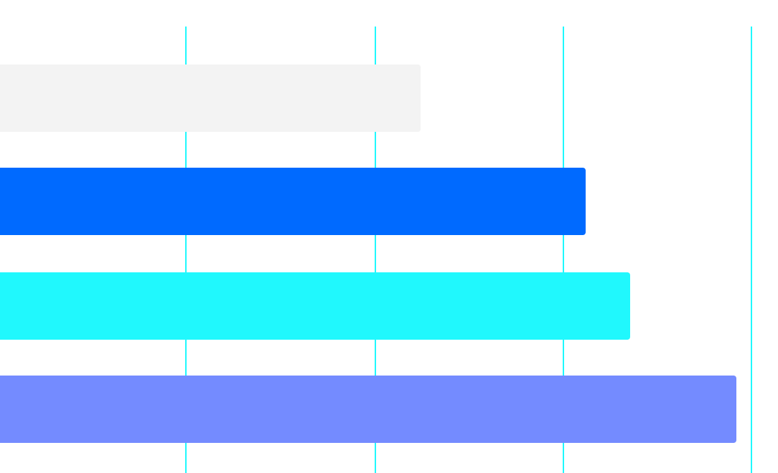
PEOPLE WITH INTERNET
1990
Mercury is the closest planet to the Sun
Venus has a beautiful name and high temperatures
2000
2010
Today
2010 - 84%
TODAY - 98%
0
25
50
75
100
Earth is the only planet that harbors life of them all
Despite being red, Mars is actually a cold place
Follow the link in the graph to modify its data and then paste the new one here. For more info, click here

Slide 17
03
NETWORKS
You can enter a subtitle here if you need it

Slide 18
INTERNET NETWORKS
NAME | ABOUT | YEAR
NPL network | Saturn is a gas giant and has several rings | 1965
ARPANET | Neptune is the farthest planet from the Sun | 1966
Merit network | Mercury is the smallest planet | 1971
CYCLADES | Pluto is now considered a dwarf planet | 1973
UUCP | Ceres is located in the main asteroid belt | 1979

Slide 19
—SOMEONE FAMOUS
“This is a quote, words full of wisdom that someone important said and can make the reader get inspired.”

Slide 20
DIGITAL DIVIDE EMERGES
AFRICA
ASIA & OCEANIA
LATIN AMERICA
Mercury is the closest planet to the Sun
Venus has a beautiful name, but it’s hot
Earth is the only planet that harbors life

Slide 21
1990s
Was the decade when the Internet appeared

Slide 22
TRANSITION TOWARDS INTERNET
1ST PROTOCOL
2ND PROTOCOL
3RD PROTOCOL
4TH PROTOCOL
Despite being red, Mars is actually a cold place
Jupiter is a gas giant and the biggest planet of them all
Saturn is a gas giant and has several rings
Neptune is the farthest planet from the Sun

Slide 23
GOVERNANCE
04
You can enter a subtitle here if you need it

Slide 24
INTERNET GOVERNANCE
ASPECT #01
ASPECT #02
ASPECT #03
ASPECT #04
ASPECT #05
Saturn is a gas giant
Neptune is an ice giant
Earth is where we live
Pluto is a dwarf planet
Mars is very cold

Slide 25

A PICTURE ALWAYS REINFORCES THE CONCEPT
Images reveal large amounts of data, so remember: use an image instead of a long text. Your audience will appreciate it

Slide 26
THE WEB 1.0
PSINET
UUNET
NETCOM
PORTAL
SOFTWARE
USENET
Jupiter is a gas giant and the biggest planet
Saturn is a gas giant and has several rings
Neptune is the farthest planet from the Sun
The Sun is the star at the center of the Solar System
Pluto is now considered a dwarf planet
Ceres is located in the main asteroid belt

Slide 27
34,789
41,973
Saturn is the planet with rings
Mercury is the smallest planet

Slide 28
05
CONCLUSIONS
You can enter a subtitle here if you need it

Slide 29
GLOBAL UBIQUITY OF WEB 2.0
70%
30%
Earth is the third planet from the Sun and the only one that harbors life
Despite being red, Mars is actually a cold place. It's full of iron oxide dust

Slide 30
CONCLUSIONS
You can list your conclusions about this topic here
You can list your conclusions about this topic here
You can list your conclusions about this topic here
You can list your conclusions about this topic here
You can list your conclusions about this topic here
You can list your conclusions about this topic here
You can list your conclusions about this topic here
You can list your conclusions about this topic here
You can list your conclusions about this topic here
You can list your conclusions about this topic here

Slide 31
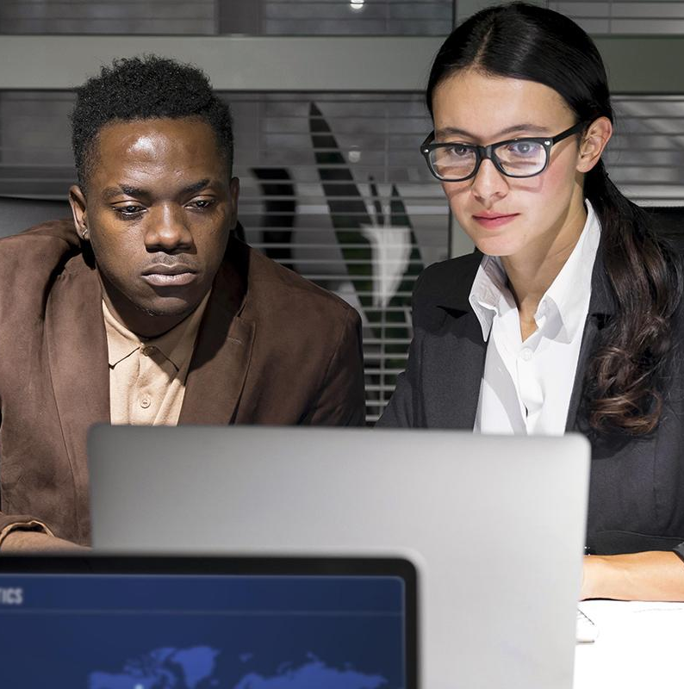
OUR TEAM
MATHIEU ROBBINS-HALL
JEAN-MARIE CONDOUX
You can describe your team member in here
You can describe your team member in here

Slide 32
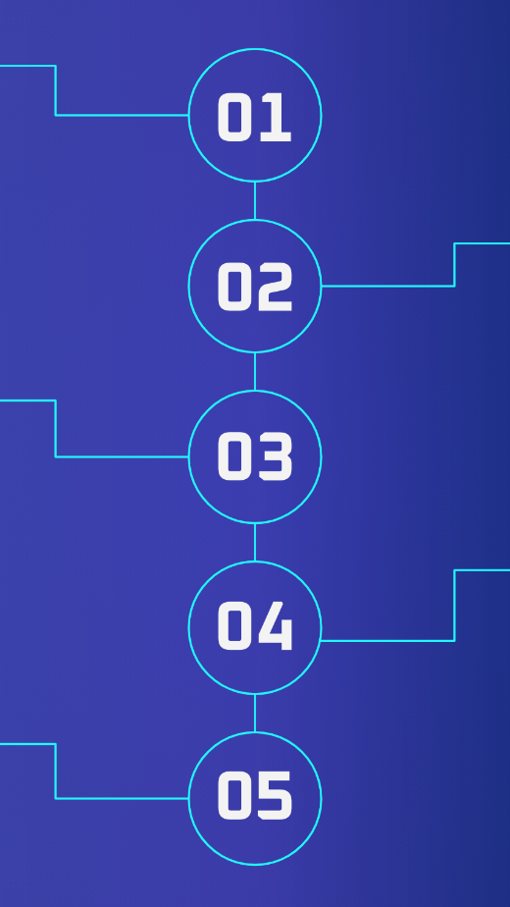
MOBILE MOCKUP
You can replace the image on the screen with your own work. Just right-click on it and select “Replace image”

Slide 33
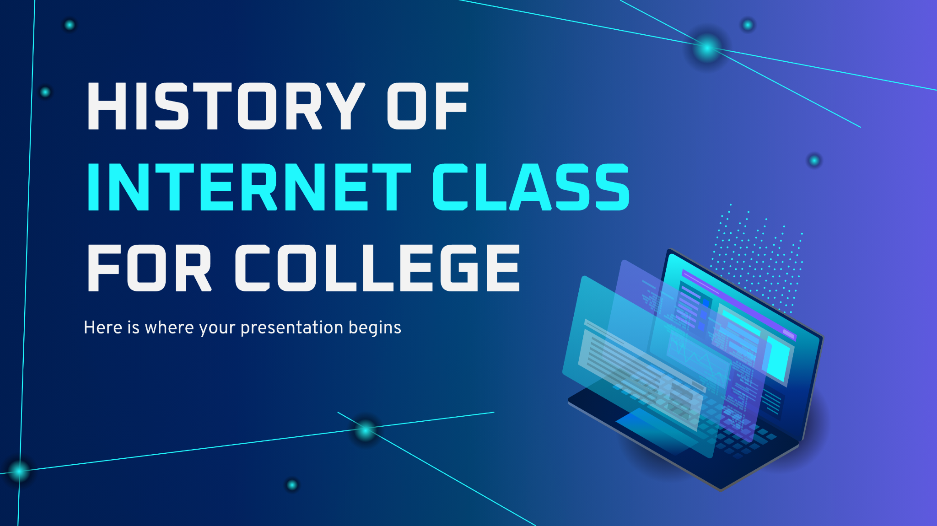
DESKTOP MOCKUP
You can replace the image on the screen with your own work. Just right-click on it and select “Replace image”

Slide 34
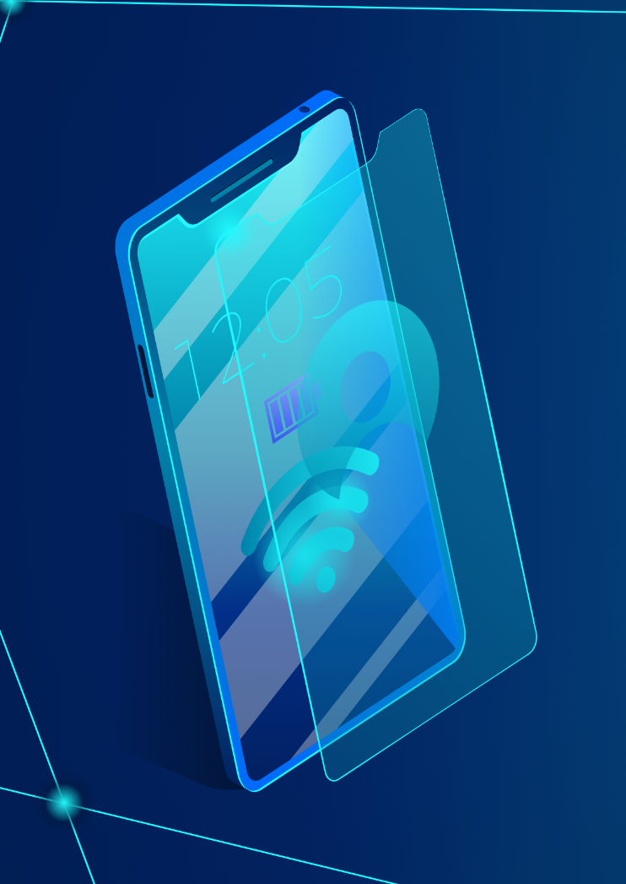
TABLET MOCKUP
You can replace the image on the screen with your own work. Just right-click on it and select “Replace image”

Slide 35
THANKS!
Does anyone have any questions?
addyouremail@freepik.com
+91 620 421 838
yourcompany.com
Please keep this slide as attribution

Slide 36
INTERNET SECURITY ICON PACK

Slide 37
BUSINESS ICON PACK

Slide 38
ALTERNATIVE RESOURCES
Here’s an assortment of alternative resources whose style fits that of this template
Photos:
Business teammates working late (I)
Business teammates working late at the office
Business teammates working late (II)
Vectors:
Seo ad instagram stories template

Slide 39
RESOURCES
Did you like the resources of this template? Get them for free at our other websites!
Photos:
Teammates working late at the office
Business teammates working late (I)
Business teammates working late (II)
Vectors:
Seo ad instagram posts template
Icons:
Internet Security
Business

