Slide 1

Sound laws.F.Bopp's law of agglutination

Slide 2

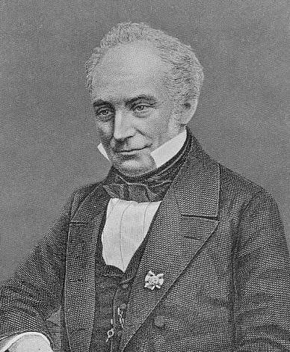
Franz Bopp
Franz Bopp (14 September 1791 – 23 October 1867)was a German linguist known for extensive and pioneering comparative work on Indo-European languages.Bopp was born in Mainz, but the political disarray in the Republic of Mainz caused his parents' move to Aschaffenburg, the second seat of the Archbishop of Mainz

Slide 3

Critics have charged Bopp with neglecting the study of the native Sanskrit grammars
Bopp was born in Mainz, but the political disarray in the Republic of Mainz
Bopp travelled to London where he made the acquaintance of Sir Charles Wilkins and Henry Thomas Colebrooke.
Franz Bopp
Bopp's interest in the sacred language of the Hindus.
There he received a liberal education at the Lyceum and Karl Joseph Hieronymus Windischmann drew his attention to the languages and literature of the East.
In 1812, he went to Paris at the expense of the Bavarian government,

Slide 4
In his Comparative Grammar Bopp set himself a threefold task:
to give a description of the original grammatical structure of the languages as deduced from their inter-comparison.
to investigate the origin of their grammatical forms.
to trace their phonetic laws.

Slide 5
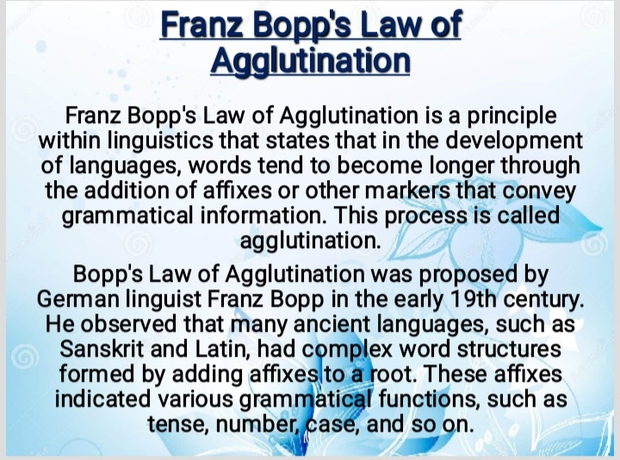

Slide 6

Bopp's Law of Agglutination is significant because it provides insight into the historical development of languages as they evolved over time. It helps explain how languages change and become more complex through the gradual addition of affixes to words.

Slide 7

Agglutination is a common feature in many language families, such as the Turkic, Uralic, and Bantu language families. In these languages, words can often be broken down into distinct morphemes, each with a specific grammatical function. For example, in Turkish, the word "evlerde" means "in the houses," and it can be divided into three morphemes: "ev" (house), "-ler" (plural marker), and "-de" (locative marker).

Slide 8
However, not all languages exhibit agglutination to the same extent.
Some languages, like English, have a more analytic structure, where grammatical information is conveyed primarily through word order and auxiliary verbs, rather than affixes.
In contrast, others, like Finnish or Tamil, have a highly agglutinative structure with extensive use of affixes.

Slide 9
Overall, Bopp's Law of Agglutination is a valuable concept in linguistics that helps explain the development and structure of languages, particularly those that exhibit agglutinative properties. It contributes to our understanding of language evolution and how languages shape and adapt over time.

Slide 10
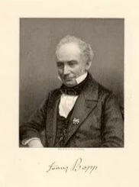
Franz Bopp was a German linguist who is best known for his discovery and formulation of the "law of agglutination" in the field of historical linguistics.
Bopp's law of agglutination was a fundamental principle that he proposed in the early 19th century while studying various Indo-European languages.
It contributes to our understanding of language evolution and how languages shape and adapt over time.

Slide 11
Bopp's law of agglutination states that the historical changes within a language can be traced back to the gradual agglutination, or joining together, of shorter linguistic elements to form longer and more complex words.

Slide 12
This process occurs in languages that belong to the agglutinative language family, where words are constructed by combining root morphemes and affixes.

Slide 13

According to Bopp, the agglutinative process is the underlying mechanism behind the development of inflections, the construction of new words, and the formation of grammatical structures in languages.
He argued that through the repeated agglutination of morphemes, languages expand their vocabulary and express different grammatical functions.
Bopp's law of agglutination greatly influenced the field of historical linguistics, as it provided a framework for understanding the evolution of languages over time.

Slide 14
It also contributed to the development of broader linguistic theories such as the comparative method, which aims to reconstruct the proto-language from which related languages evolved.

Slide 15

Overall, Bopp's law of agglutination highlighted the importance of the agglutinative process in language change and provided valuable insights into the historical development of languages.

Slide 16

The End

