Slide 1



a day in
a day in
my life
my life
BY UMIDA NORMATOVA

Slide 2
About myself
My name is Umida Nuraliyeva, and I was born on October 7, 1991. I work at the Industrial Construction Bank, where I have a busy yet fulfilling daily routine. Let me share with you what a typical day in my life looks like.

Slide 3
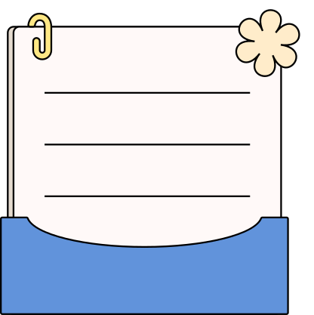
Early Morning Routine
my life
my life
My day starts early at 6:00 AM with a refreshing cup of coffee. I spend the first 30 minutes of my day journaling and setting my intentions. This quiet time helps me focus and prepare for the busy day ahead.

Slide 4
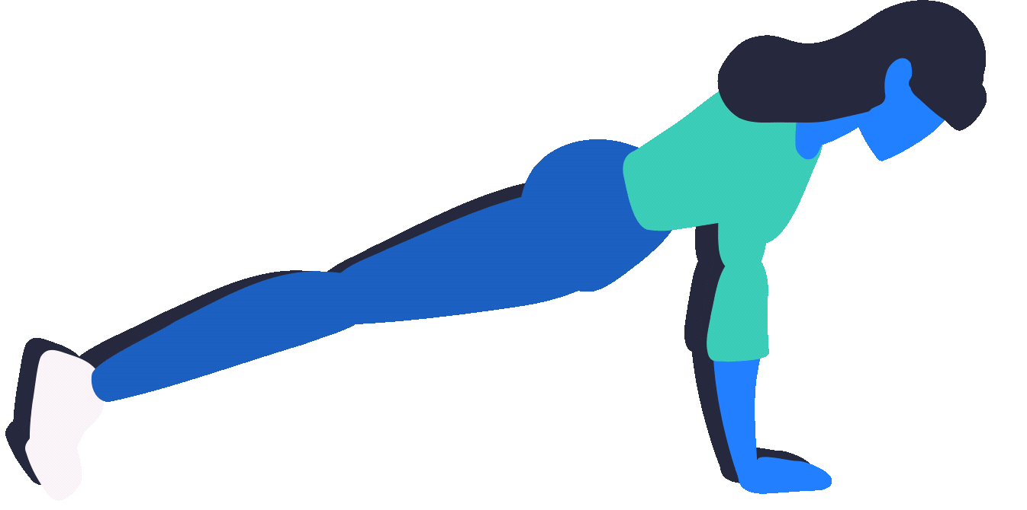
workout
workout
By 7:00 AM, I'm at the gym or outside for a run. Physical fitness is essential to me, and this morning workout boosts my energy and keeps me in shape. It’s a great way to kickstart my metabolism and stay healthy.

Slide 5
I start my day early. My workday begins at 9:00 AM, and I make sure to arrive on time, as punctuality is very important to me. The first thing I do when I arrive at the office is check my emails and organize my tasks for the day. I work in a fast-paced environment, handling various financial responsibilities, which require concentration and precision.

Slide 6
my life
my life
Breakfast and Planning
After my workout, I have a nutritious breakfast, usually consisting of oatmeal and fruits. While eating, I review my schedule, check emails, and finalize my to-do list for the day. This planning session ensures I stay organized and productive.

Slide 7
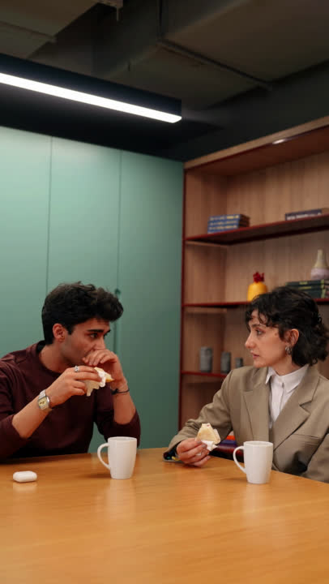
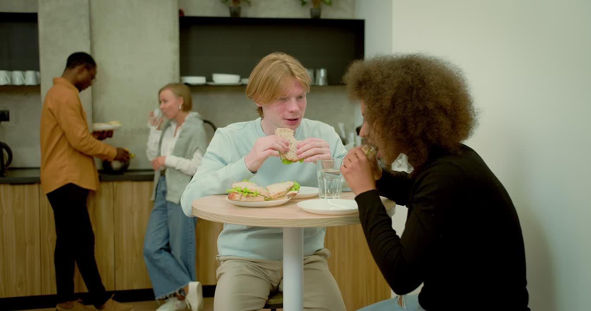
lunch break
LUNCH BREAK
Around noon, I take a break for lunch. I enjoy preparing a healthy meal, often a salad or a sandwich with a side of fruit. This break is also a time to unwind, catch up with friends, or read a book.

Slide 8


WORK
WORK
My work
I enjoy the work I do at the bank. My role involves assisting clients with their financial needs, processing transactions, and ensuring that everything runs smoothly. I am fortunate to work with a supportive team, and our collaboration is key to our success.

Slide 9
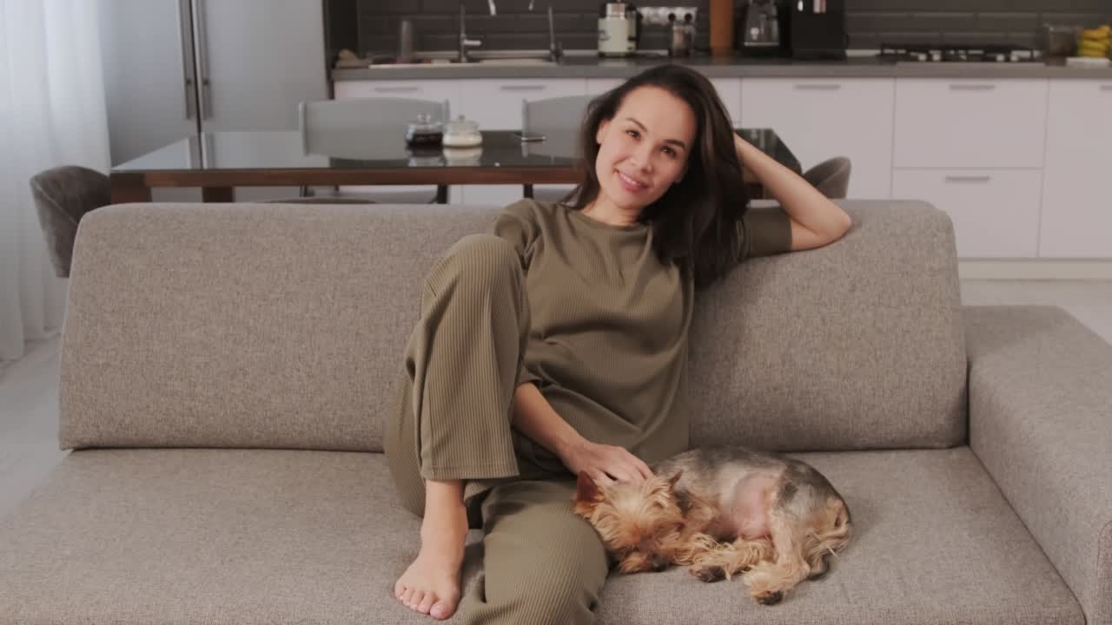
WORK
At 6:00 PM, my workday comes to an end. After finishing my tasks for the day, I head home. But the day doesn't stop there. As a mother of three, my time at home is filled with energy and love. I have two daughters and one son. My eldest child is a girl, my middle child is a boy, and my youngest is also a girl. They bring so much joy and laughter into my life.

Slide 10
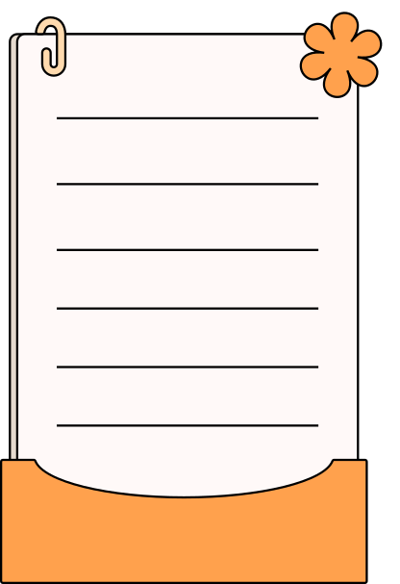
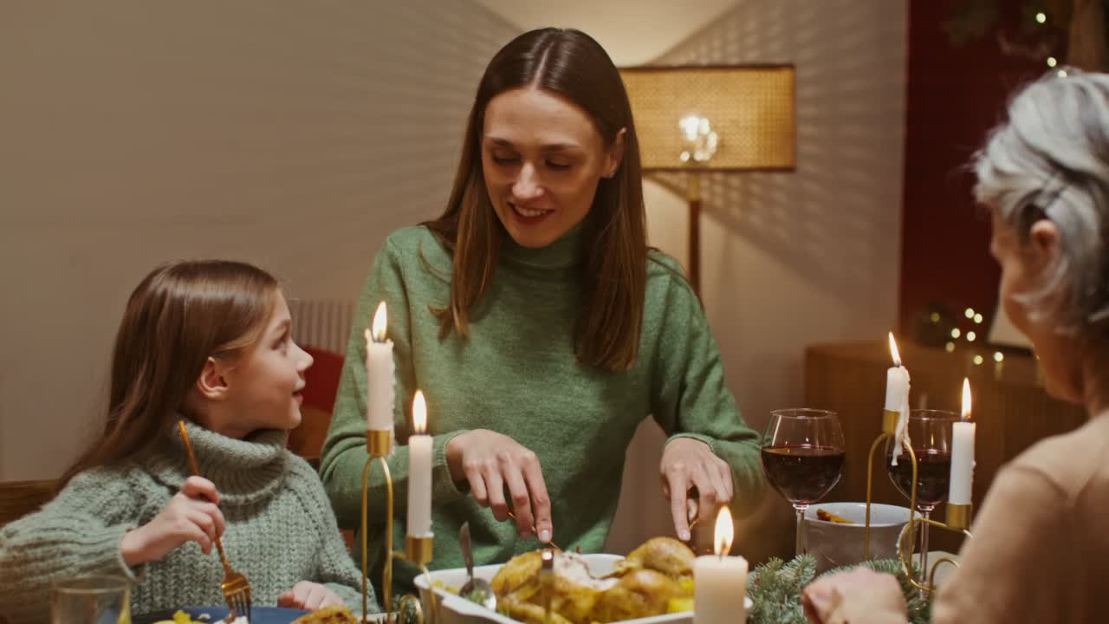
DINNER
dinner
I cherish dinner time as it’s when I connect with my family. We enjoy a home-cooked meal and discuss our day. This quality time strengthens our bond and is a lovely way to end the day.

Slide 11
Evenings at home are busy as I help my children with their homework, prepare dinner, and spend quality time with my family. After a long day of work, this time spent with my kids is incredibly precious to me. I make sure to stay involved in their lives, and we often talk about their school day, their dreams, and the things that make them happy.l

Slide 12
NIGHT
By the time the evening winds down, I get my children ready for bed, and I take a moment to reflect on my day. Though it can be tiring, I feel proud of my work and my role as a mother. The balance between my career and family life is not always easy, but it is always rewarding.

Slide 13

NIGHT
NIGHT
My night routine includes reading a book, skincare, and reflecting on the day. By 10:00 PM, I’m usually in bed, ensuring I get a good night's sleep. This routine helps me unwind and prepare for the next day.
This is a typical day for me—full of responsibilities, but also full of moments of happiness and love.

Slide 14
THANK YOU!
THANK YOU!

