Slide 1


Effective Communication: Mastering the Art of Connection

Slide 2

Overview of Communication
1
What is Communication?
2
Importance of Communication
3
Types of Communication
Communication is the process of exchanging information and ideas through various channels, such as verbal, non-verbal, and written means.
Effective communication is vital for building strong relationships, promoting understanding, and achieving goals both personally and professionally.
Verbal, non-verbal, and written communication are the three main forms, each with its own unique characteristics and impact.

Slide 3
Verbal Communication
Clear and Concise
Tone and Delivery
Active Listening
Learn to articulate your thoughts clearly and concisely to ensure that your message is understood by others.
Your tone of voice and delivery can significantly impact how your message is received.
Listen attentively and respond thoughtfully to promote understanding and effective dialogue.

Slide 4

Non-Verbal Communication
1
Body Language
Use non-verbal cues like facial expressions, gestures, and posture to enhance your communication and convey your message.
2
Eye Contact
Maintain appropriate eye contact to establish trust, show interest, and promote engagement.
3
Personal Space
Respect personal boundaries and be aware of cultural differences in personal space to avoid miscommunication.

Slide 5
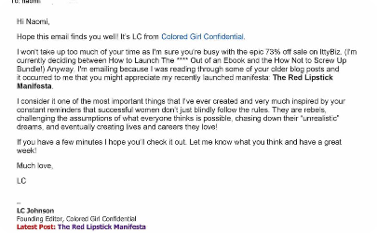
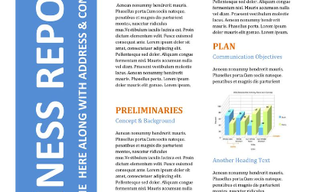

Written Communication
Email Etiquette
Business Reports
Creative Writing Skills
Master the art of writing professional emails that are clear, concise, and effective in conveying your message.
Learn how to structure and present information effectively in written reports for maximum impact.
Develop your creativity and storytelling abilities to captivate readers through compelling written content.

Slide 6
The Importance of Active Listening
1
Engagement and Understanding
2
Building Relationships
3
Conflict Resolution
Effective listening is key to resolving conflicts, as it allows for better comprehension and mutual understanding.
Active listening involves fully focusing on the speaker, understanding their perspective, and providing appropriate responses.
By actively listening, you show respect and empathy, fostering trust and stronger connections with others.

Slide 7

Effective Communication in the Workplace
1
Clear Instructions
Articulate instructions and expectations clearly to ensure tasks are completed accurately and efficiently.
2
Feedback and Collaboration
Provide constructive feedback and encourage open collaboration to enhance teamwork and boost productivity.
3
Managing Difficult Conversations
Develop skills to address challenging discussions professionally and respectfully, promoting effective resolution.

Slide 8

Challenges in Communication and How to Overcome Them
Language Barriers
Cultural Differences
Technological Distractions
Minimize language barriers by using simple language, providing visuals, and seeking clarification when needed.
Be culturally sensitive, embrace diversity, and foster inclusive communication to bridge cultural gaps.
Manage digital distractions and ensure that technology is used purposefully to enhance rather than hinder communication.

