Slide 1
Historical Places of Uzbekistan

Slide 2
PLAN:
HISTORICAL PLACES OF TASHKENT
HISTORICAL PLACES OF SAMARKAND
HISTORICAL PLACES OF BUKHARA
HISTORICAL PLACES OF KHIVA

Slide 3
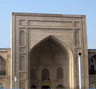
Khavendi Takhur Sheikh Mausoleum
It was founded at the 14th—15th centuries and its above-ground part was constructed between the 18th and 19th centuries. The preserved building was constructed on the old foundation keeping the basic architectural forms. Ziaratkhona and gur-khona are accommodated in the mausoleum. Light-yellow color bricks were used for construction of the mausoleum. No any decoration was used here.

Slide 4
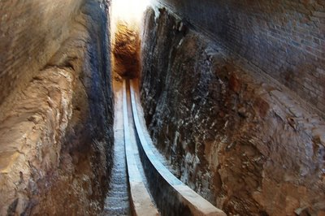
Ulugbek Observatory
In the 20ties of 15th century on one of the hills, the governor of Samarkand, Mirzo Ulugbek, built the biggest observatory in the East that can not compare with any other in the world. His star tables Zidji-Gurgani plied by him in his observatory in Samarkand, have kept their scientific value to date: astronomic tables content coordinates of 1018 stars. By Babur's words, who have seen the observatory, it was the three-storied building covered with beautiful glazed titles. The observatory 30-meters height building had 46 meters in diameter. A huge instrument — sextant was placed in the observatory to observe the Moon, the Sun and other starts of the vault of heaven. Shortly, after the death of Ulugbek the observatory was destroyed and its location forgotten. In the early years of the 20th century the observatory was rediscovered and excavated by the archaeologist V.Vyatkin. The bottom part of its main device was found — a huge quadrant with a radius of 40.2 meters and an arc 63 meters long. Presently, the Ulugbek Museum is situated next to the remains of the former observatory. Pages of the Zij as well as medieval engravings, photographs of the archaeological dig and a collection of astronomical instruments are displayed at the museum.

Slide 5
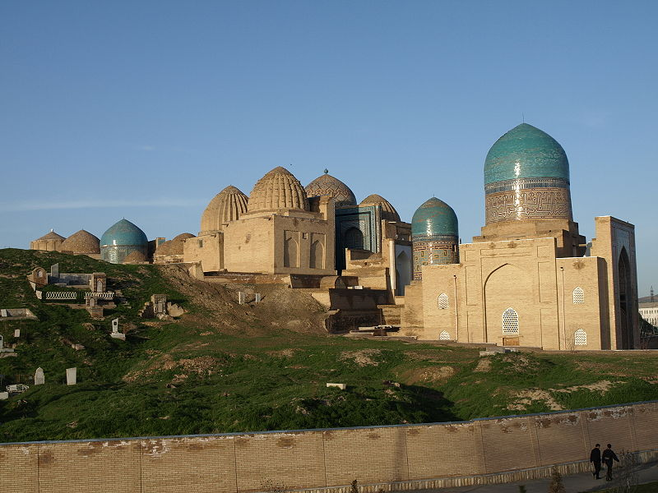
Shakhi-Zinda Necropolis
On south-eastern slope of Afrasiab is situated one of the famous architectural ensembles of Samarkand — Shakhi-Zinda Necropolis. This picturesque memorial ensemble (Shakhi-Zinda means "The Alive Tsar"), named after burial complex where the first cousin of the Prophet Kusam Ibn Abbas was buried, could be rightfully called "The Necklace of Architectural Masterpieces". Shakhi-Zinda is the most ancient architectural monument of Samarkand (midst of the 11th c.). The ensemble consisting of eleven mausoleums, built on one after another during the 14th — 15th centuries, was known as a big religious and cultural centre. Beginning from the 14th century, the Shakhi-Zinda Ensemble is considered a holy place of Samarkand. The Amir Burunduk Mausoleum, the portals of two anonymous mausoleums and the octahedral mausoleum were added in the 1380s to'90s. Mausoleums under the rulers of Amir Temur, Mirzo Ulugbek and other Temurids are the brilliant page in the history of architecture of Samarkand. The ensemble created during centuries, is remarkable for the unprecedented magnificence of its architectural decor. The refined beauty of Shakhi-Zinda seems to defy death and proclaim the eternity of the true, spiritual life.

Slide 6
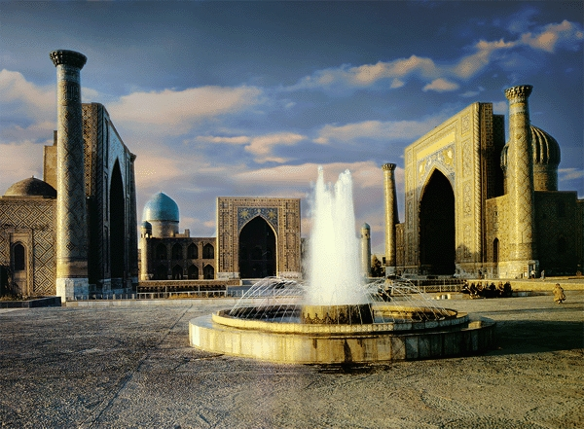
The Registan Square
It is located in the centre of the ancient city of Samarkand and includes many architectural monuments that make up this unique complex. Ulugbek, "The Scientist on the Throne", patron of science and education and grandson of Amir Temur, erected buildings such as medressahs, khanakas and mosques on the central part of the square. The beautiful and majestic buildings of Ulugbek (15th c.), Sher-Dor (17th c.) and Tillya-Kari (17th c.) are still part of Registan Square today. In the time of Amir Temur the Registan became the main meeting place and focus for trade and crafts activities. It became a centre on which the six main streets of the city radically converged. Under Ulugbek the Registan was used for military parades and public decrees. After completing construction of medressah Ulugbek gave lectures on mathematics and astronomy till his death. Two years later after construction of the Ulugbek Medressah, the ruler of Samarkand Yalangtush Bahadur ordered to build the copy of the medressah and the second, Sher-Dor Medressah was built opposite it. Several years later, the same ruler of Samarkand ordered the third — Tillya-Kari Medressah that was built like medressah but used mostly as mosque: Tillya-Kari has low minarets to call people to pray.

Slide 7
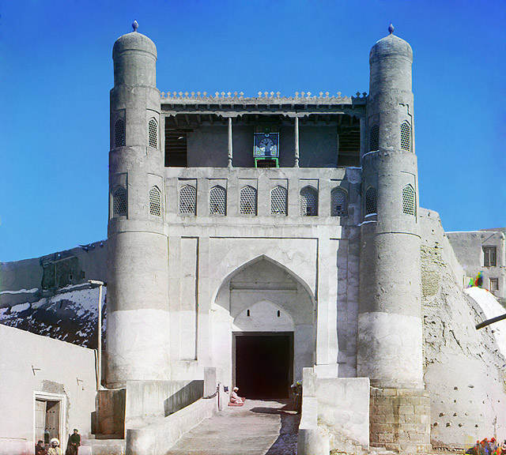
Ark Citadel
High citadel Ark, strengthened with walls, was the centre of the city, showing the military power of the ruler. The palace, treasury and prison were located just here too. Buildings preserved today in the Ark, were constructed at the end of the 18th — beginning of the 20th centuries.
Today the Ark Citadel is a big earthen platform stretched from west to east. A lot of buildings are located inside the Ark Citadel. Presently, the eastern part of the Ark represents the archaeological monument. Childukhtaron Mosque is still preserved here accommodating now the historical museum.

Slide 8
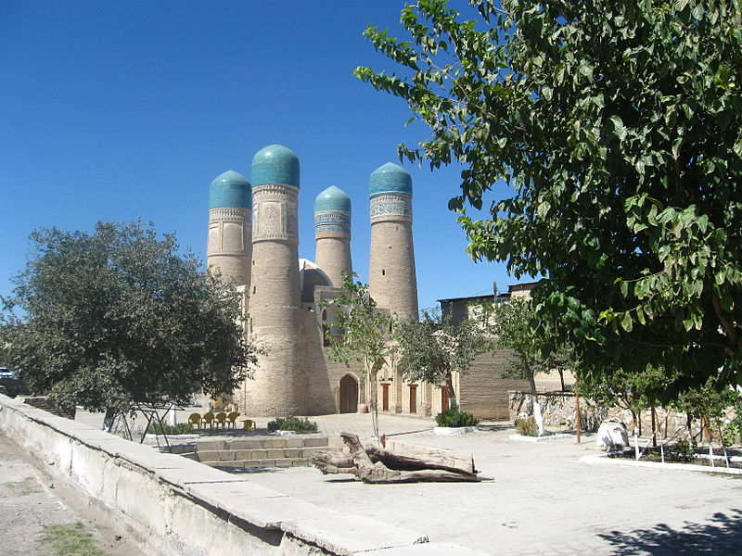
Chor-Minor Medressah
The four-towered entrance preserved to date is especially majestic giving the complex its name — Chor-Minor (Four Minarets). It was constructed at the beginning of the 19th century by order of the rich merchant, Turkmen Khalif Niyazkul, a traveler and carpet and horse seller. It stands by itself and as a beautiful pearl, shining in the sunlight under a perfect blue sky. It is truly unique, a philosophical monument that has no match in the architecture of Central Asia.

Slide 9
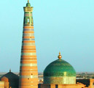
Minaret Islam-Khoja
The medressah is not so great with a traditional architecture but the main facade is covered with a rich decoration. The majestic 45-metre Minaret Islam-Khoja can be seen from everywhere. It is narrow at the top, with a lantern-shaped top crowned with a small cupola.

Slide 10
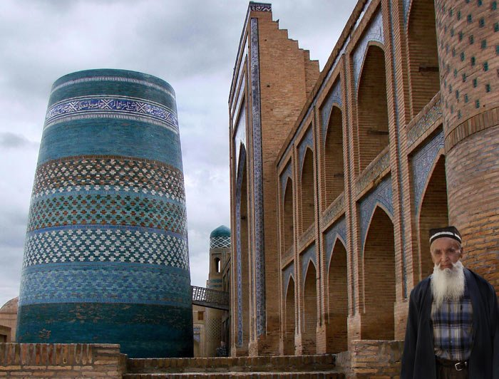
Minaret Kalta-Minor
Close to the Muhammad Amin-khan Medressah it was started construction of minaret, which according to the khan's idea should be the highest one in Khiva. But because of the khan's death the construction of the minaret was not completed. That is the reason for its title Kalta Minor ("Short Minaret"). Its massive trunck coming thinner on top, is decorated with glazed bricks.

Slide 11
Dictionary
Compare - находить подобия и различия
Heaven - рай
founded - основанный
consisting - состоя́ть
constructed - сооружа́ть
unprecedented - беспрецеде́нтный
converged - сходи́ться
represents - представля́ть
sunlight - со́лнечный
lantern-shaped - Фонарь форме

Slide 12
USED LITERATURES
http://www.uzbekembassy.org/
THANK YOU!

