Slide 1
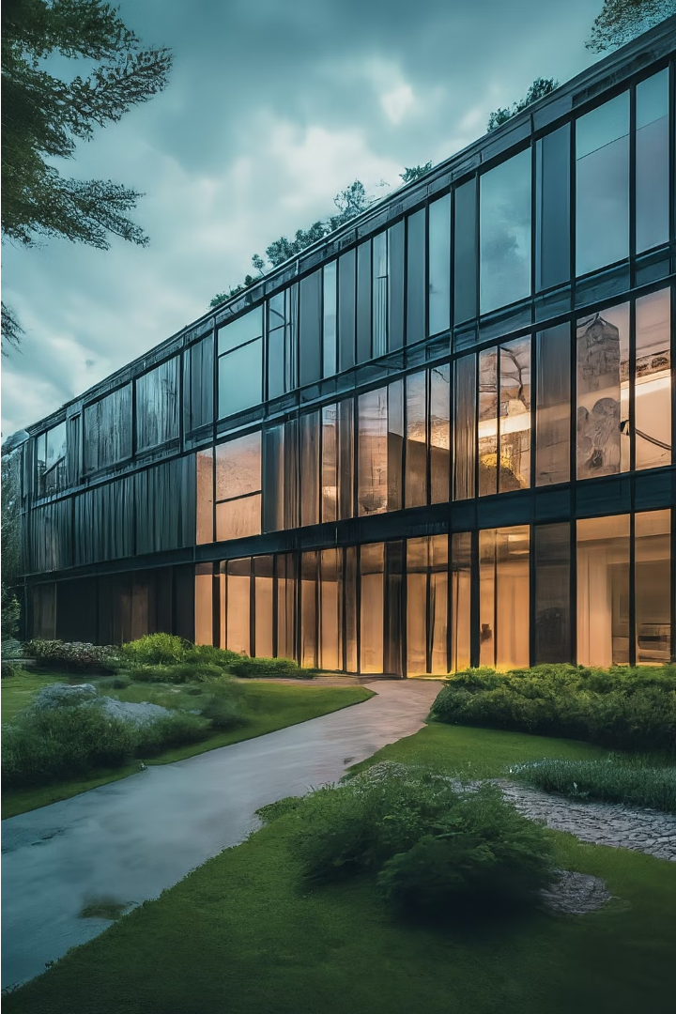
Introduction to Construction Project Benefits
Undertaking a construction project can unlock a wide range of benefits for businesses, communities, and individuals. From increased productivity to enhanced living spaces, the advantages of construction projects are far-reaching and impactful.

Slide 2
Increased Property Value
Home Renovations
Curb Appeal
Desirable Features
Upgrading your home with additions, remodeling, or high-quality finishes can significantly boost its resale value.
Enhancing the exterior of your home, like landscaping or a fresh coat of paint, can make it more inviting and increase its perceived value.
Incorporating in-demand amenities, such as an updated kitchen, luxury bathrooms, or energy-efficient systems, can drive up your home's market price.

Slide 3
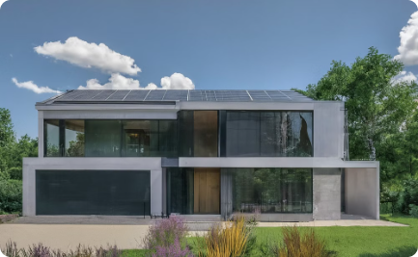
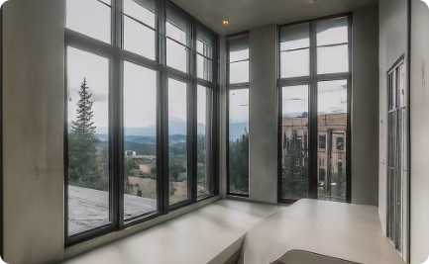
Improved Energy Efficiency
Solar Power Integration
High-Performance Windows
Superior Insulation
By incorporating solar panels during construction, homeowners can tap into renewable energy sources and dramatically reduce their energy bills.
Robust insulation systems maximize thermal efficiency, preventing unwanted heat gain or loss and lowering energy consumption for heating and cooling.
Advanced window technologies like double glazing and low-E coatings help minimize heat transfer, keeping homes cooler in the summer and warmer in the winter.

Slide 4
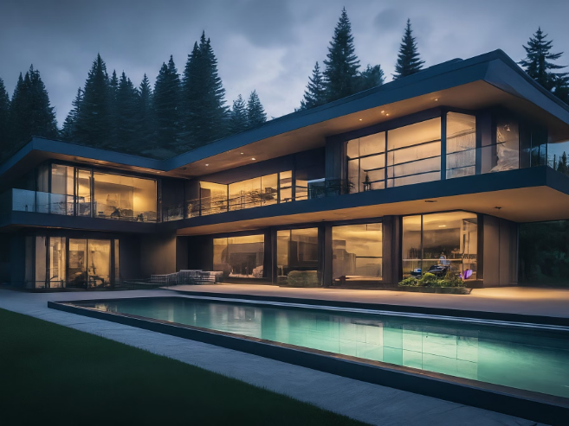
Enhanced Curb Appeal
Upgrading your home's exterior can significantly boost its curb appeal, making it more inviting and visually appealing to potential buyers or visitors. Improvements such as a fresh coat of paint, updated landscaping, and well-maintained entryways can dramatically transform the overall look and feel of your property.

Slide 5
Expanded living space
Additional Square Footage
Customized Design
Increased Property Value
Expanding your living space allows you to rethink the floor plan and create a layout that better suits your needs and lifestyle.
Expanding your home can boost its market value, making it a smart long-term investment that pays off when it's time to sell.
Renovating or adding to your home can significantly increase the total living area, providing more space for your family to live, work, and entertain.

Slide 6
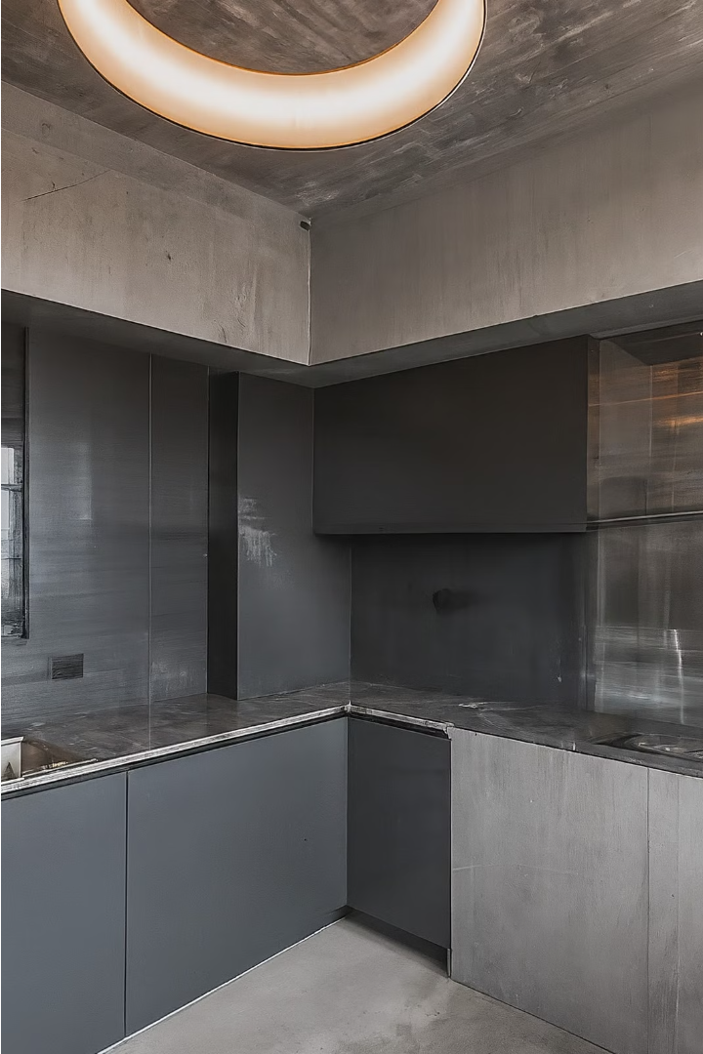
Upgraded features and amenities
Investing in construction upgrades can transform your living space with premium features and enhanced amenities. From state-of-the-art appliances to custom millwork and lighting, these enhancements elevate the functionality and aesthetic of your home, promoting a luxurious and comfortable lifestyle.

Slide 7
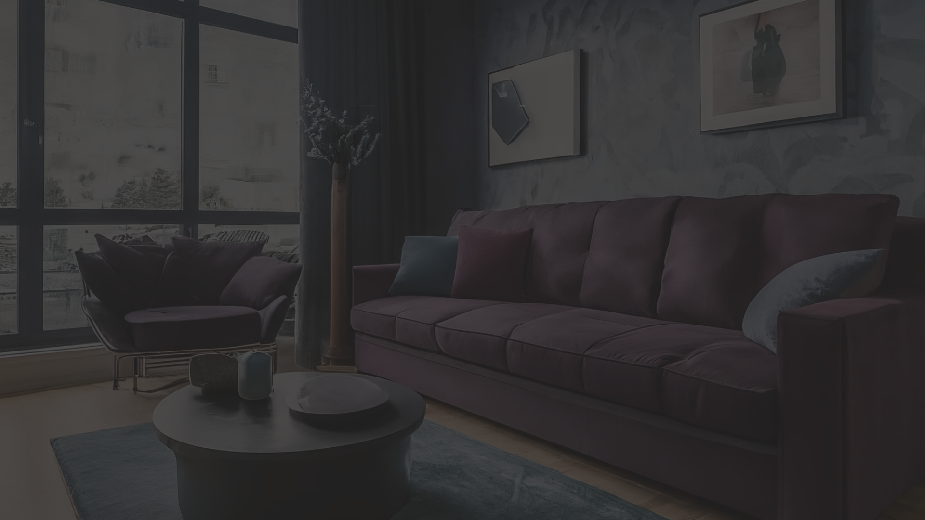
Increased Rental Income Potential
1
Higher Property Value
2
Desirable Upgrades
3
Expanded Living Space
Modern amenities, energy-efficient features, and enhanced curb appeal make your property more attractive to potential tenants, enabling you to charge premium rents.
Renovations and improvements can significantly increase the market value of your property, allowing you to command higher rental rates.
Additions and renovations that increase the livable square footage of your property can translate to higher monthly rents.

Slide 8
Improved Safety and Accessibility
Enhanced Safety
Accessibility Upgrades
Code Compliance
Improved Layout
Construction projects can improve safety by installing modern safety features like fire alarms, emergency exits, and updated electrical systems. This helps protect residents and guests from potential hazards.
Reconfiguring the layout can create a more intuitive flow and open spaces, making the property easier to navigate. This enhances both safety and accessibility.
Renovations can make a space more accessible by adding features like ramps, wider doorways, and elevators. This ensures the building can be easily navigated by those with mobility challenges.
Updates to a property can bring it up to current building codes, ensuring it meets safety and accessibility standards. This provides peace of mind and protects against potential liabilities.

Slide 9
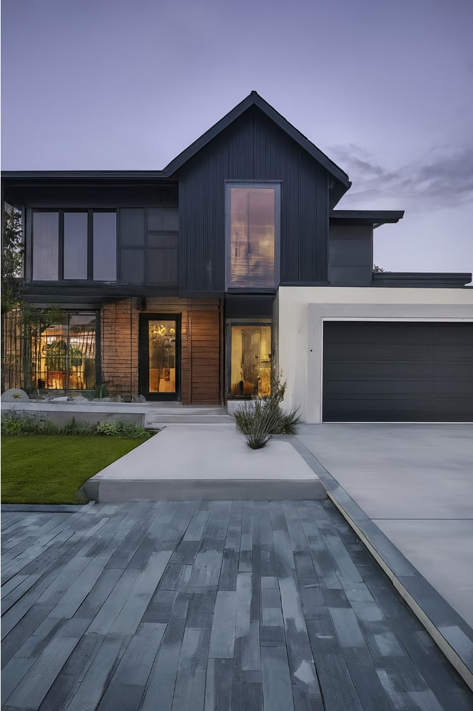
Customized Design and Functionality
Construction projects offer the opportunity to create a home tailored to your unique preferences and lifestyle. Innovative architectural designs, custom features, and personalized functionality can transform an ordinary space into an extraordinary living environment.
From custom cabinetry and built-in storage to high-end appliances and smart home technology, the options are endless for customizing your living space to maximize comfort, efficiency, and personal style.

Slide 10
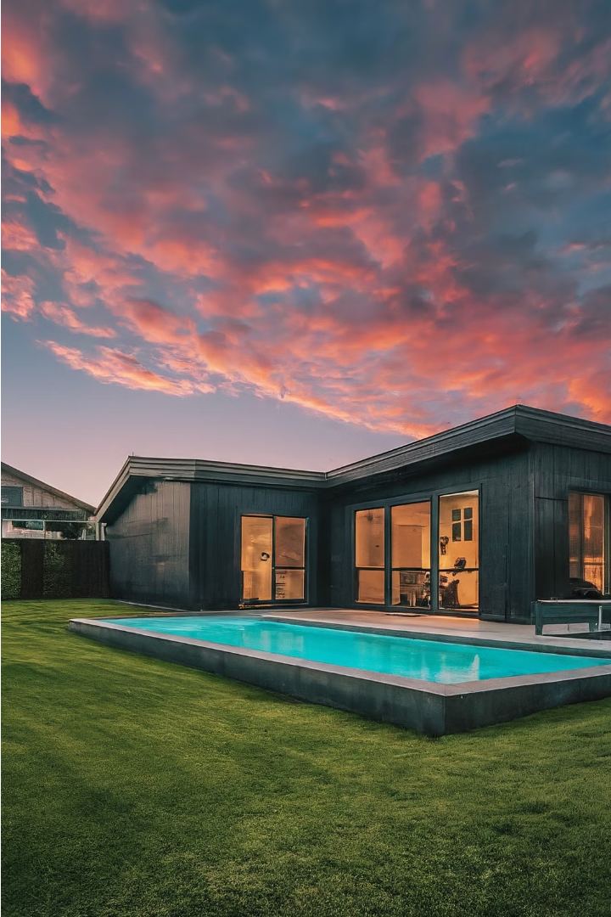
Conclusion: Maximizing construction project benefits
By thoughtfully planning and executing your construction project, you can unlock a wide range of compelling benefits that enhance your living experience and increase the long-term value of your property. From boosting curb appeal to expanding living space and improving energy efficiency, the rewards of a well-designed construction project are plentiful.

