Slide 1
Lexical Analysis of Texts

Slide 2
Lexical Analysis of Texts
Plan:
• Importance of lexical analysis in text study.
• Defining lexical analysis and its scope.
• Purpose and objectives of the presentation.

Slide 3
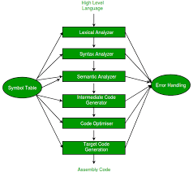
Basic Concepts in Lexical Analysis
• Definition of lexical analysis.
• Key concepts:
* Lexemes
* Lexical items
* Types and tokens
* Lexical density
* Lexical diversity
• The role of context in lexical analysis.

Slide 4
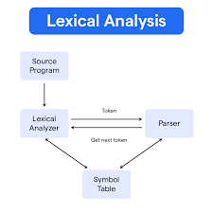
Techniques in Lexical Analysis
• Overview of various techniques:
* Frequency analysis
* Concordance analysis
* Collocation analysis
* Keyword analysis
* Semantic analysis
* Sentiment analysis
• How these techniques reveal linguistic patterns in texts.
• Examples of tools and software used for lexical analysis.

Slide 5
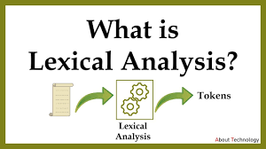
Applications of Lexical Analysis
• How lexical analysis is applied in different fields:
* Linguistics
* Literary studies
* Translation
* Natural Language Processing (NLP)
* Educational research
* Marketing and communication
• Specific examples of real-world applications in each field.

Slide 6
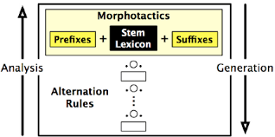
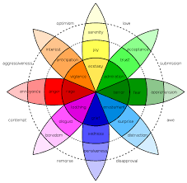
. Analyzing Lexical Patterns in Different Text Types
• How lexical patterns vary across text types:
* Narrative texts
* Expository texts
* Persuasive texts
* Academic texts
* Journalistic texts
• The impact of genre on lexical choice.
• Examples of lexical patterns specific to different text types.

Slide 7

Challenges in Lexical Analysis
• Issues and limitations in performing lexical analysis:
* Ambiguity
* Polysemy
* Idioms
* Subjectivity in semantic interpretation
* Data processing limitations
• Strategies to address these challenges.

Slide 8
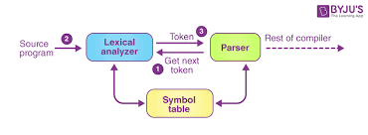
Interpreting Lexical Analysis Results
• How to interpret results obtained through lexical analysis.
• Connecting quantitative data to qualitative interpretations.
• The importance of combining multiple perspectives in lexical analysis.
• Guidelines for reporting findings from lexical analyses.

Slide 9
Conclusion
• Summary of the main points about lexical analysis.
• Importance of lexical analysis for text understanding.
• Implications for further research and applications. Use real-world examples and case studies to highlight the concepts.
• Use visual aids like charts, graphs, and word clouds to present data.
• Define key terms and avoid technical jargon.
• Encourage discussion and interaction with the audience.
• Discuss the practical applications of the techniques to increase audience engagement.

