Slide 1
Monophthongs, Diphthongs, and Triphthongs in a Language Being Learned

Slide 2
Monophthongs, Diphthongs, and Triphthongs in a Language Being Learned
Plan:
• The importance of understanding vowel types.
• Defining monophthongs, diphthongs, and triphthongs.
• Purpose and objectives of the presentation.

Slide 3

Basic Concepts in Vowel Articulation
• Definition of vowel sounds.
• Key terminology:
* Vowel height
* Vowel backness
* Lip rounding
• The vocal tract and vowel articulation.

Slide 4
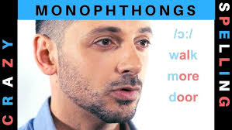
Monophthongs
• Definition and characteristics of monophthongs.
• Examples of monophthongs in the target language.
• Articulation of monophthongs with clear description of the tongue, jaw and lip position.
• Use of the IPA to denote the sounds.

Slide 5
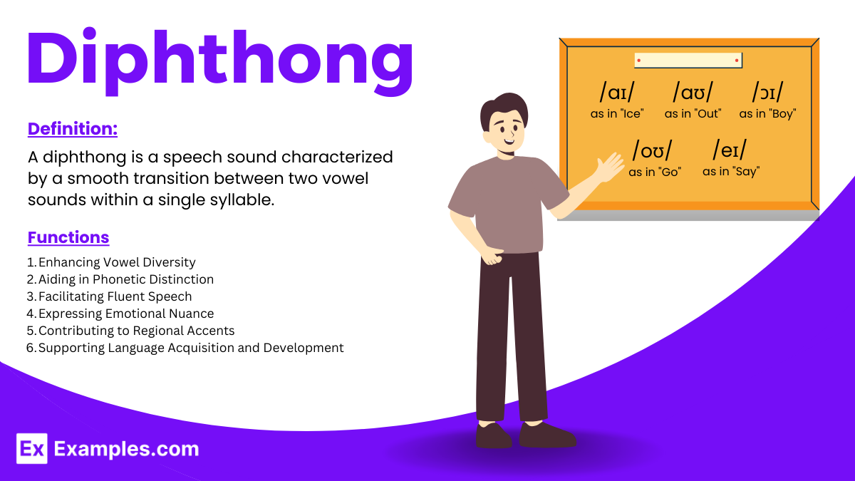
Diphthongs
• Definition and characteristics of diphthongs (vowel glides).
• Common diphthongs in the target language.
• Description of the glide, starting point and direction of the movement.
• Examples of diphthongs and where they occur in words.

Slide 6

Triphthongs
• Definition and characteristics of triphthongs (glides between three vowels).
• Occurrence of triphthongs in the target language (if they exist).
• Explanation of how three vowel sounds are connected, showing the start, direction and end.
• Examples and locations in the word structure.

Slide 7

Challenges in Learning and Producing Different Vowel Types
• Common difficulties faced by learners:
* Distinguishing monophthongs, diphthongs, and triphthongs
* Producing vowel glides
* Interference from the first language
* Vowel reduction and the schwa
• Specific examples of pronunciation errors.

Slide 8
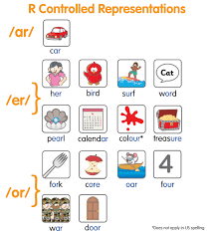
Strategies for Learning and Improving Vowel Sounds
• Techniques for improving pronunciation:
* Auditory discrimination
* Articulatory training
* Visual aids and diagrams
* Minimal pairs
* Use of recording one’s own pronunciation.
• The importance of feedback from teachers and native speakers.
• Use of online resources and pronunciation tools.

Slide 9

The Role of Monophthongs, Diphthongs and Triphthongs in Connected Speech
• How vowel types vary in connected speech and context.
• The role of stress patterns on vowel quality and length.
• The impact of vowel reduction and assimilation on these vowel types.

Slide 10
Conclusion
• Summary: Monophthongs are single vowels; diphthongs involve a glide between two vowels; and triphthongs involve glides through three vowels.
• Importance: Understanding these vowel types is key for improving pronunciation.
• Implications: For language learning and teaching, it is important to understand how different vowel types are produced and used in speech, so that they are effectively taught and learned.

