Slide 1
Past continuous
Makhmasiddikov Shakhriyor

Slide 2
Past continuous tense
We use the past continuous when we describe a situation, or several situations in progress, happening at the same time in the past. This is often contrasted with a sudden event in the past simple.
For example
“I was working on my computer and my brother was reading a book * when we heard a loud bang on the door *”

Slide 3
Forming Past continuous
The past continuous is formed with the past form of the auxiliary verb to be and the -ing form of the main verb. Questions are formed by inverting the subject and the auxiliary verb to be. Negatives are formed with the auxiliary verb to be + not. This is contracted in speech and informal writing.
For instance:
-Jim was playing video games all night.
-Jim was not playing video games all night.
-Was Jim playing video games all night?

Slide 4
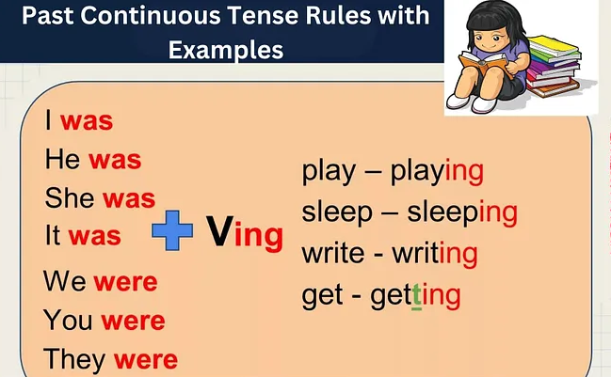
You can see some examples on this table!

Slide 5
Forming with ‘Time
Some time markers can emphasize the duration of the action or state when the action was taking place. These time markers are at 7 o'clock, for two hours, in January, last week, all night etc.
F/e: Kate was trying to find a nice apartment in her area for 5 months
We can use when or while with the past continuous to mean "during the time that".
F/e: James broke his finger when he was playing basketball

Slide 6
Independent Practice
Choose the correct phrase.
1.Last summer I was swimming/swam in the river every day.
2.While I took/was taking a shower, the phone rang/ringed.
3.Ann was breaking/broke a cup when she washed/was washing the dishes.
4. Peter fell asleep when/while he was watching TV.
5. I had/was having fun at the party.

Slide 7
Complete each sentence with a suitable time marker.
At` while` when` in`
1.Sally was working on her thesis .................... 8 o'clock.
2.Tom was sleeping peacefully in his bed .................... his mom took a picture of him.
3.I was living in Italy .................... 2009.
4.A burglar broke into their house .................... they were watching TV

Slide 8
Answer the questions.
1.What were you doing at 5 p.m. last night?
2.What were you eating at lunchtime yesterday?
3. What were you wearing when you last went out at night?
4. What were you doing at breaktime?
5. How was the weather this morning?

Slide 9
6. What were you trying to make when you last tried to bake or cook? (Girl)
7. Think about the last dream that you remember. What were you dreaming about?
8. What were you thinking about five minutes ago?
9. What was your mother doing when you saw her last?

Slide 10
Conclusion
Understanding the past continuous tense and its rules will help you improve your English grammar skills and become a more effective communicator. By practicing the correct use of “was” and “were,” using the present participle form of verbs, and avoiding common mistakes, you will master this tense in no time. You can learn what are the participles and use them in English.
Thanks for everybody!!!

