Slide 1
Role of IT in education
University: TUIT named after Muhammad
al-Kharazmiy
Group: _________
Surname: ______________
Name: _________________
Sabject: English
Teacher: ________________

Slide 2
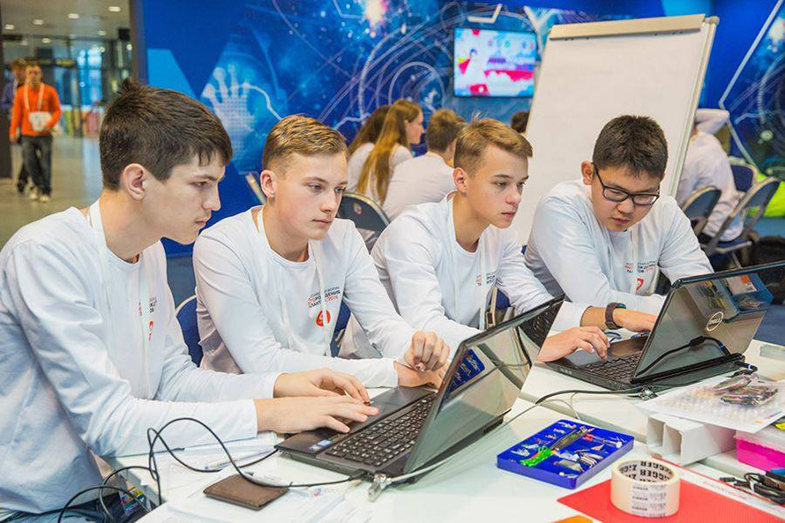
The topic of the presentation is the importance of IT in education.

Slide 3

One should not spend a lot of time in front of monitor

Slide 4
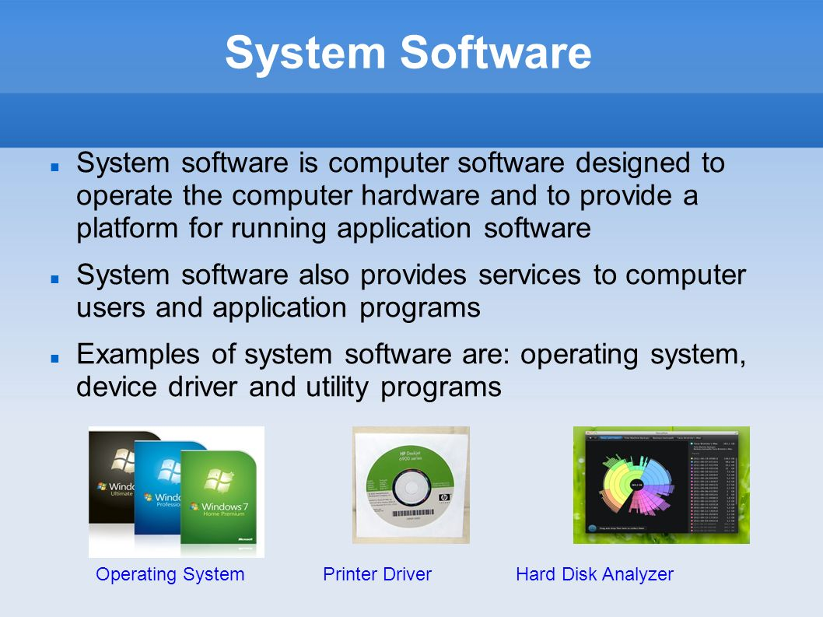

Slide 5
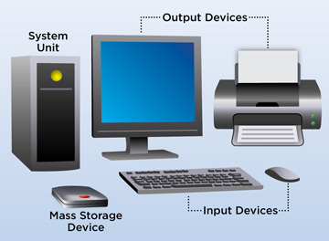
Computer hardware includes the physical, tangible parts or components of a computer, such as the central processing unit, monitor, keyboard, computer data storage, graphic card, sound card, speakers and motherboard

Slide 6
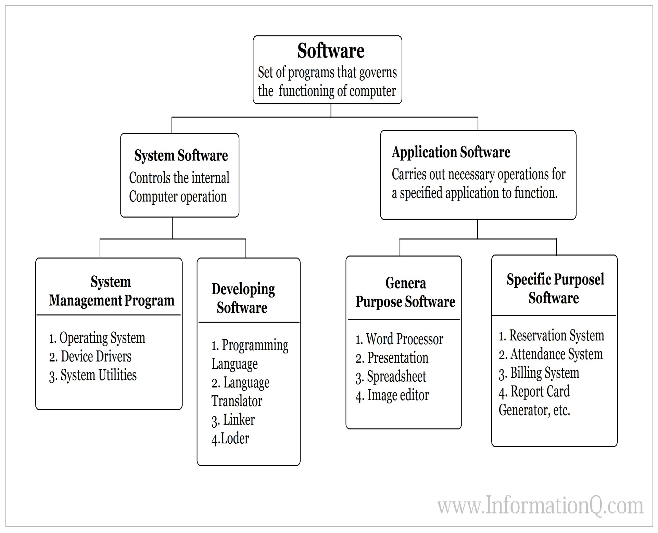

Slide 7
THANK YOU FOR YOUR ATTENTION
THE END

