Slide 1

TRIGONOMETRIC FUNCTIONS

Slide 2
Design
1. ABOUT TRIGONOMETRIC FUNCTIONS
2. TRIGONOMETRIC FUNCTIONS OF SIGNS
3. EXAMPLES

Slide 3
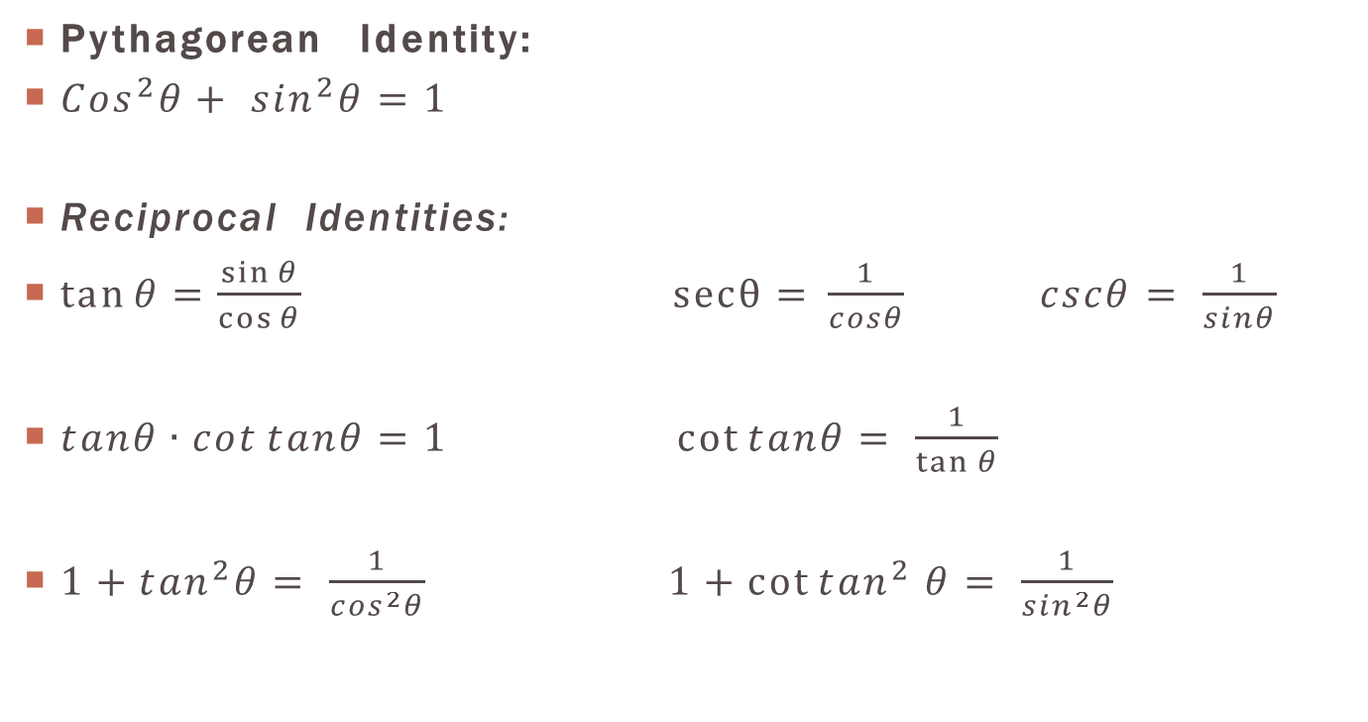
Pythagorean Identity:
${Cos}^{2}θ+ \sin^{2}θ=1$
Reciprocal Identities:
$\tan{θ}=\frac{\sin{θ}}{\cos{θ}}$ $secθ={\frac{1}{cosθ}}$ $cscθ= \frac{1}{sinθ}$
$tanθ∙\cot{tanθ=1}$ $\cot{tanθ= \frac{1}{\tan{θ}}}$
$1+\tan^{2}θ= \frac{1}{\cos^{2}θ}$ $1+\cot{\tan^{2}}$ $θ= \frac{1}{\sin^{2}θ}$

Slide 4
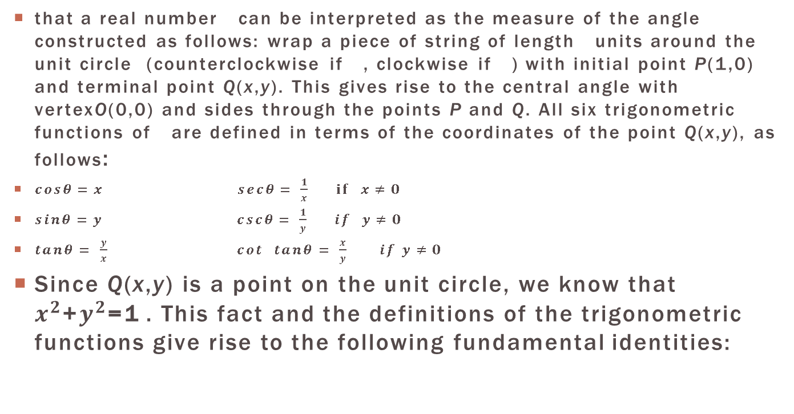
Recall
that a real number can be interpreted as the measure of the angle constructed as follows: wrap a piece of string of length units around the unit circle (counterclockwise if , clockwise if ) with initial point P(1,0) and terminal point Q(x,y). This gives rise to the central angle with vertexO(0,0) and sides through the points P and Q. All six trigonometric functions of are defined in terms of the coordinates of the point Q(x,y), as follows:
$cosθ=x$ $secθ= \frac{1}{x}$ $if x≠0$
$sinθ=y$ $cscθ= \frac{1}{y}$ $if y≠0$
$tanθ= \frac{y}{x}$ $cot$ $tanθ= \frac{x}{y}$ $if y≠0$
Since Q(x,y) is a point on the unit circle, we know that $x^{2}$+$y^{2}$=1 . This fact and the definitions of the trigonometric functions give rise to the following fundamental identities:

Slide 5
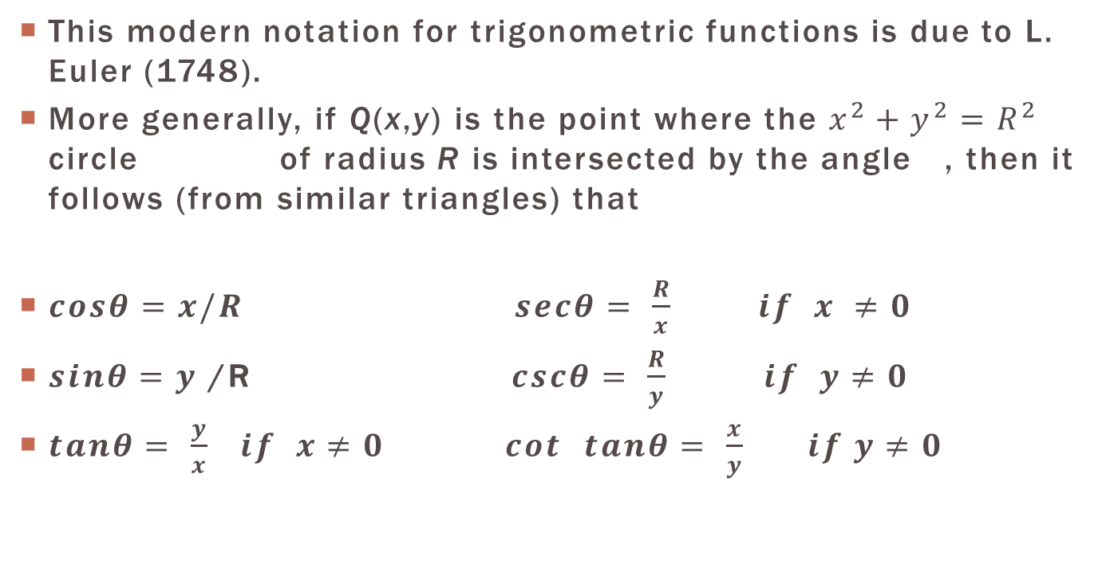
This modern notation for trigonometric functions is due to L. Euler (1748).
More generally, if Q(x,y) is the point where the $x^{2}+y^{2}=R^{2}$ circle of radius R is intersected by the angle , then it follows (from similar triangles) that
$cosθ=x/R$ $secθ= \frac{R}{x}$ $if x ≠0$
$sinθ=y$ /R $cscθ= \frac{R}{y}$ $if y≠0$
$tanθ= \frac{y}{x}$ $if x≠0$ $cot$ $tanθ= \frac{x}{y}$ $if y≠0$

Slide 6
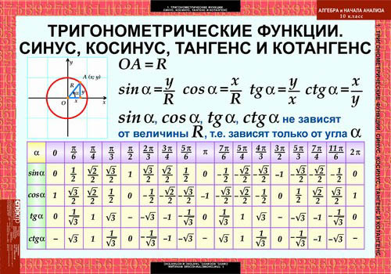

Slide 7
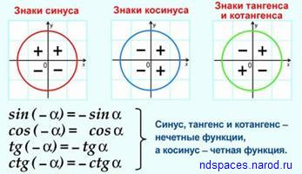

Slide 8
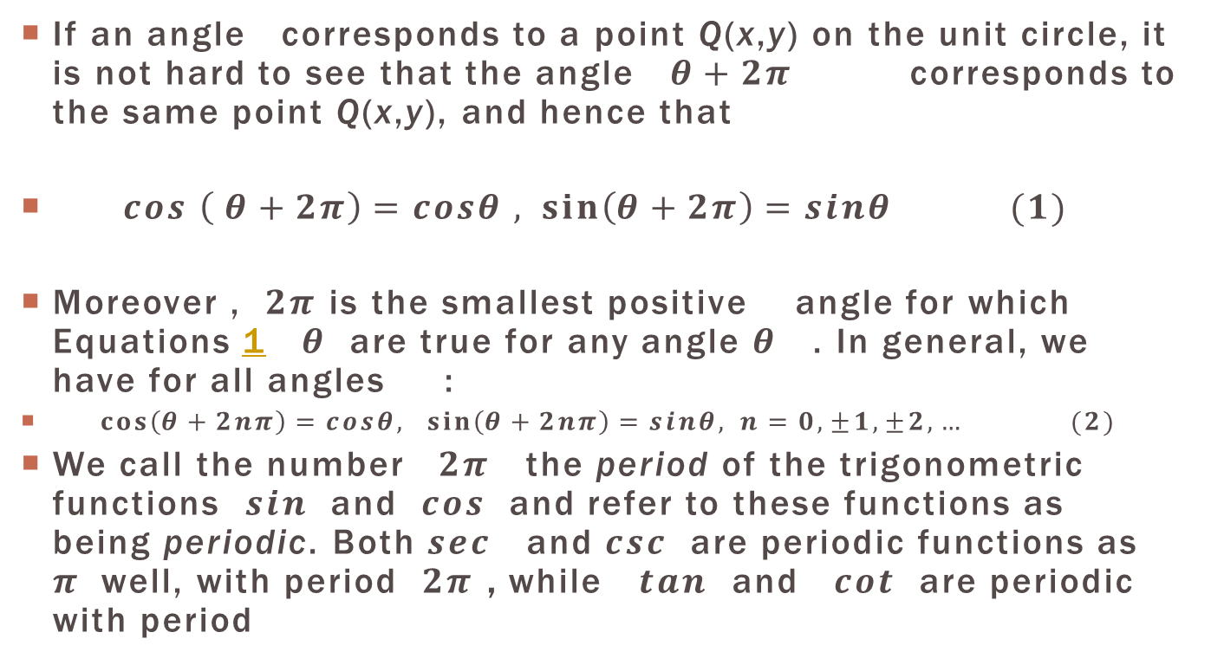
Periodic Functions
If an angle corresponds to a point Q(x,y) on the unit circle, it is not hard to see that the angle $θ+2π$ corresponds to the same point Q(x,y), and hence that
$cos \left( θ+2π\right)=cosθ , \sin\left(θ+2π\right)=sinθ (1)$
Moreover , $2π$ is the smallest positive angle for which Equations 1 $θ$ are true for any angle $θ$ . In general, we have for all angles :
$\cos\left(θ+2nπ\right)=cosθ, \sin\left(θ+2nπ\right)=sinθ, n=0,±1,±2,… (2)$
We call the number $2π$ the period of the trigonometric functions $sin$ and $cos$ and refer to these functions as being periodic. Both $sec$ and $csc$ are periodic functions as $π$well, with period $2π$ , while $tan$ and $cot$ are periodic with period

Slide 9
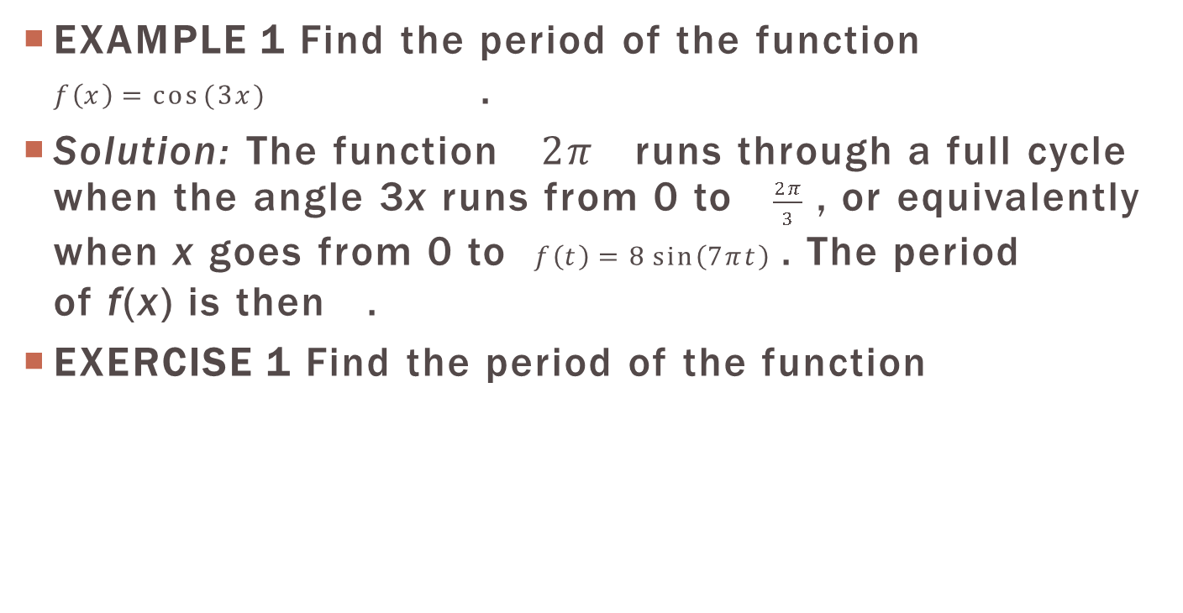
EXAMPLE 1 Find the period of the function $f\left(x\right)=cos⁡(3x)$ .
Solution: The function $2π$ runs through a full cycle when the angle 3x runs from 0 to $\frac{2π}{3}$ , or equivalently when x goes from 0 to $f\left(t\right)=8\sin\left(7πt\right)$ . The period of f(x) is then .
EXERCISE 1 Find the period of the function

Slide 10
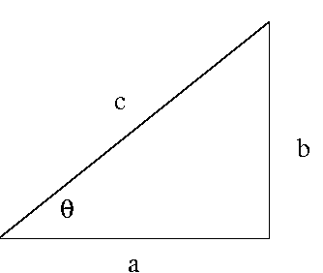

Evaluation of Trigonometric functions
Consider the triangle with sides of length and hypotenuse c>0 as in Figure 1 below:
For the angle $θ$ pictured in the figure, we see that

Slide 11
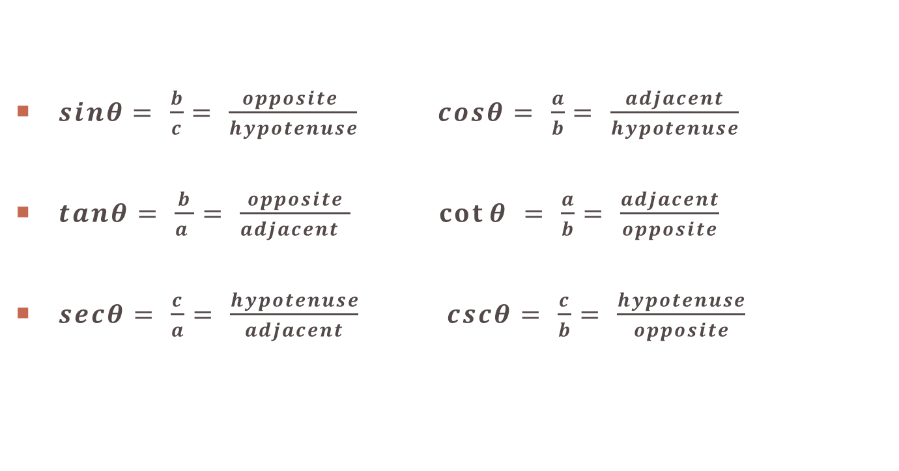
$sinθ= \frac{b}{c}$ $= \frac{opposite }{hypotenuse}$ $cosθ= \frac{a}{b}$ $= \frac{adjacent}{hypotenuse}$
$tanθ= \frac{b}{a }$ $= \frac{opposite}{adjacent }$ $\cot{θ }= \frac{a}{b}= \frac{adjacent}{opposite}$
$secθ= \frac{c}{a}= \frac{hypotenuse}{adjacent}$ $cscθ= \frac{c}{b}= \frac{hypotenuse}{opposite}$

Slide 12
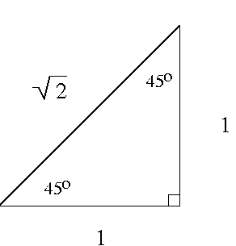
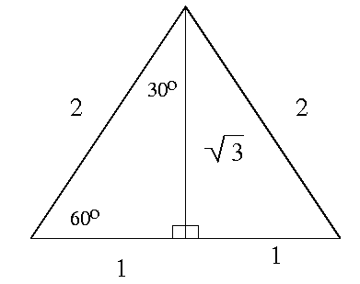
There are a few angles for which all trigonometric functions may be found using the triangles shown in the following Figure 2.

Slide 13
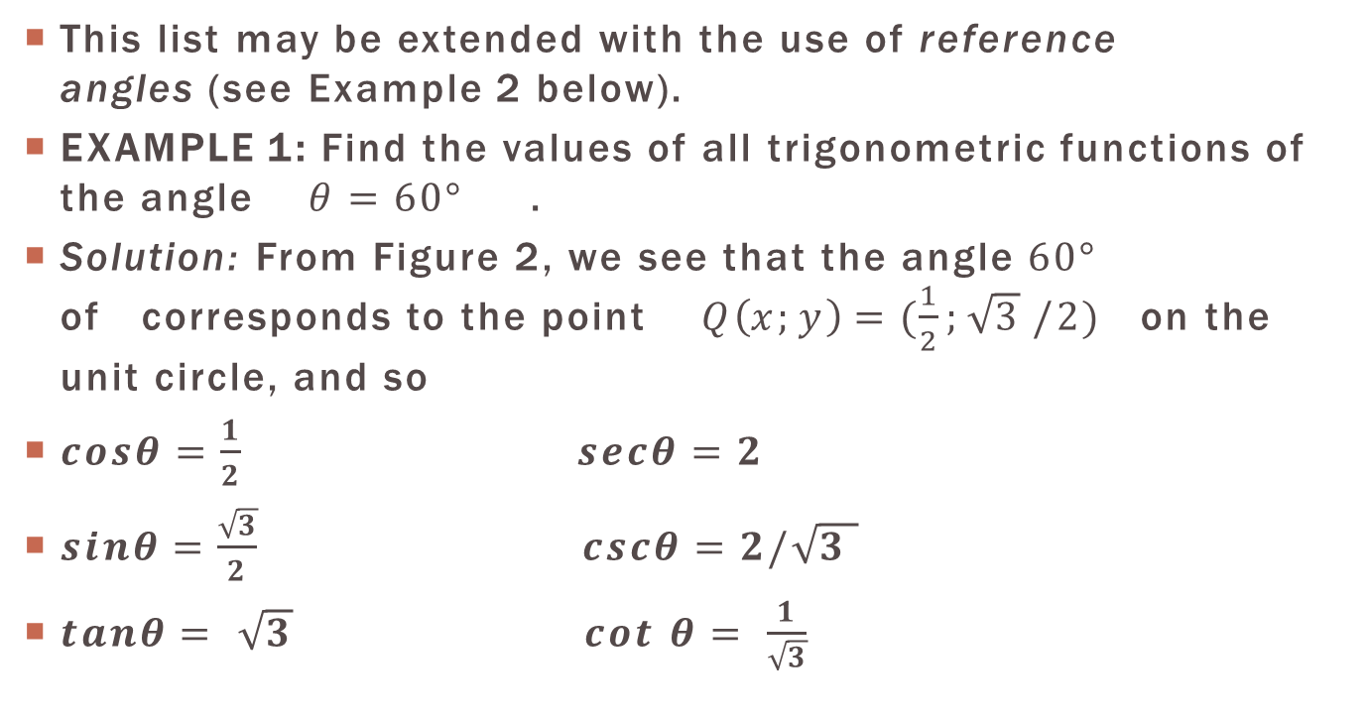
This list may be extended with the use of reference angles (see Example 2 below).
EXAMPLE 1: Find the values of all trigonometric functions of the angle $θ=60°$ .
Solution: From Figure 2, we see that the angle $60°$ of corresponds to the point $Q\left(x;y\right)=(\frac{1}{2};\sqrt{3}$ $/2)$ on the unit circle, and so
$cosθ=\frac{1}{2}$ $secθ=2$
$sinθ=\frac{\sqrt{3}}{2}$ $cscθ=2/\sqrt{3 }$
$tanθ= \sqrt{3} cot$ $θ= \frac{1}{\sqrt{3}}$

Slide 14
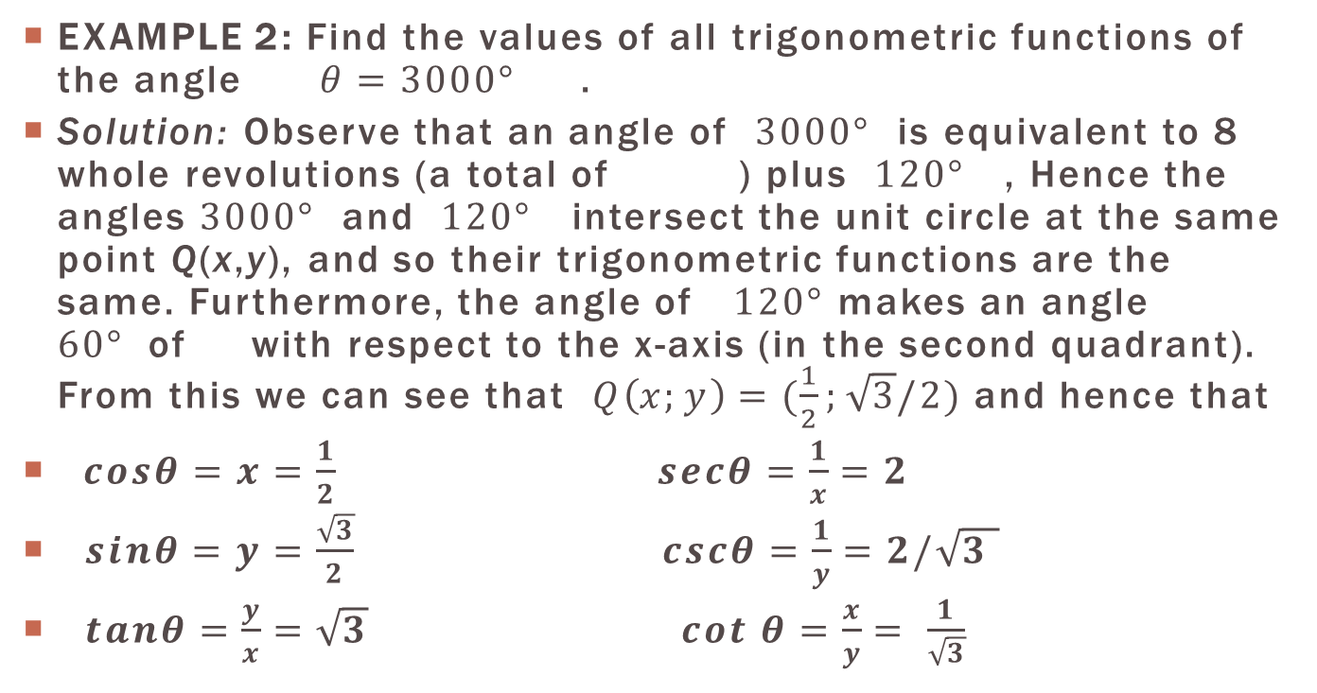

EXAMPLE 2: Find the values of all trigonometric functions of the angle $θ=3000°$ .
Solution: Observe that an angle of $3000°$ is equivalent to 8 whole revolutions (a total of ) plus $120°$ , Hence the angles $3000°$ and $120°$ intersect the unit circle at the same point Q(x,y), and so their trigonometric functions are the same. Furthermore, the angle of $120°$ makes an angle $60°$of with respect to the x-axis (in the second quadrant). From this we can see that $Q\left(x;y\right)=(\frac{1}{2};\sqrt{3}/2)$ and hence that
$cosθ=x=\frac{1}{2}$ $secθ=\frac{1}{x}=2$
$sinθ=y=\frac{\sqrt{3}}{2}$ $cscθ=\frac{1}{y}=2/\sqrt{3 }$
$tanθ=\frac{y}{x}=\sqrt{3} cot$ $θ=\frac{x}{y}= \frac{1}{\sqrt{3}}$
$$2880°$$

Slide 15
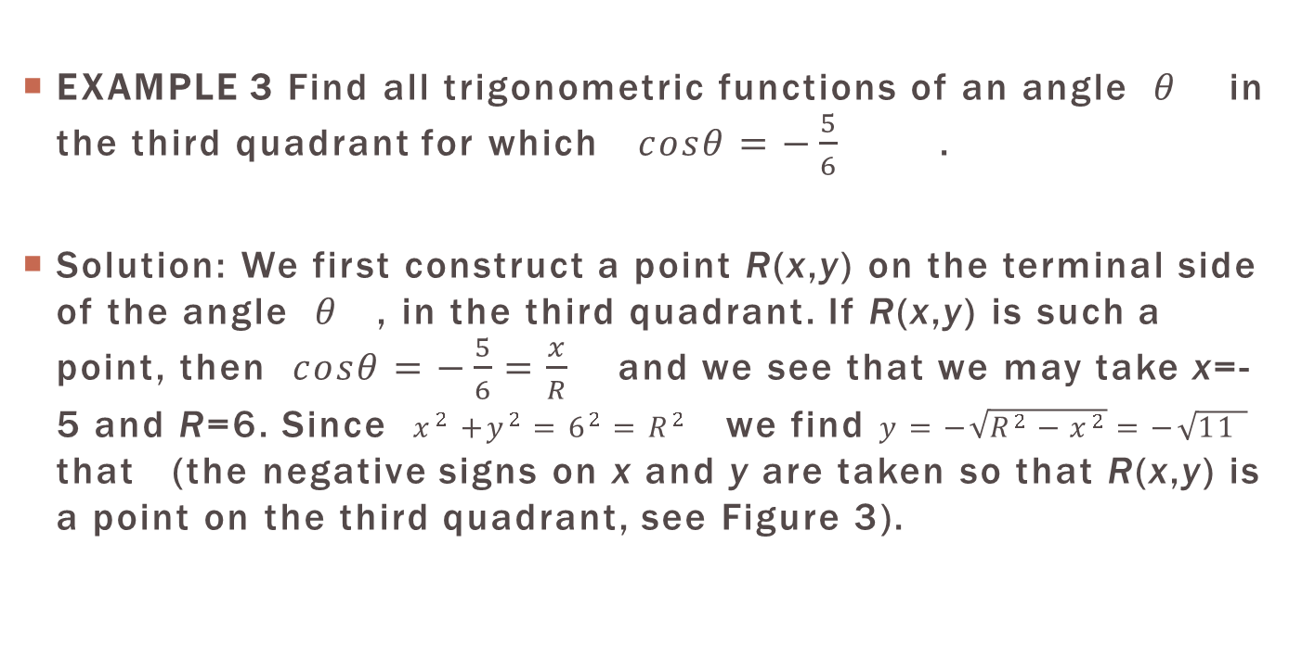
EXAMPLE 3 Find all trigonometric functions of an angle $θ$ in the third quadrant for which $cosθ=−\frac{5}{6}$ .
Solution: We first construct a point R(x,y) on the terminal side of the angle $θ$ , in the third quadrant. If R(x,y) is such a point, then $cosθ=−\frac{5}{6}=\frac{x}{R}$ and we see that we may take x=-5 and R=6. Since $x^{2}$ $+y^{2}=6^{2}=R^{2}$ we find $y=−\sqrt{R^{2}−x^{2}}=−\sqrt{11 }$ that (the negative signs on x and y are taken so that R(x,y) is a point on the third quadrant, see Figure 3).

Slide 16
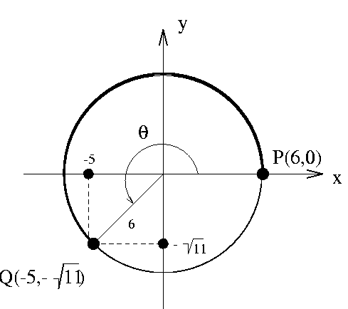

Slide 17
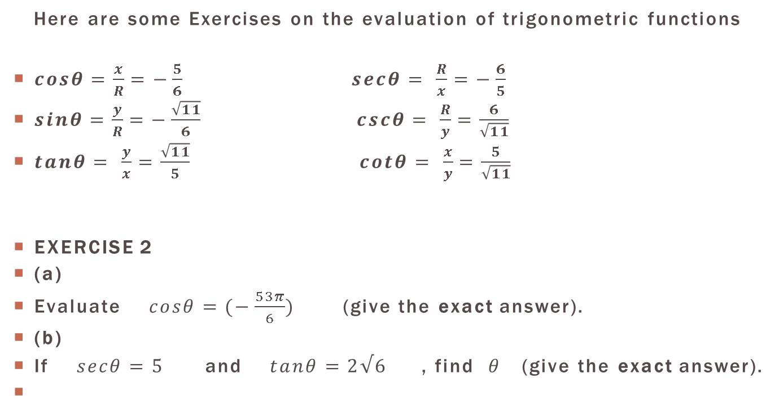
Here are some Exercises on the evaluation of trigonometric functions
$cosθ=\frac{x}{R}=−\frac{5}{6}$ $secθ= \frac{R}{x}=−\frac{6}{5}$
$sinθ=\frac{y}{R}=−\frac{\sqrt{11}}{6}$ $cscθ= \frac{R}{y}=\frac{6}{\sqrt{11}}$
$tanθ= \frac{y}{x}$ $=\frac{\sqrt{11}}{5}$ $cotθ= \frac{x}{y}=\frac{5}{\sqrt{11}}$
EXERCISE 2
(a)
Evaluate $cosθ=(−\frac{53π}{6})$ (give the exact answer).
(b)
If $secθ=5$ and $tanθ=2√6$ , find $θ$ (give the exact answer).

Slide 18
Pythagorean- pifagor
Identity – hisobga olish
Reciprocal – javoban qilingan
Recall – yodlamoq
Real – haqiqiy
Cengle – burchak
Piece – bo’lak
Length – uzunlik
Unit – bir butun
Around – atrof
Circle – aylana
Intersected – keshishadigan
Similar – o’xshash
Triangles – uchburchak
Correspond – muvofiq
Positive – musbat
Equation – tenglashtrish
Being – mavjud
Example – misol
Solution – yechish
Full – butun
Hypotenuse – gipotenuza
Counterclock wise – soat miliga teskali yo’nalishi
Clockwise – soat yo’nalishi bo’yicha
Initial – boshlang’ich
Point – nuqta
Central – markaz
Vertex – uchi
Trigonometric – trigonometrik
Function – funksiya
Coordinatis – kordinatalari
Definition – aniqlash
Fundamental – asosiy
Opposite – qarama-qarshi
Adjlant – qoshni
Extended – kengaytirish
Equivalent – ekvivalent
Whole – to’liq
Total – yig’indi
Plus – qo’shish
Second – ikkichi
Quadrant – kvadrat
Negative – manfiy
Signs – ishoralar
Evaluate – baholash
Answer – javob

