Slide 1

Problems and solutions
Problems and solutions
No'monov G'olibjon
____________________________

Slide 2

Problems and solutions
Plan:
1. Air Pollution and Its Control Measures
2. Plastic Waste Management Solutions
No'monov G'olibjon
3. Water Scarcity and Sustainable Solutions

Slide 3


...
1. Air Pollution and Its Control Measures
Air pollution is caused by particulate matter, nitrogen oxides, sulfur dioxide, carbon monoxide, and volatile organic compounds. Major sources include industrial emissions, vehicle exhaust, and burning of fossil fuels. Health impacts include respiratory diseases, cardiovascular issues, and premature death, affecting millions globally. Control measures involve implementing stricter emission standards, increasing public transportation efficiency, and adopting cleaner technologies like electric vehicles. The use of renewable energy sources, such as solar and wind, reduces reliance on coal and oil. Reforestation and green urban planning can also help absorb pollutants. Regulations like the Clean Air Act in the United States have successfully reduced pollutants by over 70% since its enactment.
t.me/slaydai_bot

Slide 4

...
1. Mechanical recycling is a key plastic waste management solution, involving processes like washing, shredding, and melting to repurpose materials. Approximately 9% of global plastic waste has been recycled since 1950. Chemical recycling, including depolymerization and pyrolysis, enables breaking down plastics to basic chemicals for reuse, though currently accounts for only 1% of plastic recycling. Additionally, incineration converts waste to energy, but emits CO2 and other pollutants.
2. Biodegradable plastics are emerging as a solution, aiming to reduce landfill contributions. Approximately 8% of global oil production is used for plastic manufacturing, highlighting the need for alternatives. Countries like Germany recycle over 56% of their plastic waste, setting benchmarks in waste management. The European Union aims to recycle 55% of plastic packaging by 2030.
t.me/slaydai_bot

Slide 5
...
XXXXX
Request timed out.
t.me/slaydai_bot

Slide 6
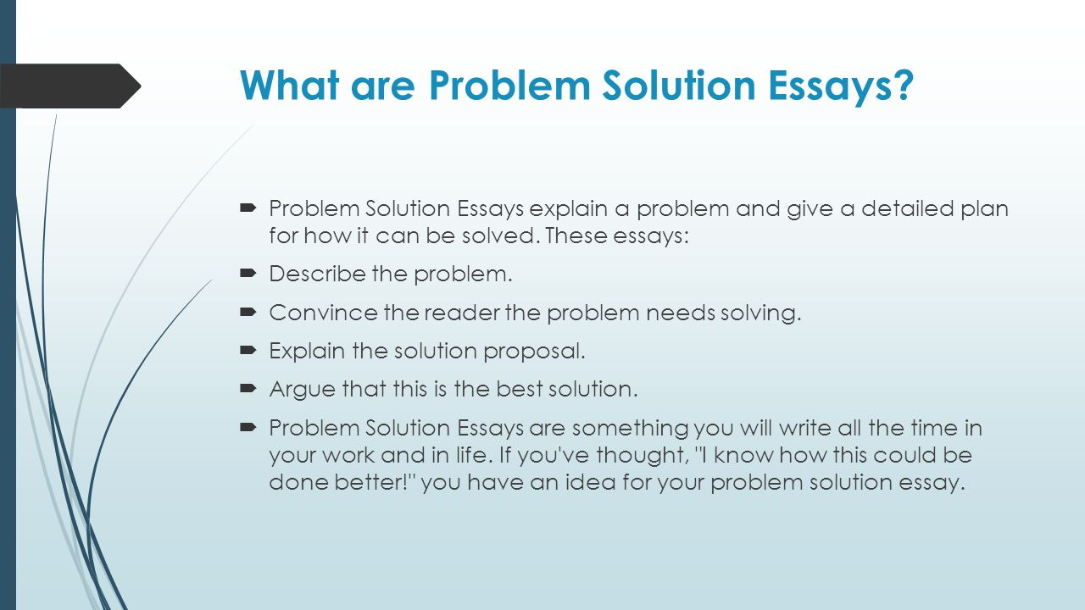
...
4. Climate Change Mitigation Strategies
Climate change mitigation strategies encompass techniques to reduce greenhouse gas emissions and enhance carbon sequestration. Renewable energy adoption, such as solar and wind, can greatly reduce emissions, potentially achieving 70% global electricity generation by 2050. Energy efficiency improvements in buildings, industrial processes, and transportation could cut emissions by 40% by 2030. Reforestation and afforestation efforts aim to sequester carbon, with global initiatives targeting 1 trillion trees. Carbon capture and storage (CCS) technology could capture up to 90% of CO2 emissions from power plants, aiming to store 5,600 million tons annually by 2050. Implementing these strategies requires financial investments possibly reaching $1 trillion annually, with significant economic and environmental benefits anticipated.
t.me/slaydai_bot

Slide 7
...
1. Improving agricultural productivity is crucial; innovations like drought-resistant crops can boost yields by up to 20%, helping feed more people. 2. Reducing food waste is vital, as 1.3 billion tons of food are wasted annually, which is about one-third of global food production. 3. Strengthening food supply chains ensures more efficient distribution; currently, up to 30% of food in developing regions spoils before it reaches consumers. 4. Promoting sustainable farming practices can raise food production by 70% globally by 2050, meeting increased population demands. 5. Enhancing access to markets and financial services for smallholder farmers could increase their incomes by up to 68%, improving food security in rural communities.
t.me/slaydai_bot

Slide 8
...
Cybersecurity threats include malware, phishing, ransomware, and DDoS attacks. In 2021, cybercrime caused estimated global damages of $6 trillion. The average cost of a data breach was $4.24 million, according to IBM. Protective measures involve using firewalls, two-factor authentication, and encryption. Over 70% of organizations utilized cloud-based security services for enhanced protection in 2021. Regular software updates and employee training programs reduce vulnerabilities significantly. According to Verizon, 85% of breaches involved a human element, emphasizing the need for strong security awareness programs. Employing advanced AI-based systems can detect threats in real time, with over 50% of companies planning to increase AI use for cybersecurity defenses by the end of 2023.
t.me/slaydai_bot

Slide 9
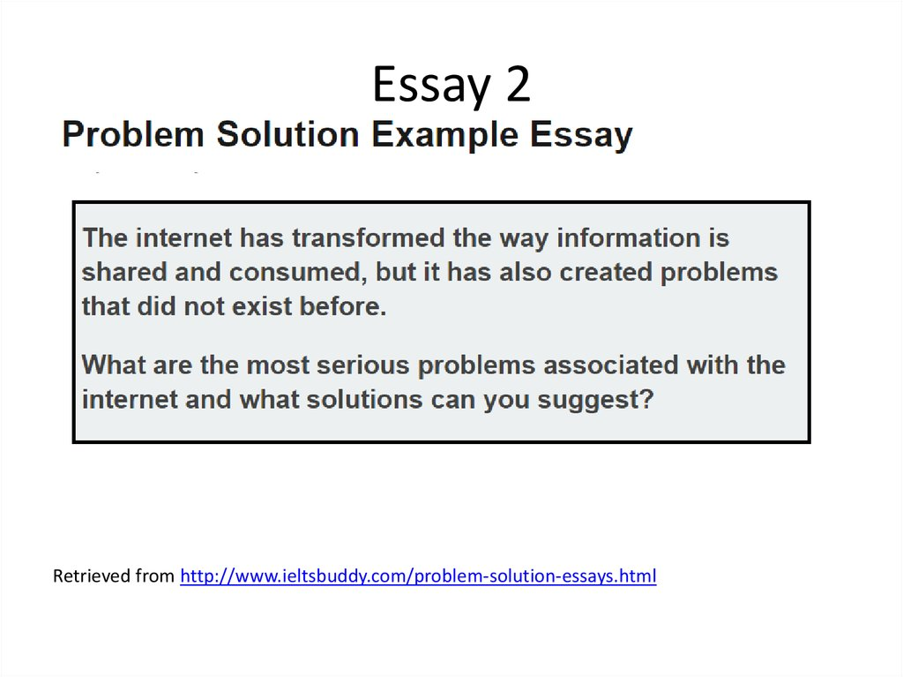
...
7. Overpopulation and Resource Management
Overpopulation significantly strains resource management, as it leads to increased demand for finite resources such as water, food, and energy. The global population, currently over 8 billion, exacerbates the depletion of arable land and accelerates deforestation, reducing biodiversity. Urban areas, housing over 55% of the population, face infrastructure stress and pollution. Water scarcity affects over 2 billion people, with demand projected to increase by 20-30% by 2050. Energy consumption has risen by over 40% since 2000, heightening carbon emissions. Sustainable practices are crucial, as current agricultural methods will need to increase food production by 60% to feed 9.3 billion people by 2050, emphasizing the importance of efficient resource management.
t.me/slaydai_bot

Slide 10
...
Renewable energy adoption faces numerous challenges, including high initial costs, intermittency issues, and infrastructure limitations. For instance, solar and wind energy rely on weather conditions, leading to variable output. The International Energy Agency (IEA) notes that in 2021, renewables accounted for nearly 29% of global electricity generation. Solutions include improving energy storage technologies like lithium-ion batteries, which saw costs drop by 89% from 2010 to 2020. Grid modernization and smart grid technologies enhance the integration of renewables. Additionally, policy support and financial incentives, such as feed-in tariffs and tax credits, encourage investment. By addressing these challenges, renewables can potentially account for 90% of new power capacity by 2025, according to IEA forecasts.
t.me/slaydai_bot

Slide 11
Problems and solutions
Thank you for your attention!
No'monov G'olibjon

