Slide 1
My native town
TASHKENT CITY

Slide 2

PLAN:
1. Tashkent is largest city of uzbekistan
2. About the many famous place
3. Abulkasim Khan a great intellectual of his time.

Slide 3
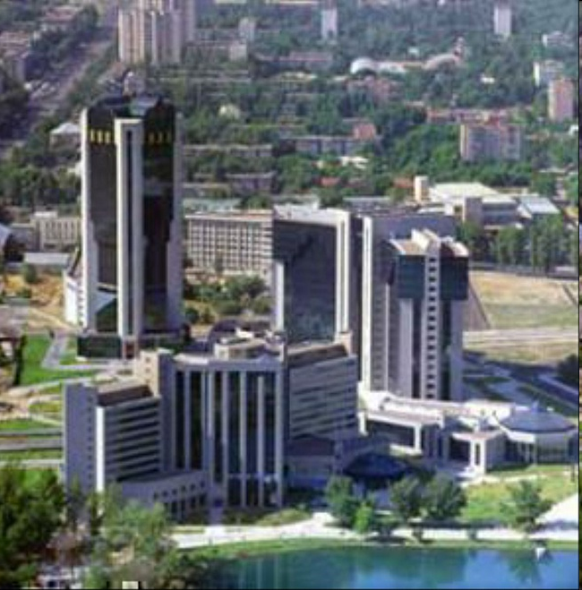
Tashkent is the capital of Uzbekistan, Uzbekistan's largest city (population 2,400,000) is also Central Asia's largest city and its main transportation hub. At present, Tashkent is one of the most important business centers in Central Asia. Present-day Tashkent is one of the most beautiful cities in Asia, and its architecture is unique; the hospitality and friendliness of Tashkent people is amazing

Slide 4
The city is more than 2000 years old, and has evolved from a small ancient settlement to the one of the largest metropolitan areas in the region
Many remarkable events, both in peace and war, have taken place during the history of Tashkent, including many periods of rise and decline

Slide 5
The city is host to Embassies and consulates of many countries of the world, and is known among travelers as a great place to stay and arrange visa and trips throughout the region; Tashkent lies right on the border with Kazakhstan and also is known as the main "gates of the Orient" on international air routes from India, Afghanistan, Pakistan, and China to Europe
The Tashkent Metro, currently the only subway in Central Asia, is fantastically designed in a unique, monumental Uzbek-Soviet style. It is never crowded, and the easiest and cheapest way to quickly transit the city. Tashkent is simply bursting with interesting museums, ancient historical sites, lush parks, and a diverse selection of high-quality retaurants, nightclubs and shops.

Slide 6
The city of Tashkent is located within Tashkent Region, which lies in the far northeastern corner of Uzbekistan, near the border with Kazakhstan and Kyrgyzstan
Its area covers 15,300 sq km; 10% percent of the total population of Uzbekistan lives in the Tashkent Region
The majority are Uzbeks, but more than 90 other nationalities also live here, primarily Russians, Kazakhs, Tajiks, Kyrgyz, and ethnic Koreans
The average population density is more than 146 persons per sq km. The Tashkent Region consists of 15 districts, 16 towns, 17 settlement, and 147 kishlak (villages) councils. It is situated between the western slopes of the Tien Shan Mountains and the Syrdarya river

Slide 7
The Tashkent Region ranks second in Uzbekistan in industrial development. Over 260 enterprises representing 160 industrial branches produce twenty percent of the country's gross output. Principal industries are power generation, mechanical engineering, metallurgy, chemicals, textiles, footwear, and cotton processing and agricultural production.

Slide 8
