Slide 1

The chest

Slide 2
Introduction
Chest X-Ray is one of the most frequently requested hospital investigations.
It is readily available and inexpensive in comparison to other imaging studies.
The basic interpretation is of utmost importance in answering several clinical questions at hand.
It is an important tool to complement both history and initial clinical examination.

Slide 3
BASIC CHEST X-RAY INTERPRETATION
A. Patient details
Name of the patient
Age
Date

Slide 4
B. Quality
Image quality influences interpretation
Quality is influenced by radiographic technique and patient factors.
First determine if the clinical question can be answered.
Check the image for – Projection, rotation, inspiration, penetration and artefacts.

Slide 5
1. Projection
Look to see if the film is antero-posterior (AP) or postero-anterior (PA) view
With an AP view the X-ray beam is in front the patient and the X-Ray placed at the back, and the other way round for PA.
The standard CXR is PA but many emergency CXRs are AP.
The CXR projection has an important bearing on the interpretation of the structures.

Slide 6
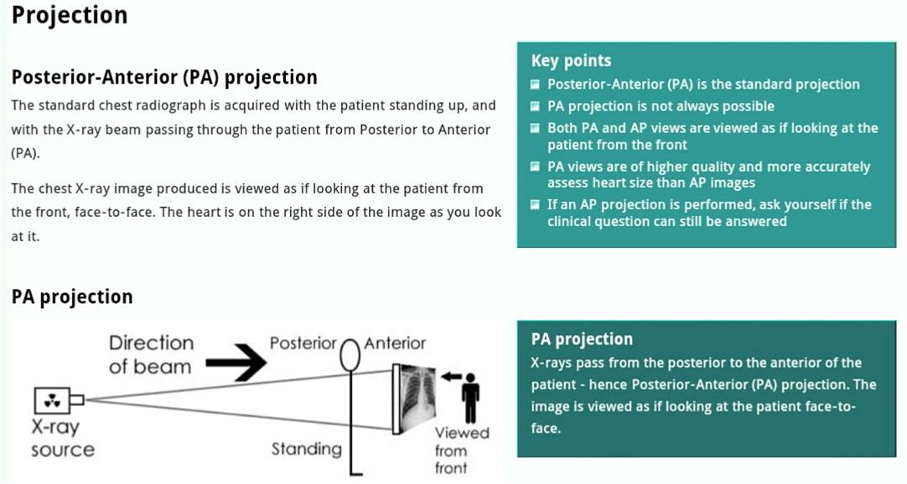

Slide 7
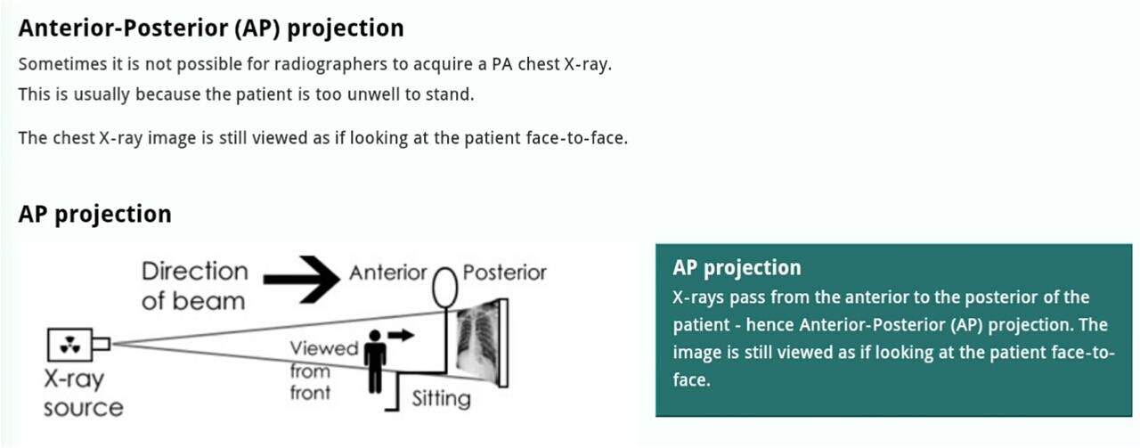

Slide 8
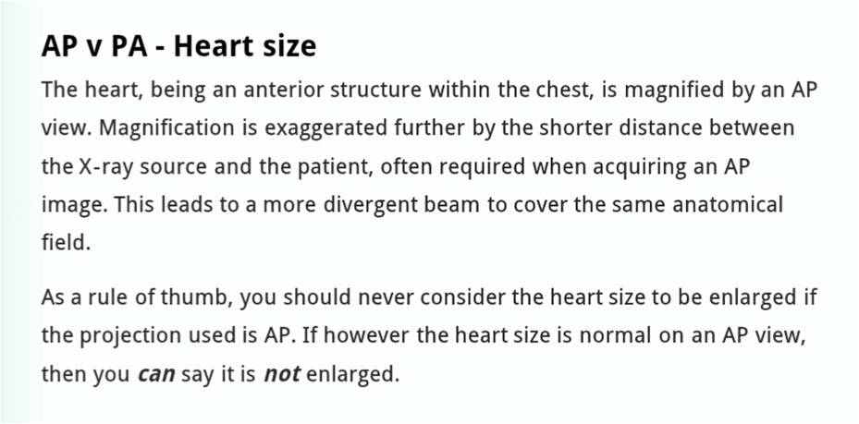

Slide 9
2. Orientation
Identify the left/right markings
Identify the anatomical structures, erect/supine.
Do not always assume that the heart will always be on the left because certain pathologies can result with mediastinal shift, dextrocardia can also be a possibility.
You do not have to solely rely on just the CXR markings.

Slide 10
3. Rotation
Identify the medial ends of the clavicles and select one of the thoracic vertebra spinous processes that falls between them.
The medial ends of the clavicles should be equidistant from the spinous process, if that’s not the case then the X-Ray is rotated.

Slide 11
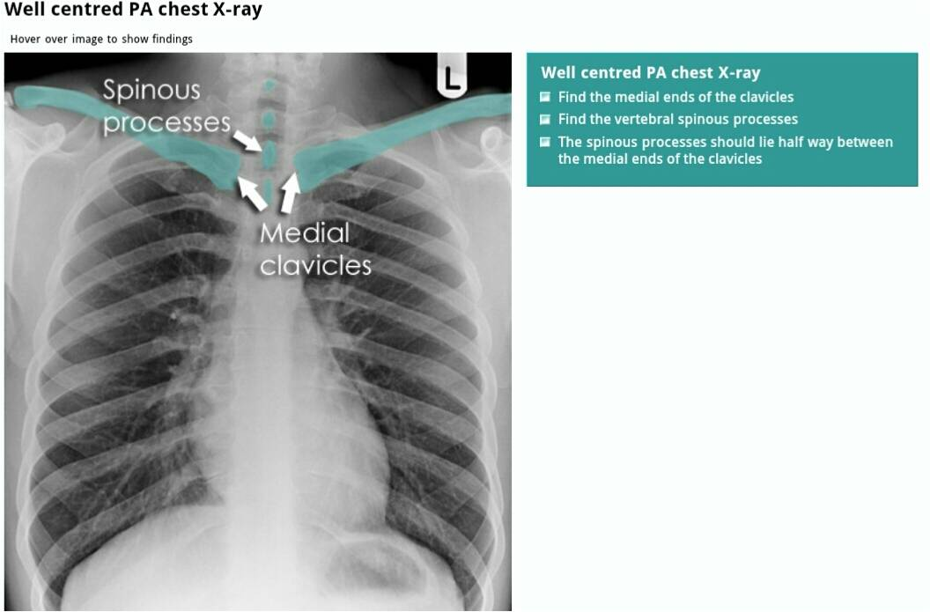

Slide 12
4. Inspiration (Degree of inspiration)
To judge the degree of inspiration, count the number of ribs above the diaphragm.
The midpoint of the right hemi-diaphragm should be between the 5th and 7th ribs anteriorly.
The anterior end of the 6th rib should be above the diaphragm as should the posterior end of the 10th rib.
If more ribs are visible the patient is hyperinflated
If fewer it indicates inadequate inspiration
Poor inspiration will make the heart look larger, give appearance of basal shadowing and cause the trachea to appear deviated to the right

Slide 13
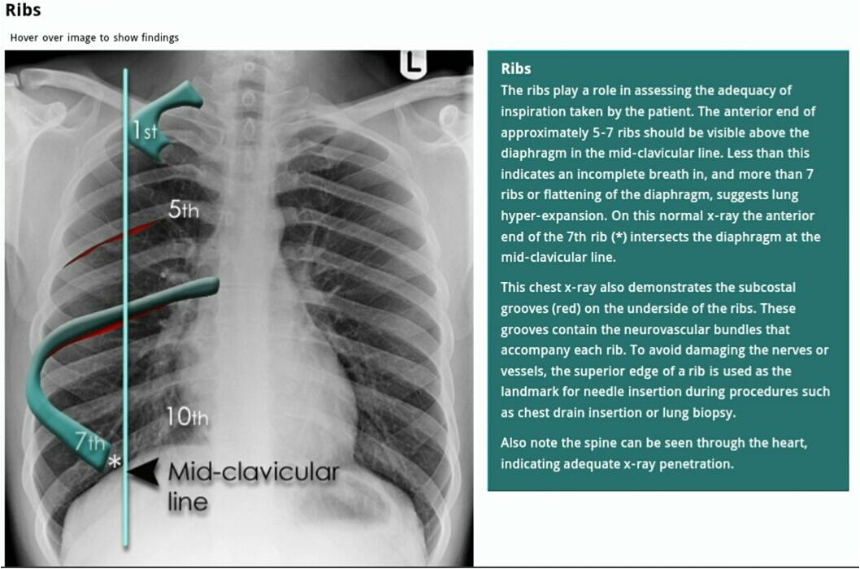

Slide 14
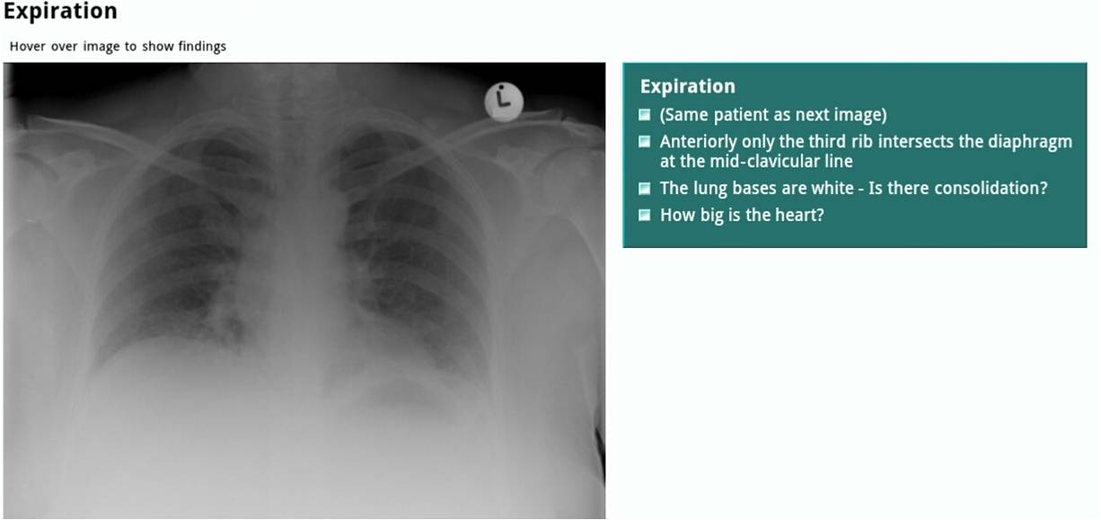
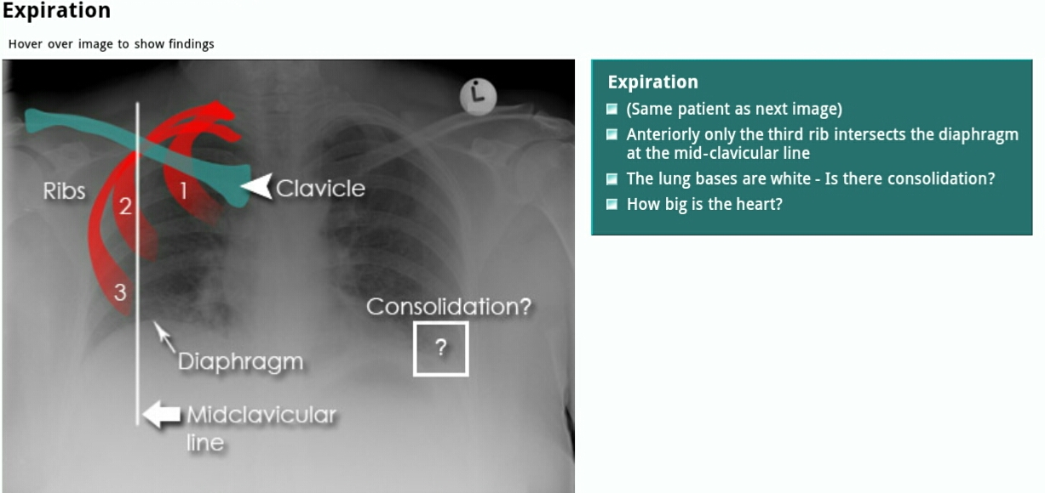

Slide 15
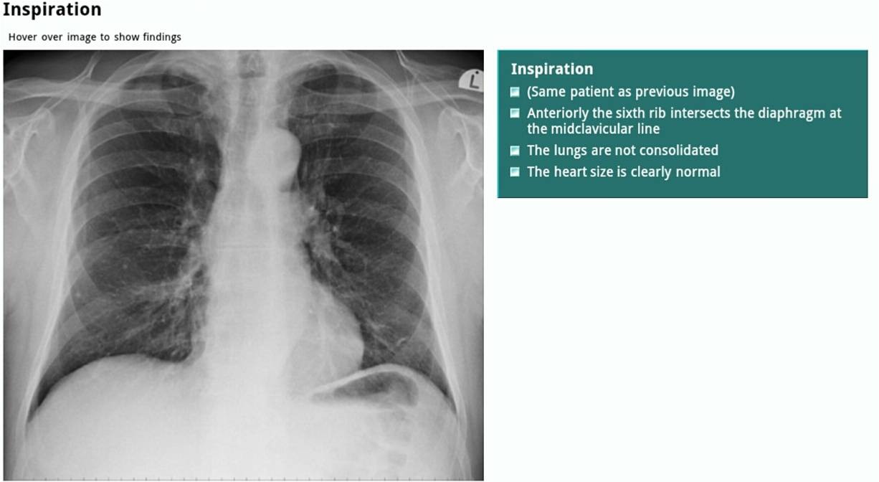
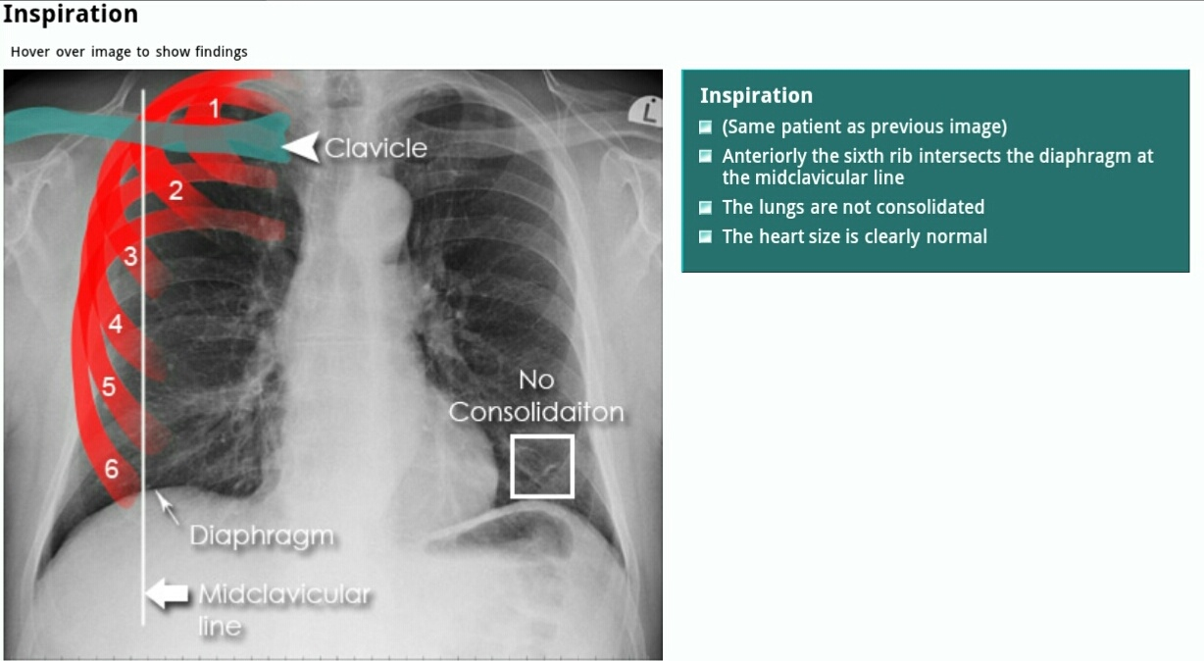

Slide 16
5. Penetration
To check the penetration, look at the lower part of the cardiac shadow
The vertebral bodies should be barely visible through the cardiac shadow at this point.
If they are clearly visible then the film is over penetrated and you may miss low density lesion.
If you cannot see them at all then the film is under penetrated and the lung fields will appear falsely opaque (white).
The left hemidiaphragm should be visible to the edge of the spine
When comparing X-Rays first determine if the level of penetration is similar.

Slide 17
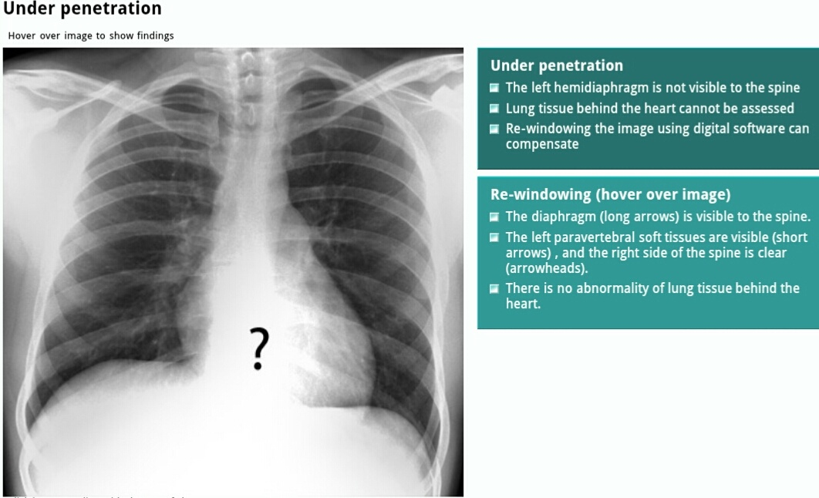
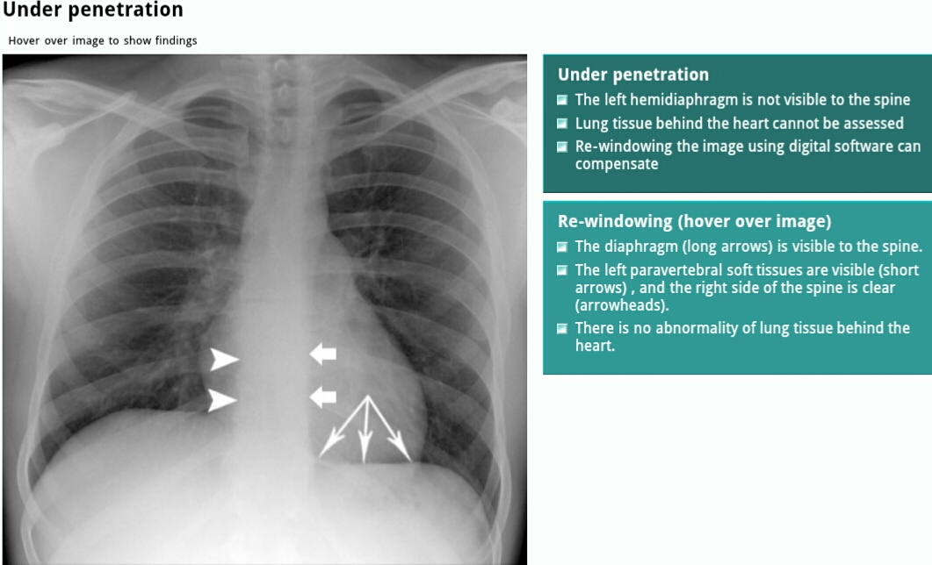

Slide 18
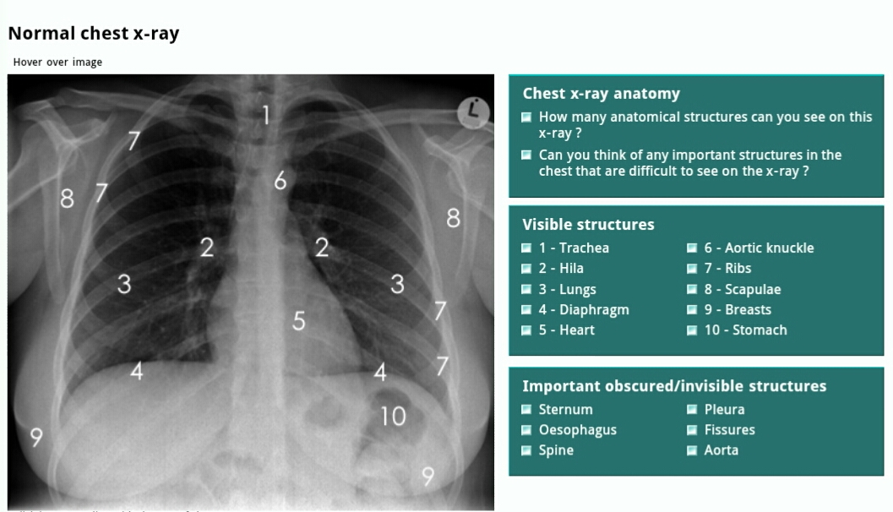
CHEST X-RAY ANATOMY

Slide 19
TRACHEA
It should be central or slightly deviated to the right.
- In case of deviation decide if is due to rotation or pathology
View the carina, angle should be between 60 –100 degrees.
Because it contains air, it appears darker (blacker/radiolucent).
Trachea normally narrows at the vocal cords (T3/T4)

Slide 20
2. HILAR STRUCTURES
Also called lung root, consists of the major bronchi and pulmonary vessels (veins/arteries).
The hila are not symmetrical but consist of the same basic structures.
The lymph nodes are also present but no visible unless abnormal.

Slide 21
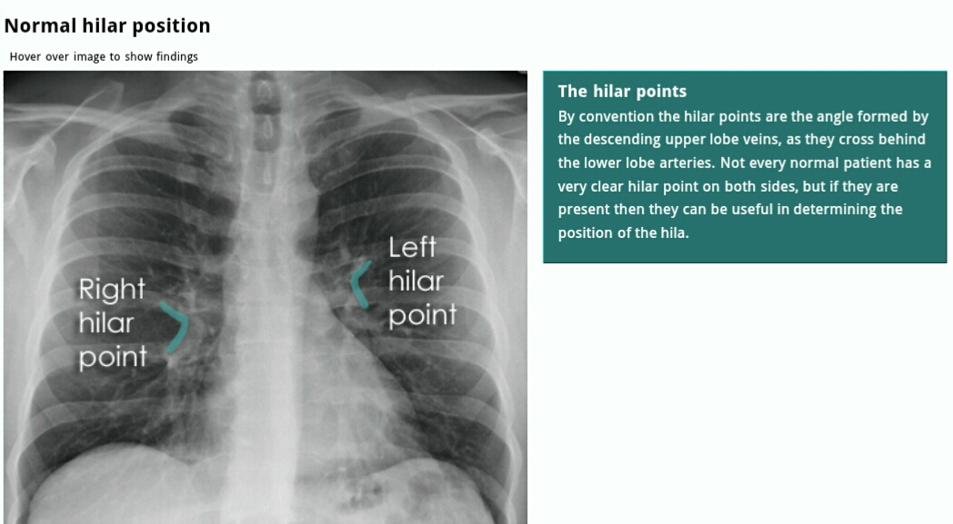

Slide 22
3. LUNGS
The lungs occupies the largest portion of the thoracic cavity.
The lungs are assessed and described by dividing them into upper, middle and lower zones.
The lung zones do not equate to lung lobes e.g. The lower zone on the right consists of middle and lower lobes.
Compare left with right.
Compare an area of abnormality with the rest of the lung on the same side.
If there is any asymmetry decide which side is abnormal

Slide 23
4. PLEURA AND PLEURAL SPACES
The pleura are only visible when there is an abnormality present.
This can be due to pleural thickening and fluid or air accumulating in the pleural spaces.
Lung markings should reach the thoracic wall

Slide 24
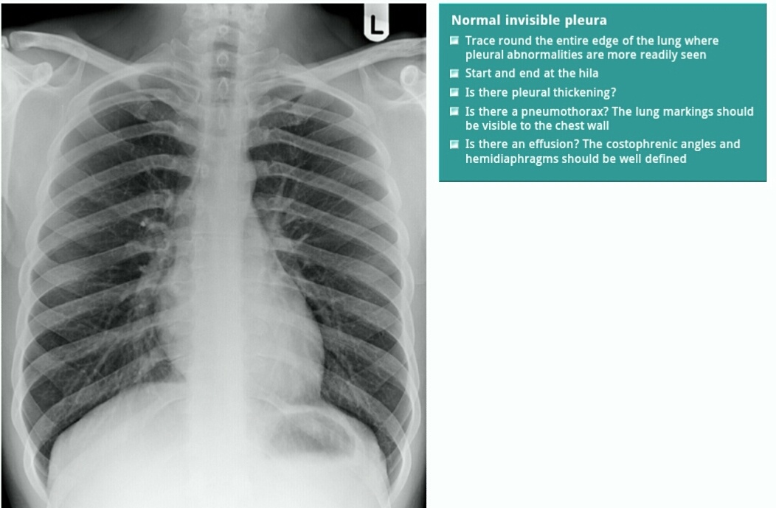

Slide 25
5. COSTOPHRENIC ANGLE AND RECESS
The costophrenic recesses are formed by hemidiaphragms and chest wall.
They contain the rim of the lung bases which lie over the dome of each hemidiaphragm.
These angles are known as the costophrenic angles.
Costophrenic angles should form acute angles that are sharp to the point.

