Slide 1
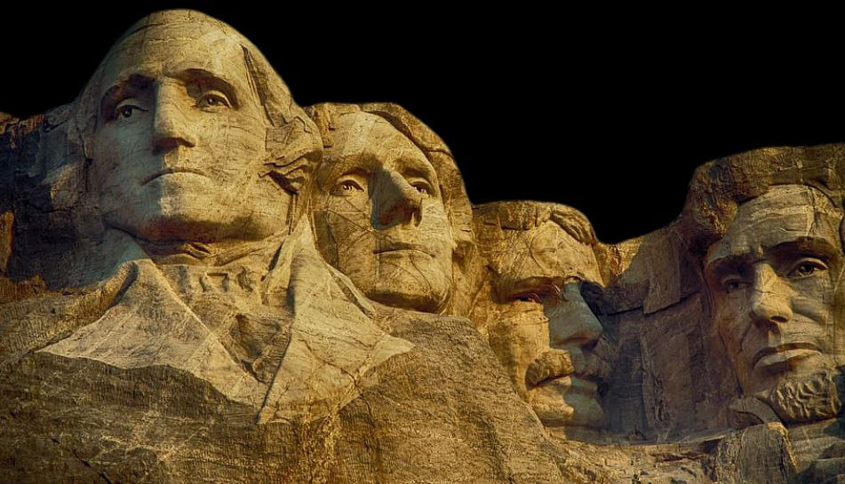
MOUNT RUSHMORE

Slide 2
MOUNT RUSHMORE

Slide 3
George Washington
Thomas Jefferson
MOUNT RUSHMORE
Abraham Lincoln
Theodore Roosevelt

Slide 4
George Washington
Thomas Jefferson
Abraham Lincoln
Theodore Roosevelt
George Washington: the birth of the nation
Leading the Revolution: Washington's leadership of the Continental Army during the Revolutionary War was critical in securing American independence from Great Britain.
First President: He was the unanimous choice for the first president and helped establish the foundations of the new government.
Because of these contributions, Borglum saw Washington as representing the birth of the United States..
MOUNT RUSHMORE

Slide 5
George Washington
Thomas Jefferson
George Washington: the birth of the nation
Abraham Lincoln
Theodore Roosevelt
Abraham Lincoln: the preservation of the nation
Leading the Revolution: Washington's leadership of the Continental Army during the Revolutionary War was critical in securing American independence from Great Britain.
Preserving the Union: Lincoln's leadership during the Civil War was instrumental in holding the United States together. He firmly believed that the nation's unity was paramount.
First President: He was the unanimous choice for the first president and helped establish the foundations of the new government.
Because of these contributions, Borglum saw Washington as representing the birth of the United States..
Emancipation Proclamation: Lincoln issued the Emancipation Proclamation in 1863, which declared enslaved people in Confederate states to be free. This was a major turning point in the war and a significant step towards ending slavery in the United States.Because of these actions, Borglum saw Lincoln as representing the preservation of the United States and the fight for a more just nation.
MOUNT RUSHMORE

Slide 6
George Washington
Thomas Jefferson
George Washington: the birth of the nation
Abraham Lincoln
Theodore Roosevelt
Abraham Lincoln: the preservation of the nation
Leading the Revolution: Washington's leadership of the Continental Army during the Revolutionary War was critical in securing American independence from Great Britain.
Preserving the Union: Lincoln's leadership during the Civil War was instrumental in holding the United States together. He firmly believed that the nation's unity was paramount.
First President: He was the unanimous choice for the first president and helped establish the foundations of the new government.
Because of these contributions, Borglum saw Washington as representing the birth of the United States..
Emancipation Proclamation: Lincoln issued the Emancipation Proclamation in 1863, which declared enslaved people in Confederate states to be free. This was a major turning point in the war and a significant step towards ending slavery in the United States.Because of these actions, Borglum saw Lincoln as representing the preservation of the United States and the fight for a more just nation.
MOUNT RUSHMORE

