Slide 1

Artificial Intelligence in Defence: A Strategic Imperative
Artificial Intelligence (AI) is rapidly transforming various sectors, and its impact on defence and national security is profound. This presentation explores the critical role of AI in modern defence strategies, examining its potential to revolutionise military capabilities, enhance decision-making, and reshape the geopolitical landscape. We will delve into the multifaceted applications of AI, from advanced intelligence gathering to autonomous systems, while also addressing the crucial ethical considerations and the importance of international collaboration.

Slide 2

The AI Revolution: Impact on Global Security
The advent of AI represents a pivotal moment in global security, promising a paradigm shift akin to the invention of gunpowder or nuclear weapons. AI's ability to process vast amounts of data, learn from patterns, and automate complex tasks introduces new dimensions to warfare and defence operations.
Key Impacts:
Accelerated Threat Analysis: AI can swiftly identify and analyse emerging threats, providing unprecedented situational awareness.
Enhanced Operational Efficiency: Automation of routine tasks allows human personnel to focus on strategic planning and complex problem-solving.
New Forms of Warfare: The rise of autonomous weapons systems and cyber warfare capabilities introduces entirely new operational domains.
Geopolitical Shifts: Nations that master AI in defence stand to gain significant strategic advantages, potentially reshaping global power dynamics.
Deterrence and Stability: AI can contribute to enhanced deterrence by improving surveillance and response capabilities, potentially fostering greater stability.

Slide 3

Defining AI in Defence: Capabilities and Applications
AI in defence encompasses a broad spectrum of technologies and applications, all aimed at improving military effectiveness, safety, and strategic advantage. These capabilities range from data analysis to physical autonomy.
Intelligent Data Processing
Autonomous Systems
AI algorithms excel at sifting through vast datasets from various sources, such as surveillance feeds, intelligence reports, and communication intercepts, to identify critical patterns and anomalies.
This includes unmanned aerial vehicles (UAVs), unmanned ground vehicles (UGVs), and autonomous maritime systems capable of operating with varying degrees of independence, from reconnaissance to combat roles.
Enhanced Decision Support
Cyber Defence & Offence
AI provides commanders with real-time, actionable insights, helping them make faster and more informed decisions in complex and rapidly evolving operational environments.
AI is crucial for detecting sophisticated cyber threats, automating responses to attacks, and developing advanced offensive cyber capabilities to protect national interests.

Slide 4

Enhancing Decision-Making: AI-Powered Intelligence
In modern warfare, the ability to make rapid, informed decisions can be the difference between success and failure. AI significantly augments human intelligence analysts and commanders by providing superior data processing and predictive capabilities.
Key Contributions:
Faster Information Processing: AI can ingest and analyse petabytes of data from diverse sources – satellite imagery, social media, intercepted communications – far quicker than human teams.
Pattern Recognition: It identifies subtle patterns and correlations that might be missed by human analysts, revealing hidden threats or opportunities.
Predictive Analytics: AI models can forecast potential adversary actions, predict equipment failures, or anticipate logistical challenges, allowing for proactive planning.
Situational Awareness: By integrating and visualising vast amounts of real-time data, AI provides a comprehensive and constantly updated common operating picture.
Resource Optimisation: AI can recommend optimal deployment of resources, from personnel to equipment, based on current intelligence and mission objectives.
This allows human operators to focus on higher-level strategic thinking, judgment, and nuanced ethical considerations, rather than being overwhelmed by raw data.

Slide 5



Autonomous Systems: Reshaping the Battlefield
Autonomous systems, powered by AI, are poised to fundamentally alter the nature of military operations. These systems can perform tasks without continuous human intervention, offering significant advantages in dangerous or inaccessible environments.
Unmanned Aerial Vehicles (UAVs)
Unmanned Ground Vehicles (UGVs)
Autonomous Maritime Systems
Used for reconnaissance, surveillance, target acquisition, and even strike missions, operating with greater endurance and reduced risk to human pilots.
Deployed for explosive ordnance disposal, logistics, perimeter security, and combat support, reducing soldier exposure to direct threats.
Performing undersea surveillance, mine countermeasures, and intelligence gathering in challenging aquatic environments.
The development of these systems necessitates careful consideration of ethical guidelines, command responsibility, and the potential for unintended escalation.

Slide 6
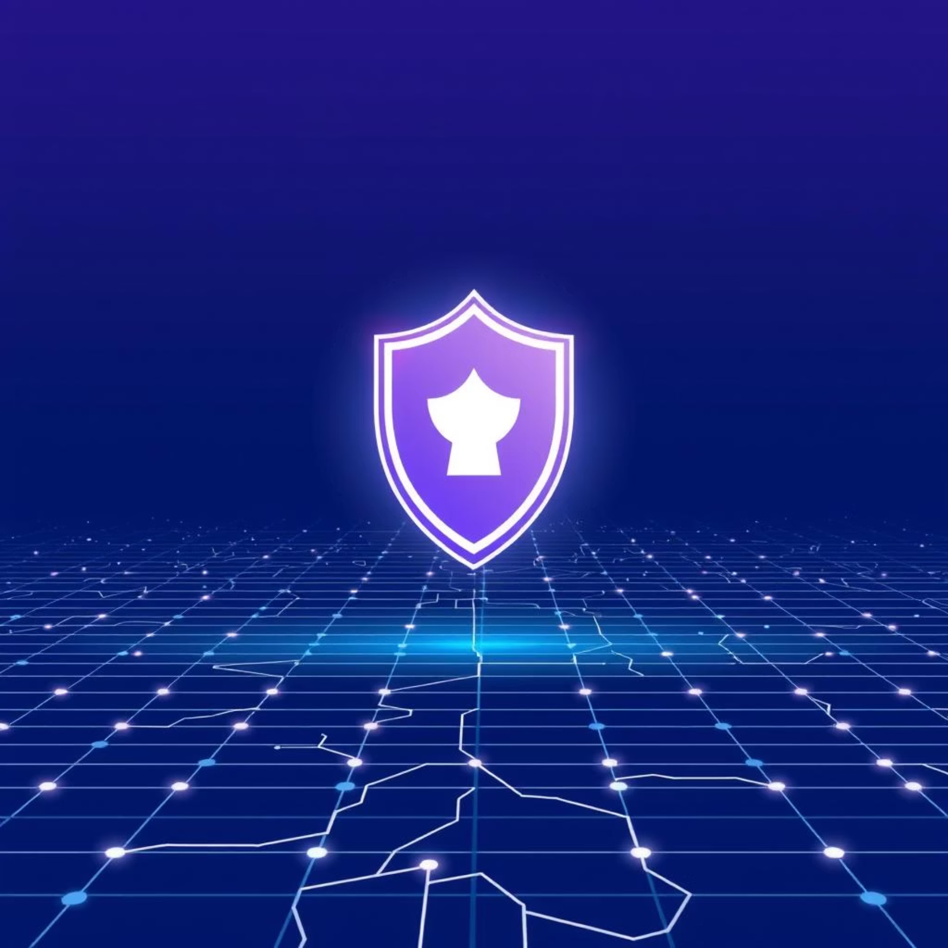

Cybersecurity and AI: Protecting Critical Infrastructure
As defence systems become increasingly digitalised and interconnected, cybersecurity becomes paramount. AI is a double-edged sword in this domain, simultaneously offering powerful defensive capabilities and posing new offensive threats.
AI for Cyber Defence:
Threat Detection: AI algorithms can detect anomalies and identify sophisticated cyber-attacks faster than traditional methods, often predicting attacks before they fully manifest.
Automated Response: AI can initiate rapid, automated responses to mitigate threats, isolating compromised systems and preventing wider damage.
Vulnerability Management: Machine learning can analyse vast codebases to identify potential vulnerabilities in software and systems.
Behavioural Analytics: AI monitors network and user behaviour to flag suspicious activities that deviate from established norms.
The constant evolution of cyber threats means that AI-driven defence mechanisms must also continuously adapt and learn to remain effective against increasingly intelligent adversaries.

Slide 7
Ethical Considerations: Responsible AI Development and Deployment
The integration of AI into defence raises profound ethical questions that demand careful consideration and robust frameworks. Ensuring the responsible development and deployment of AI is crucial to maintaining public trust and upholding international humanitarian law.
Accountability
Lethal Autonomous Weapons Systems (LAWS)
Who is responsible when an autonomous system makes a decision with unintended consequences? Establishing clear lines of accountability for AI actions is critical.
The debate surrounding 'killer robots' and the degree of human control required over lethal force decisions is one of the most pressing ethical challenges.
Bias and Discrimination
Transparency and Explainability
AI systems are only as unbiased as the data they are trained on. Biased data can lead to discriminatory outcomes, which is unacceptable in defence applications.
Understanding how AI reaches its conclusions ('explainable AI') is vital for auditing, correcting errors, and building trust in these complex systems.
International dialogues and national policies are actively working to address these complex issues, aiming to harness AI's potential while mitigating its risks.

Slide 8




International Collaboration: Shaping the Future of Defence AI
The global nature of AI development and its implications for defence necessitate strong international collaboration. No single nation can unilaterally address the challenges and opportunities presented by AI in this domain.
Shared Norms
Joint Research
Developing international norms and standards for the responsible use of AI in military applications.
Collaborative research and development efforts to advance AI capabilities and counter emerging threats.
Diplomacy
Security Protocols
Engaging in diplomatic discussions to manage the risks of AI proliferation and ensure strategic stability.
Establishing common security protocols and best practices to prevent AI systems from being exploited by malicious actors.
Partnerships between allied nations are essential for pooling resources, sharing expertise, and developing interoperable AI systems that enhance collective security.

Slide 9

The UK's Vision: Investing in AI for National Security
The United Kingdom recognises AI as a critical component of its future defence capabilities and has committed significant investment and strategic planning to integrate AI across its armed forces.
Key Pillars of the UK's Strategy:
Dedicated AI Centre: Establishment of dedicated AI centres and hubs to drive innovation and expertise within the Ministry of Defence (MOD).
Skilled Workforce: Investing in training and recruitment to build a highly skilled workforce capable of developing, deploying, and maintaining AI systems.
Ethical Frameworks: Prioritising the development of robust ethical guidelines and legal frameworks for AI use in defence, aligning with international standards.
Industry Partnerships: Fostering collaboration between government, academia, and defence industry partners to accelerate AI adoption and capability development.
International Cooperation: Actively participating in international forums and partnerships to shape global norms and standards for defence AI.
This comprehensive approach aims to position the UK as a leader in responsible defence AI, ensuring national security in an increasingly complex global environment.

Slide 10
Q&A and Next Steps: Driving Innovation Responsibly
We have explored the transformative potential of Artificial Intelligence in defence, its diverse applications, the ethical dilemmas it presents, and the collaborative efforts required to manage its impact.
Your Questions:
Key Takeaways:
Next Steps:
We now open the floor for your questions and insights on this critical subject. Your perspectives are invaluable in shaping a comprehensive understanding of AI's role in future defence strategies.
AI is an indispensable tool for modern defence, enhancing intelligence, autonomy, and cybersecurity.
Continued dialogue, policy refinement, and sustained investment in ethical AI research will be essential to harness its benefits for national and international security responsibly.
Ethical considerations and responsible development are paramount.
International collaboration is crucial for managing risks and ensuring global stability.

