Slide 1
COMMON EUROPEAN
FRAMEWORK
OF REFERENCR (CEFR)

Slide 2
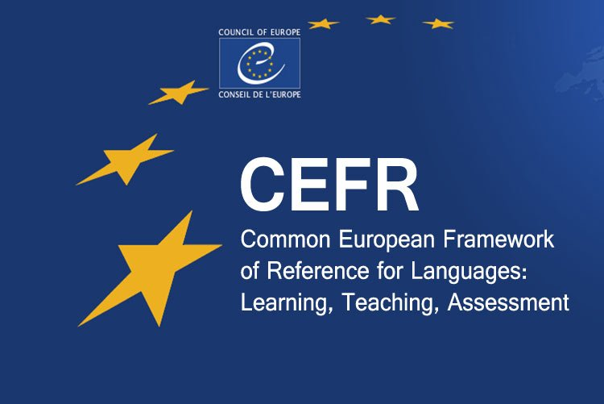

Slide 3
What is CEFR?
The CEFR is a framwork published by the Council of Europe in 2001 which describes language learnerrs ability in terms of speaking, reading, listening and writing at six reference levels.
Main Purpose of CEFR is to provide methodological options of learning, teaching and assessing which applies to all languanges in Europe

Slide 4
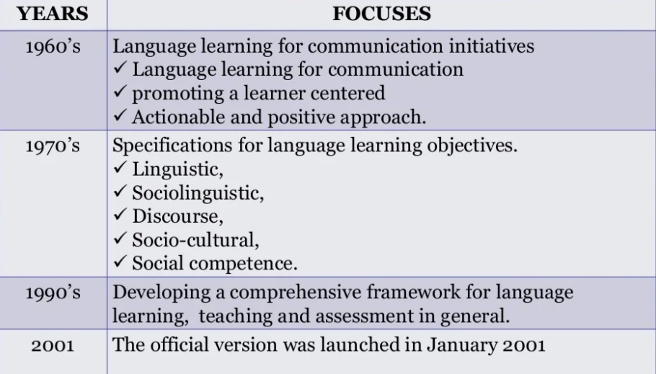
Historical Review

Slide 5
Common European framework of Reference
Framework- a system of rules, ideas, or beliefs that is used to plan or decide something

Slide 6
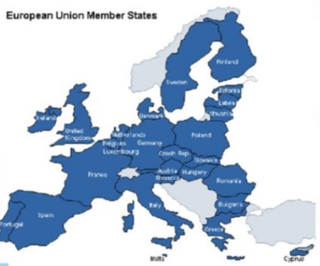
European Union: 28 countries, a diversity of languages
Languages are one of the key features of cultural identity
Language skills are crucial for economic growth, jobs and mobility
Standardization will help EU labour market to develop

Slide 7
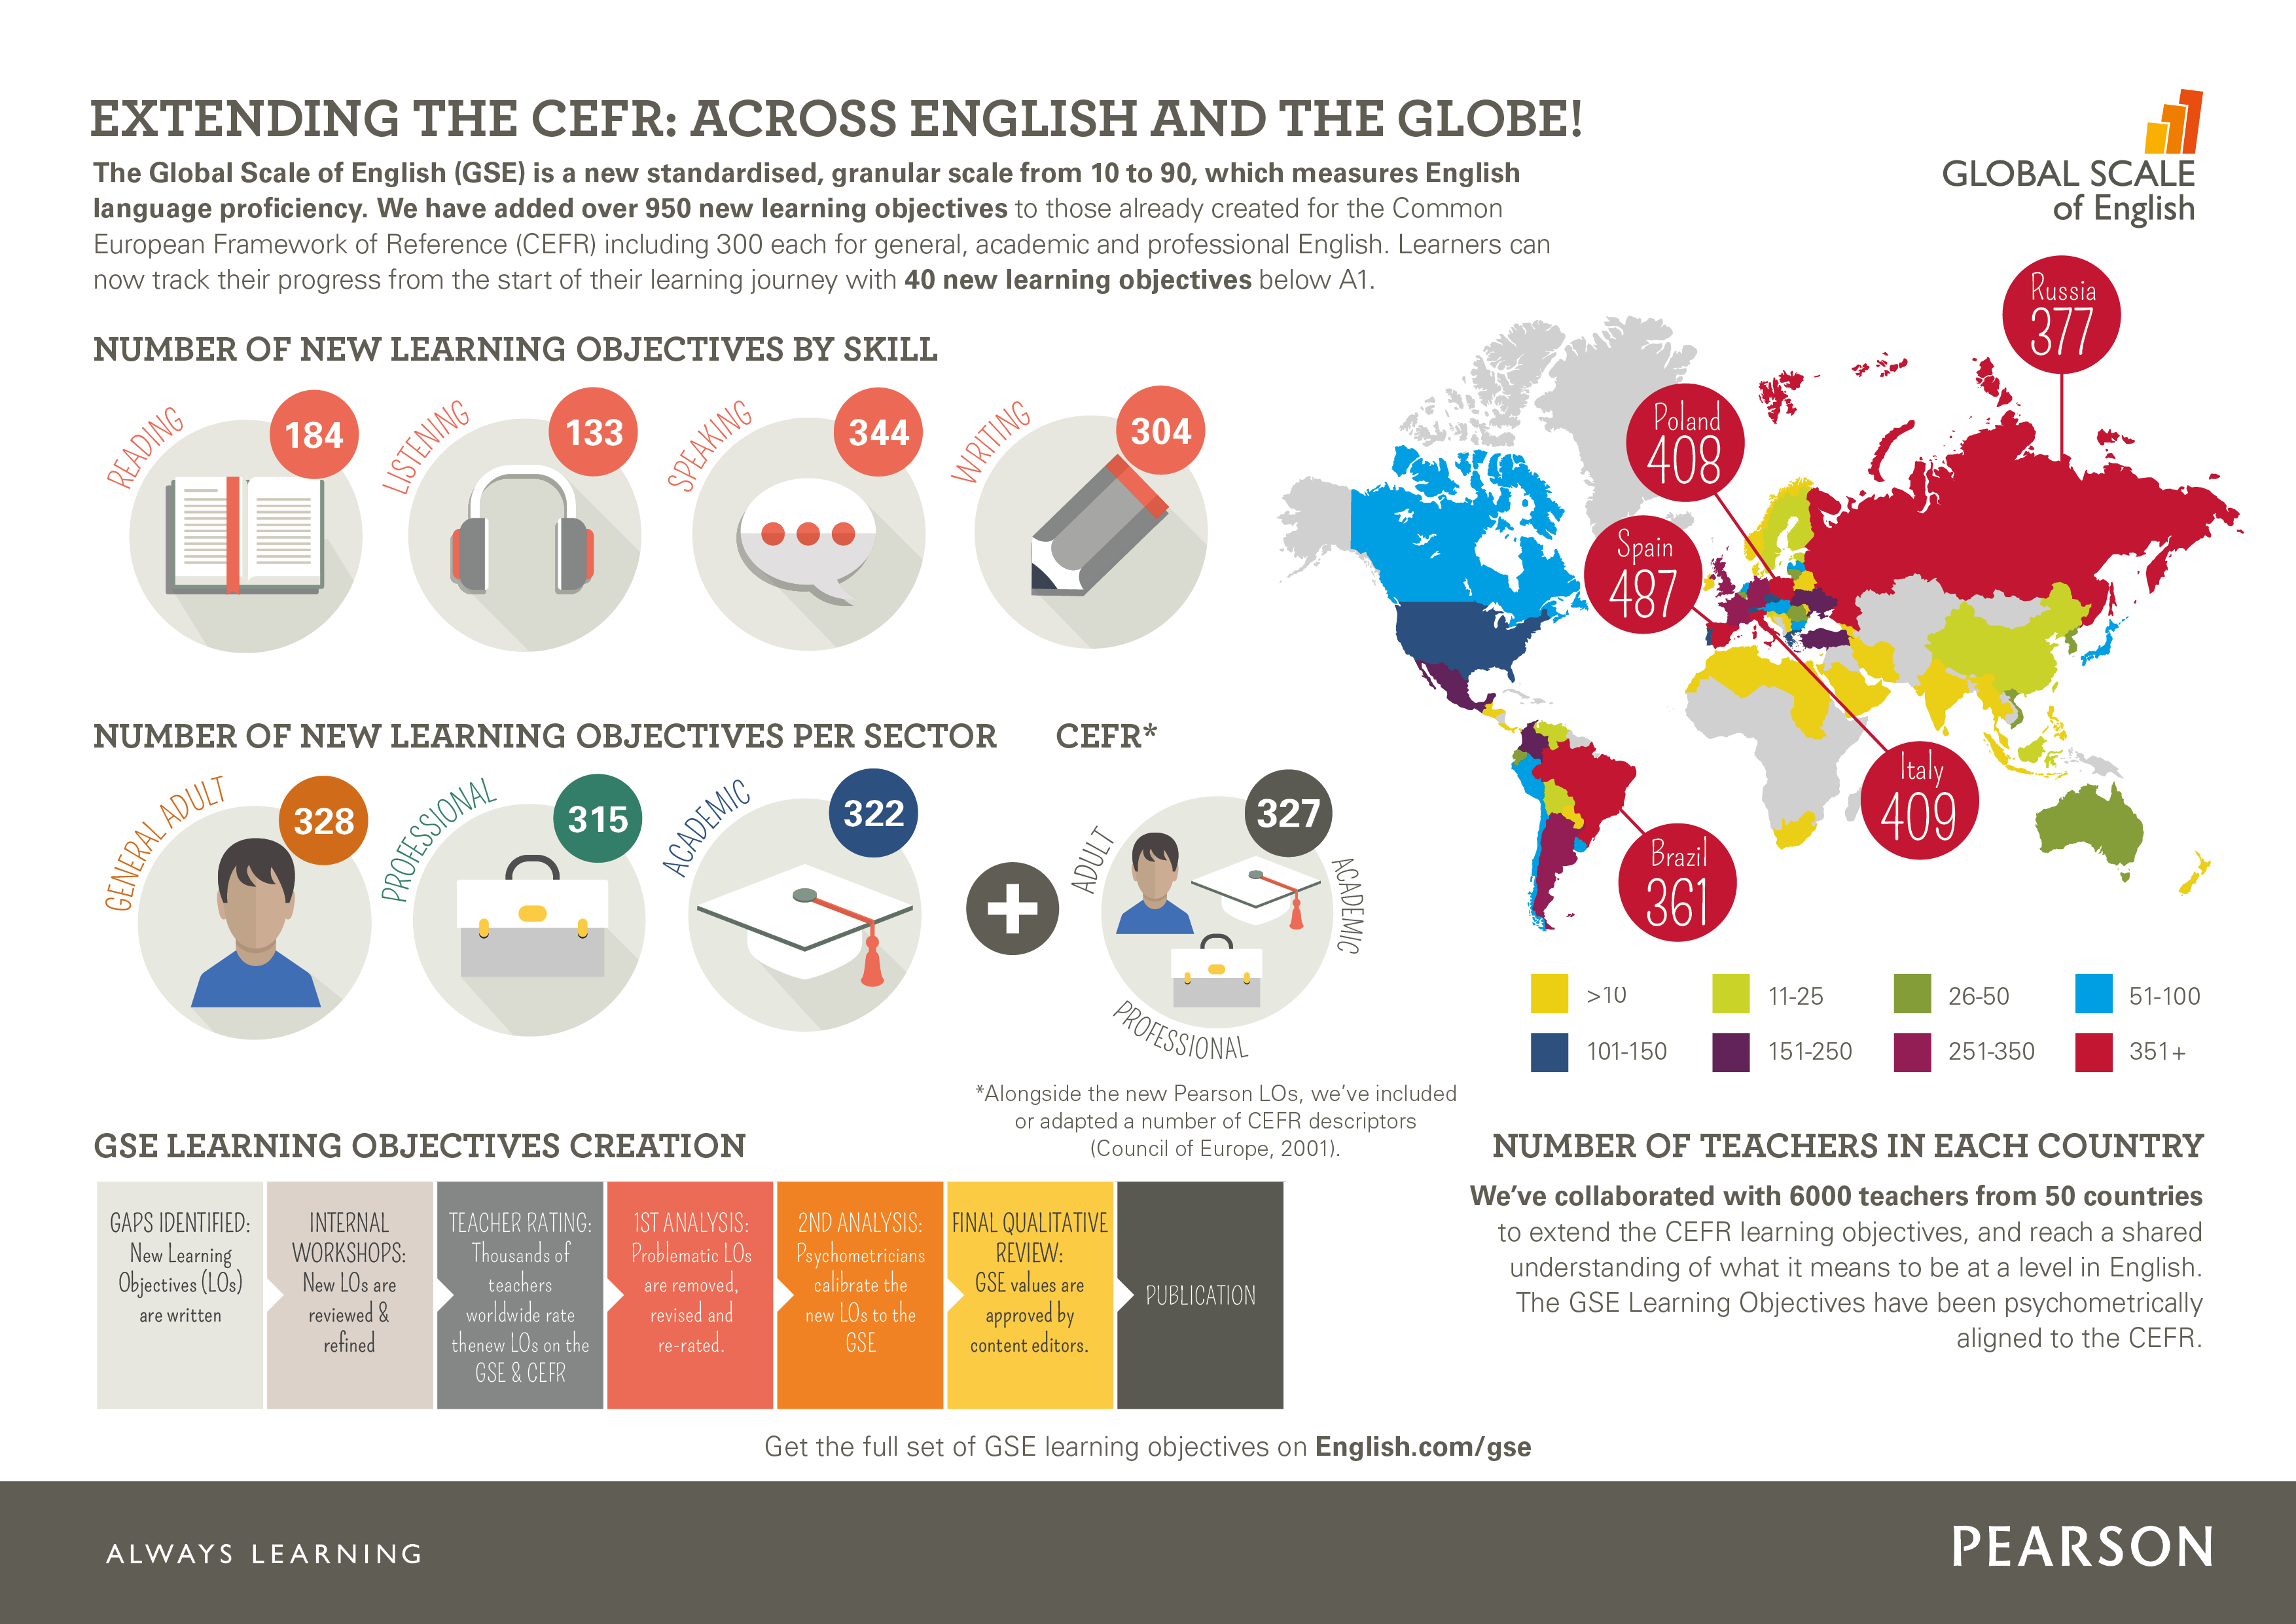

Slide 8
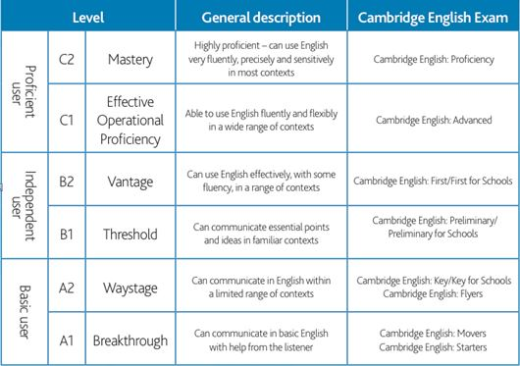

Slide 9
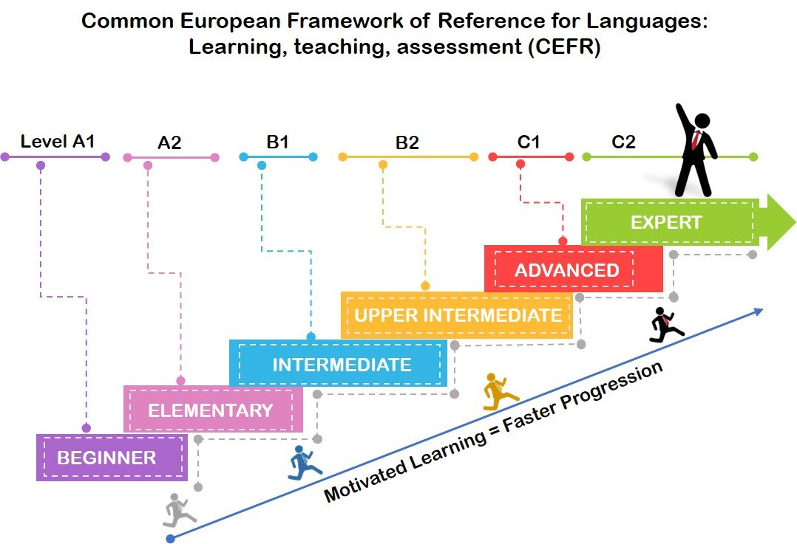

Slide 10
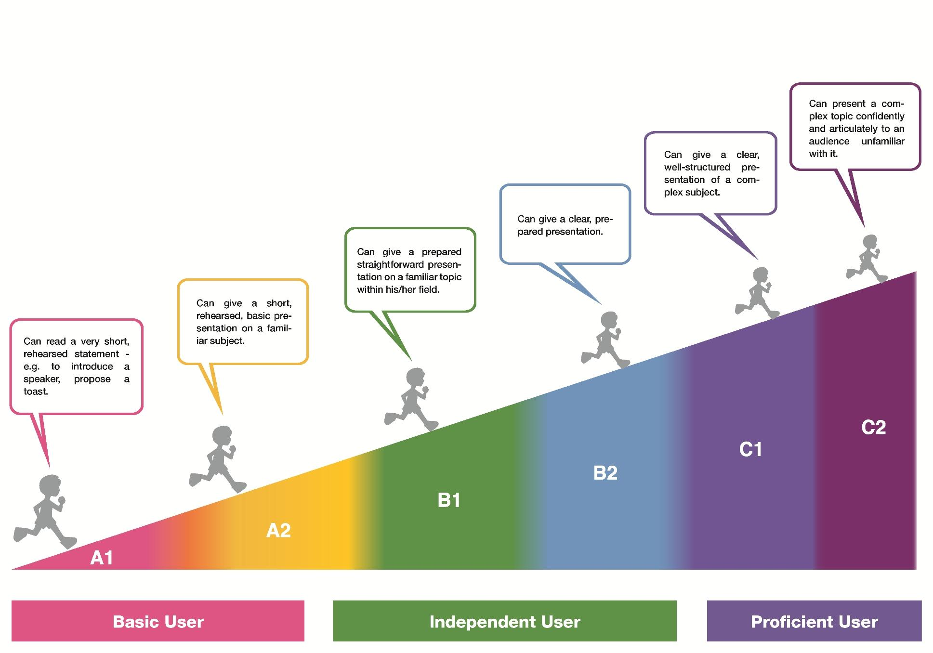

Slide 11
CEFR uses and users:
The overarching goal : increase transparency of language education
Uses
setting targets for particular groups of learners;
determine the language ability needed to do an activity;
designing language tests;
comparting language qualifications;
reflecting on and describing teaching practice.

Slide 12
Language activities
Production
Speaking
Writing
Recepition
Reading
Listening
Interaction
All 4 skills
..

Slide 13
Productive scales: Speaking
Overall oral production
Sustained monolopgue describing experience
Addressing the audience
Public announcements
Sustained monolopgue (putting up a case or a debate)

Slide 14
Receptive scales
Overall listening comprehension
Understanding interaction between native speakers
Listening as a member of a live audience
Listening to announcements and instructions
Listening to audio, media and recording
Listening

Slide 15
Pruductive scalesa: Writing
Overall written production
Creative writing
Reports and essays

Slide 16
Receptive scales
Overall reading comprehension
Reading correspondence
Reading for orientation
Reading for information and argument
Reading instructions
Reading

Slide 17
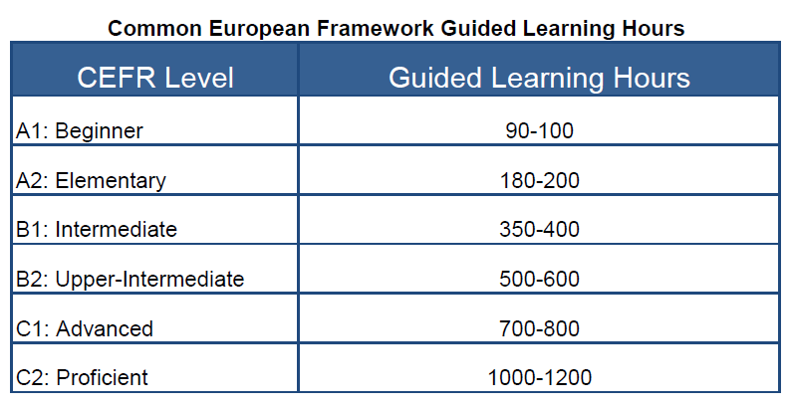

Slide 18
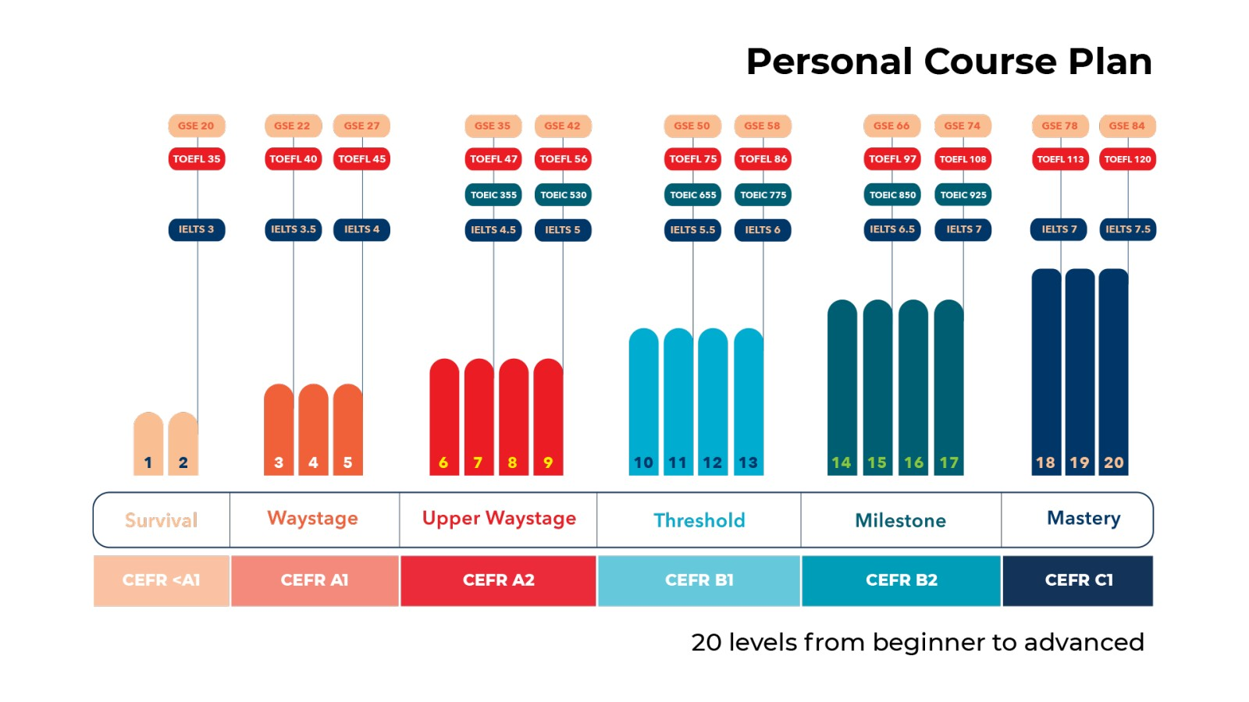

Slide 19


