Slide 1

Celebrating Brilliance: A Journey Through Nobel Laureates
The Nobel Prize represents the pinnacle of human achievement, honoring individuals whose extraordinary work has transformed our understanding of the world and improved countless lives. Since 1901, these distinguished laureates have illuminated paths of knowledge, peace, and progress.

Slide 2
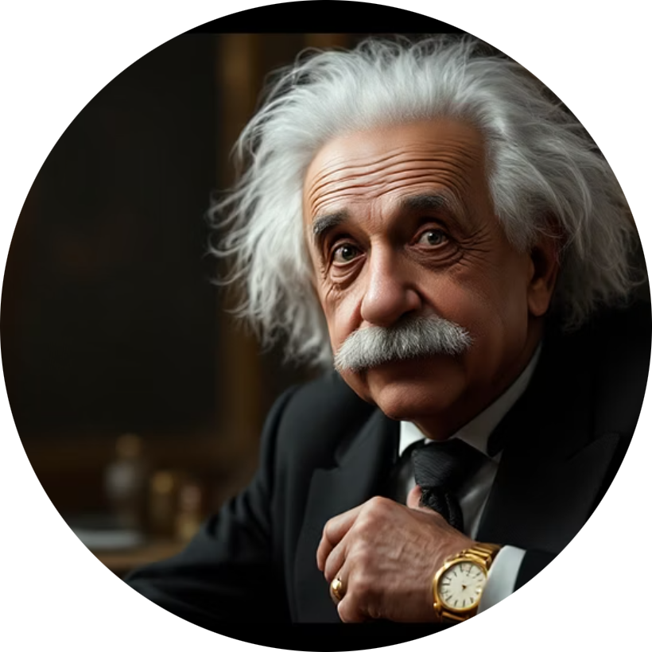

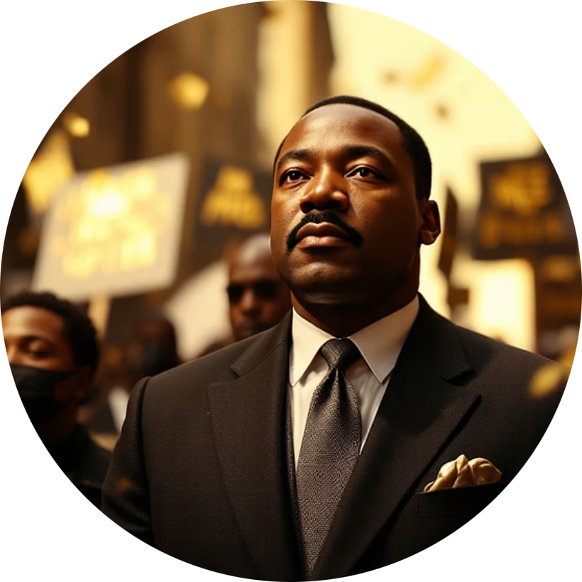

Moments of Discovery: Impactful Contributions Across Disciplines
Physics Revolution
Chemistry Breakthrough
Peace Advocacy
Medical Milestones
Einstein's theory of relativity reshaped our understanding of space, time, and gravity, fundamentally altering physics forever.
Curie's pioneering research on radioactivity opened new frontiers in medicine and science, earning her two Nobel Prizes.
Peace laureates like King and Mandela championed justice, equality, and nonviolent change across generations.
Discoveries in medicine have saved millions of lives, from DNA structure to groundbreaking treatments and vaccines.

Slide 3

Beyond the Prize: Their Enduring Legacy and Inspiration
A Lasting Impact
Continuing Inspiration
Nobel laureates inspire future generations of scientists, writers, and peacemakers. Their work continues to shape research, policy, and thought worldwide.
Their dedication to knowledge and humanity reminds us that individual commitment can create lasting change.
Advancing scientific research and innovation
Shaping public policy and humanitarian efforts
Mentoring emerging talent across disciplines

