Slide 1

Xiva haqida
𝗬𝗨𝗟𝗗𝗔𝗦𝗛𝗘𝗩

Slide 2
Plan:
1. Plan1
2. Plan2
3. Plan3

Slide 3
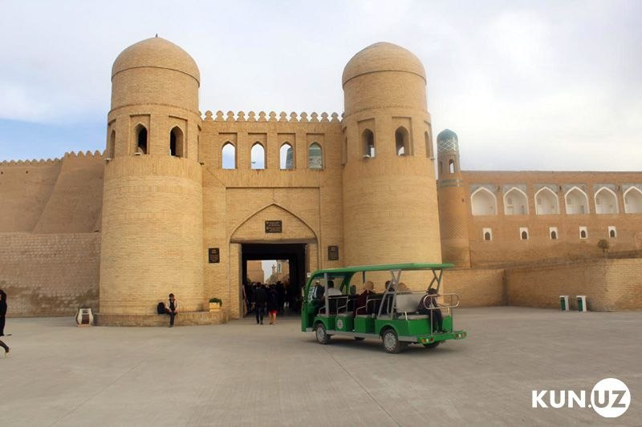
Slide1
Point1
Point2

Slide 4
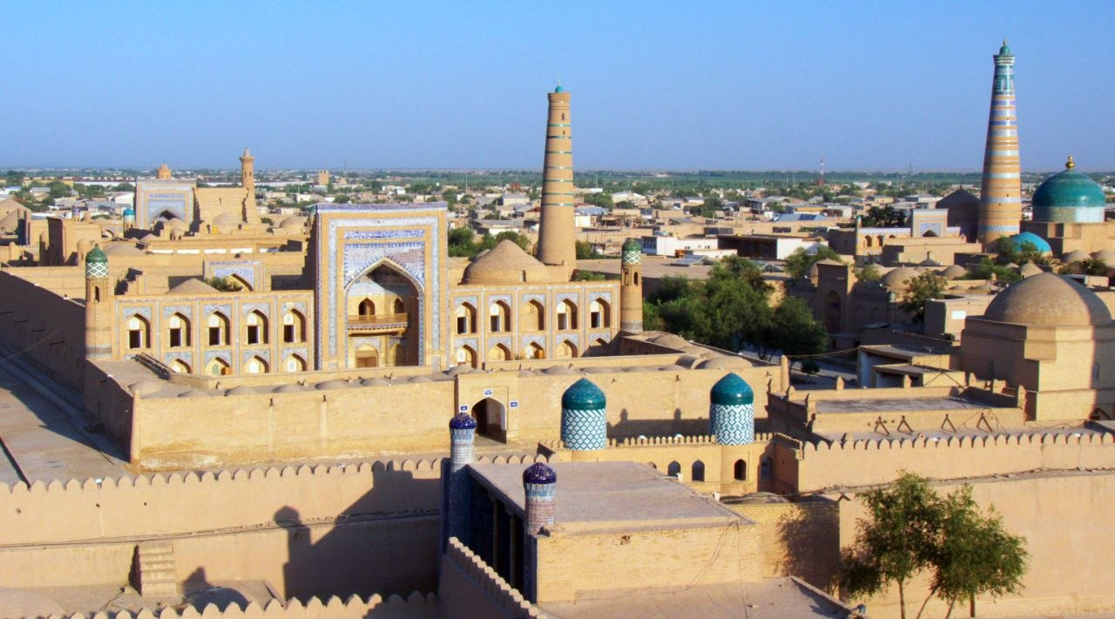
Slide 2
Content point
Content point

Slide 5
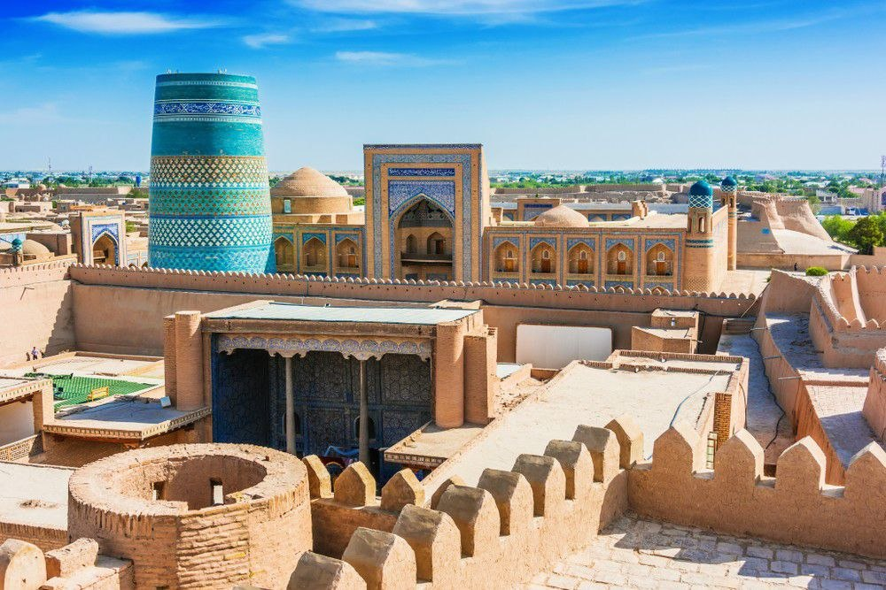
Slide 3
Content point
Content point

Slide 6
Thank you for your attention

