Slide 1


RIMBERIO.CO
BUSINESS
PROPOSAL
CONNECTING ALL OF US WITH THE WORLD

Slide 2

INTRODUCTION
CONNECTING ALL OF US WITH THE WORLD

Slide 3

CONTENT INDEX
  ABOUT US
  VALUES
  OUR TEAM
  SERVICES
  Projects
  Project Timeline
  PRICING PACKAGE
  Testimonials
  Contact

Slide 4


ABOUT US
WE ARE A COMMUNICATION AND INTERNET PROVIDER THAT HAS BEEN OPERATING FOR THE PAST 30 YEARS. THE EMERGENCE AND PROLIFERATION OF THE INTERNET HAS ENABLED US THE CHANCE TO PROGRESS AS A COMPANY OVER THE DECADES. CURRENTLY, WE OFFER THE BEST DEDICATED INTERNET SERVICES FOR INDIVIDUALS, HOUSES, BUSINESSES, AND OTHER INSTITUTIONS TO CONNECT THEM TO ADDRESS ALL OF THEIR NEEDS.

Slide 5


VALUES
Vision
Mission
TO MAINTAIN THE HIGHEST LEVELS OF QUALITY SERVICES SO THAT WE CAN PROVIDE THE BEST INTERNET SERVICES IN THE COUNTRY.
TO EXCEED THE EXPECTATIONS OF THE CUSTOMERS AND PROVIDE THEM WITH THE BEST INTERNET SERVICES AND THE MOST RELIABLE SUPPORT SYSTEM.

Slide 6

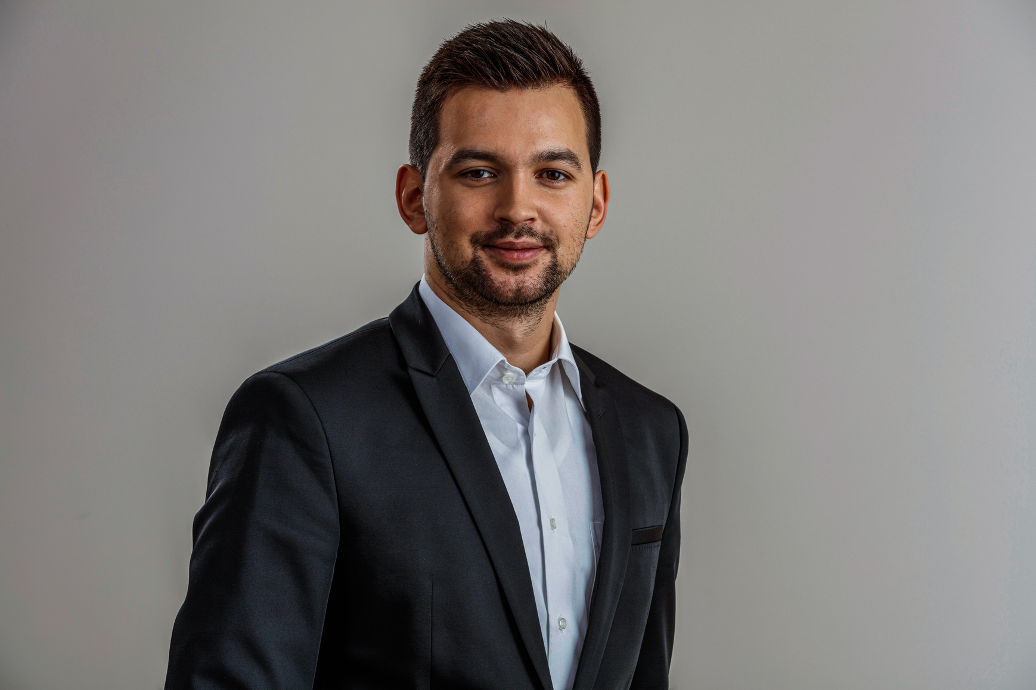

LORNA
ALVARADO
CAHAYA
DEWI
NEIL
TRAN
Communication Department
Internet
Department
Content
Department

Slide 7

SERVICES
1
NETWORK SOLUTION
A wide variety of easily scalably network solutions that can be easily integrated into any infrastructure.
2
WIRELESS TERRESTRIAL BROADBAND
Enables the lightning-speed network speed to the customers.
3
TELECOM VALUE ADDED SERVICE
An offering of relevant, customized, and content-based service over SMS, USSD, and WAP.

Slide 8

CLIENTS
OUR THOROUGH SERVICES HAVE WON THE AMAZEMENT AND LOYALTY FROM THE CLIENTS OVER THE DECADES
  Borcelle
  Ingoude Company
  Keithston and Partners
  Larana, Inc.
  Paucek and Lage
  Warner & Spencer

Slide 9

1
PROJECT
INGOUDE COMPANY (2019)
Wereless Terrestrial Broadband Provider

Slide 10

2
PROJECT
LARANA, INC, (2020)
Network Solution Service

Slide 11

3
PROJECT
WARNER & SPENCER (2022)
Telecom Value Added Service

Slide 12
1
BRIEF AND RESEARCH
Providing briefing to the client and doing research on the client’s precise internet needs
2
CUSTOMIZATION
Making adjustments on the service based on the client’s needs and setting its intended network range
3
EXECUTION
Installing the internet network’s facility in the intended location as desired by the client

Slide 13
PRICING PACKAGE
FULL SERVICE
FULL SERVICE
INDIVIDUAL SERVICE
Network Solution
Wireless Terrestrial Broadband Provider
Telecom Value Added Service
Routine checks for one year
Service adjustment in the sixth month
Full access to two of our main services
Routine checks for six months
Service adjustment in the sixth month
Pick one of our services
Routine checks for six months
Service adjustment in the sixth month
7000 / YEAR
6000 / YEAR
5000 / YEAR

Slide 14


TESTIMONIALS
PAUCEK AND LAGE
INGOUDE COMPANY
“The increasing use of digital service pushed us to look for trusted network vendors that can provide reliable services with friendly prices. After using the services of this company, we definitely can recommend this company to help your needs.”
“Before we used the services provided by this company, we’ve always had problems in setting the network ourselves and keeping them stable even for just a month. Now, after we cooperate with this company, those problems seem so far away.”

Slide 15


CONTACT US
123-456-7890
hello@reallygreatsite.com
www.reallygreatsite.com
www.reallygreatsite.com

