Slide 1
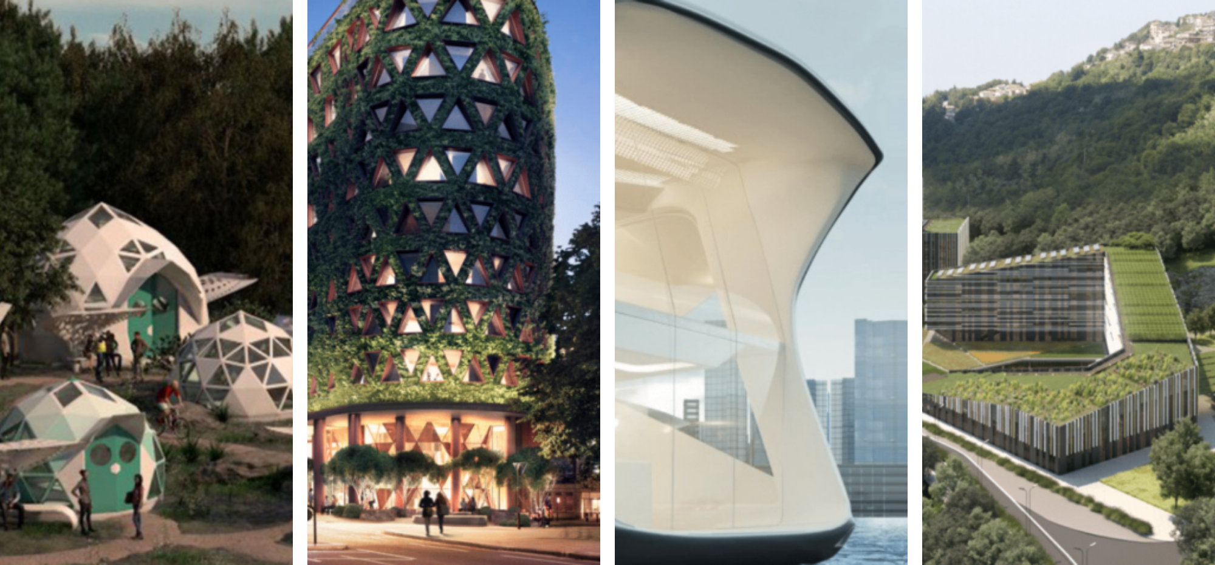
Theme : architectural innovation

Slide 2


Slide 3
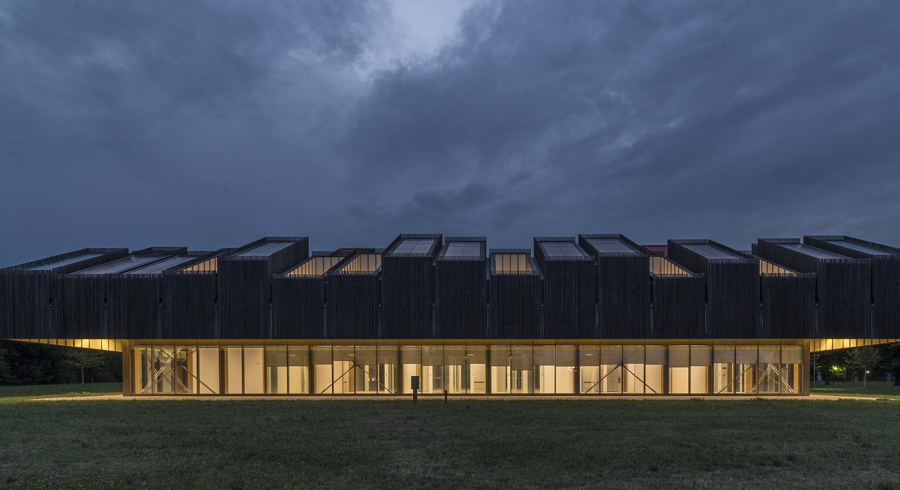
Population growth and the use of resources for construction will increasingly be crucial issues for the building industry. the forecasts presented by architecture 2030 are clear, and in order to meet the demand for housing and sustainable buildings we will need to build an incredible amount of square meters. In 2060 we will build more than twice what is currently existing on earth. If we want to discover answers to this emergency, the questions are: where will we find the resources to build new housing and where we will find the energy to maintain it? The EU is responding to these questions with a road map of precise objectives for the reduction of CO2 emissions and the construction of almost zero energy buildings.

Slide 4
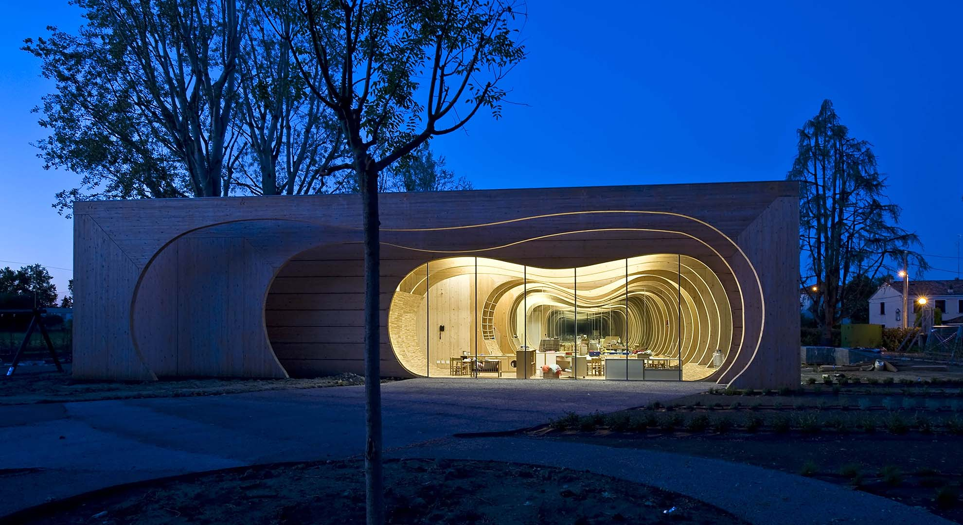
There are two main pillars of the definition of sustainability. One is related to performance, although a building is not only a technical object. The other part of sustainability is understanding how to properly design a building for a specific context based on “creative empathy.” It is the same way you create a human relationship; being empathetic means trying to understand others.
Architects need to think about how they can solve local problems, not global issues, which is the most interesting aspect of architecture: how a building’s design can be adapted to a specific culture. This is an empathic action because sustainable design can offer technical solutions, but in the end, you need an acquired level of learning to make this interpretation. This is why education is essential in order to inspire future generations regarding these concerns. The new generation of designers will need to understand the problems of today—such as the consequences related to CO2 and energy consumption—and what the next step will be for buildings.

Slide 5
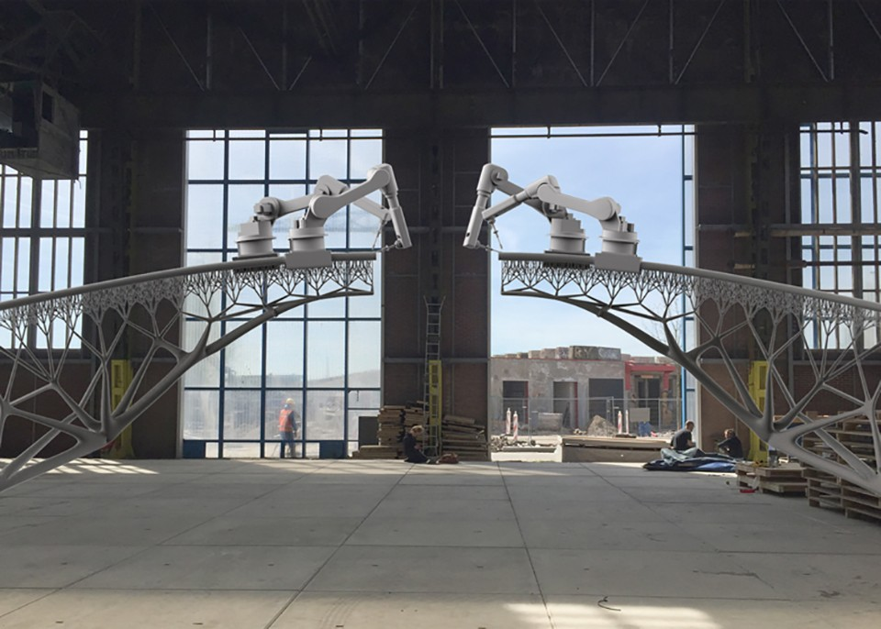
Architectural innovations like the steel-frame skyscraper have reshaped the built world's look and function. And every day, new technologies enable architects to address the challenges of the future. Chicago has long been an incubator for design innovation. Advances in engineering have led to supertall buildings that define skylines worldwide, big data has become an urban design material unto itself, and sustainable materials and 3d printing are helping us reimagine the built environment. Here, we’ll track the technical and creative developments that push architecture’s boundaries and impact our interactions with the world around us.

Slide 6
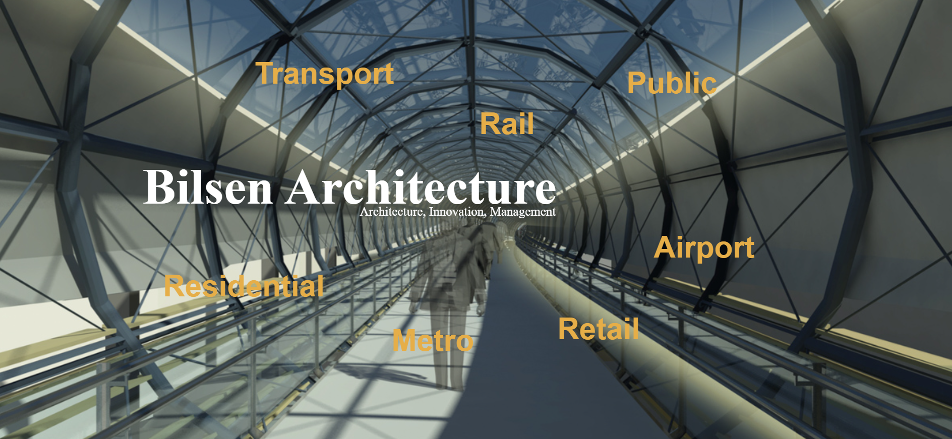

Slide 7
Who we are ? Bilsen architectuur is a dutch architectural design office. We consider ourselves to be part of a larger renowned dutch tradition in public building and infrastructural design. We have a humanistic approach to design, emphasizing the human scale and well being above any technical solution. Besides that inspiration is drawn from many current societal developments like green building, durable design, co-creating and many technical driven innovations for construction, energy and climate. We love to integrate all these into a flowing and functional design. What we do ? We translate the clients brief and the local site conditions into an attractive, outspoken and original design. a design with identity yet also fitting in the context. A building to be most advance yet acceptable (maya), to quote raymond loewy. Our expertise is in public and spatial projects where architecture, urban design and infrastructure blend. We perform specialist architectural design of railway stations, metro, park & ride facilities and bridges. An independent advising role is taken in projects. We manage the design process with an emphasis on content and quality, and guard the concept along the various project phases, from preliminary design through to execution on site.

Slide 8
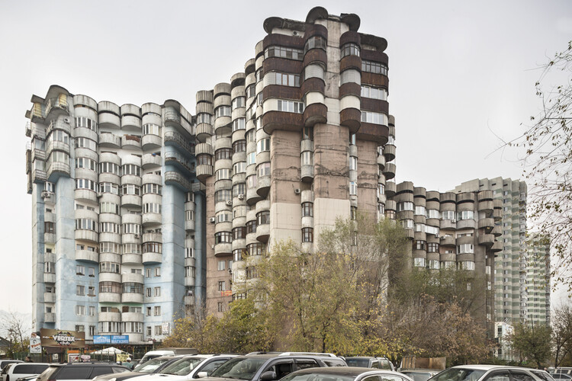
Brutalism in Central Asia: The Eastern Influences that Shaped Soviet Architecture

Slide 9
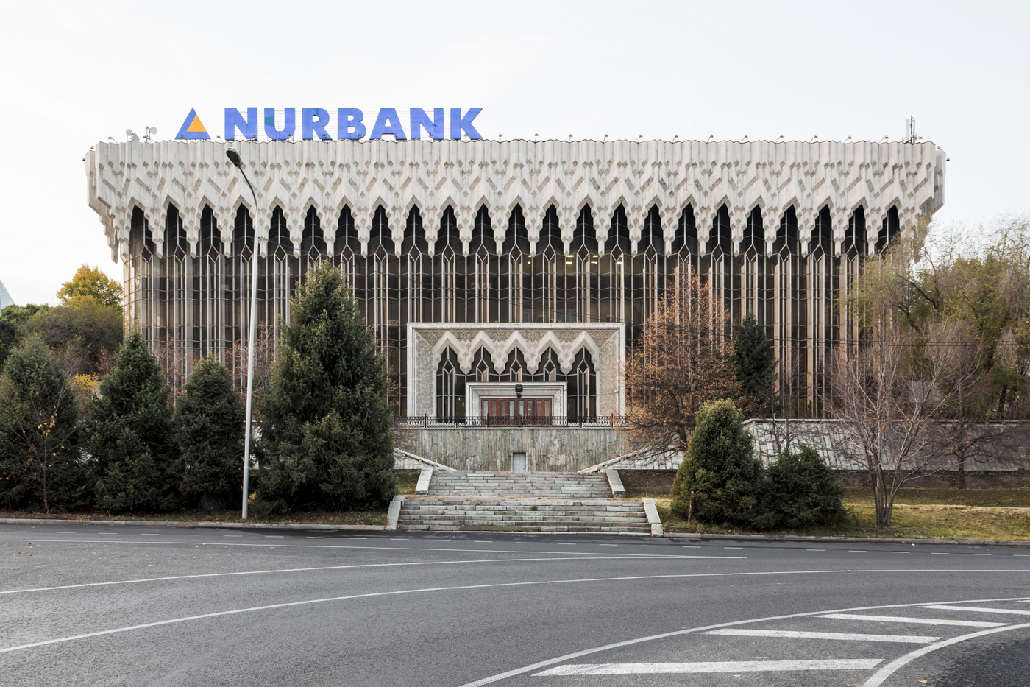
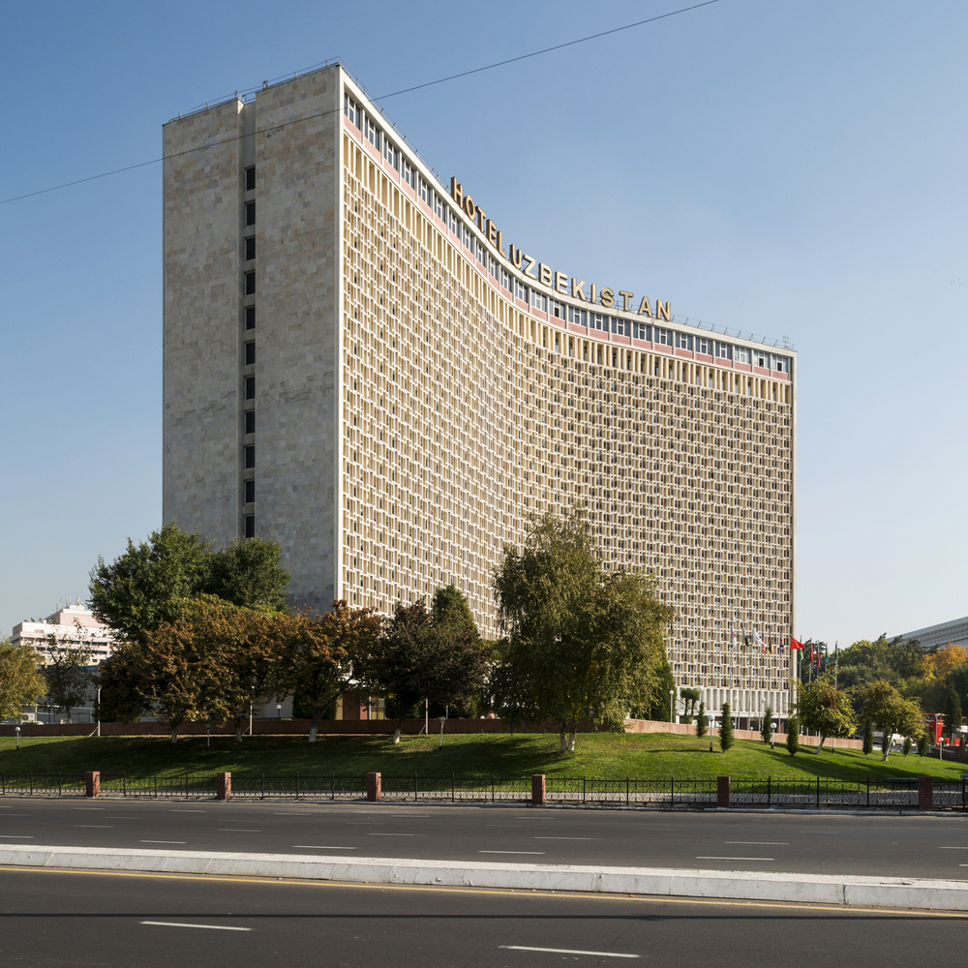
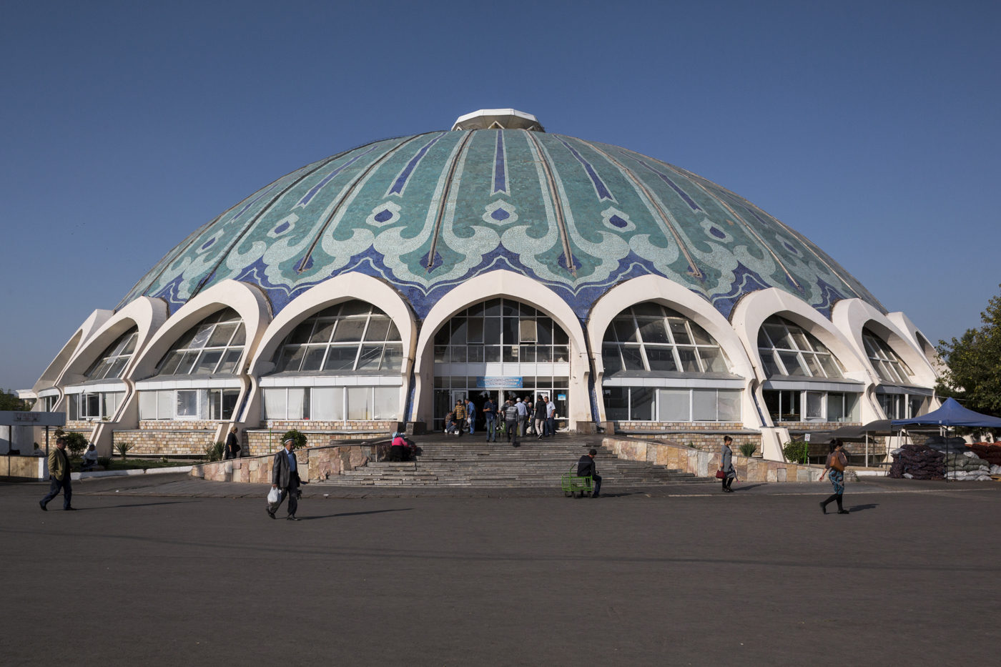
In the second half of the 20th century, soviet architecture has spread a common aesthetic across highly diverse environments, being an integral part in promoting the totalitarian ideology that disregarded local cultures, envisioning a unified, homogenous society. nevertheless, in practice, the architecture proved itself susceptible to adaptations and local influences, perhaps nowhere more than in Central Asia. The article looks at the architectural heritage of a geographical area largely excluded from the western-centric narratives on soviet modernism, encouraging a re-reading of a layered and nuanced urban landscape, with images by roberto conte and stefano perego.

Slide 10
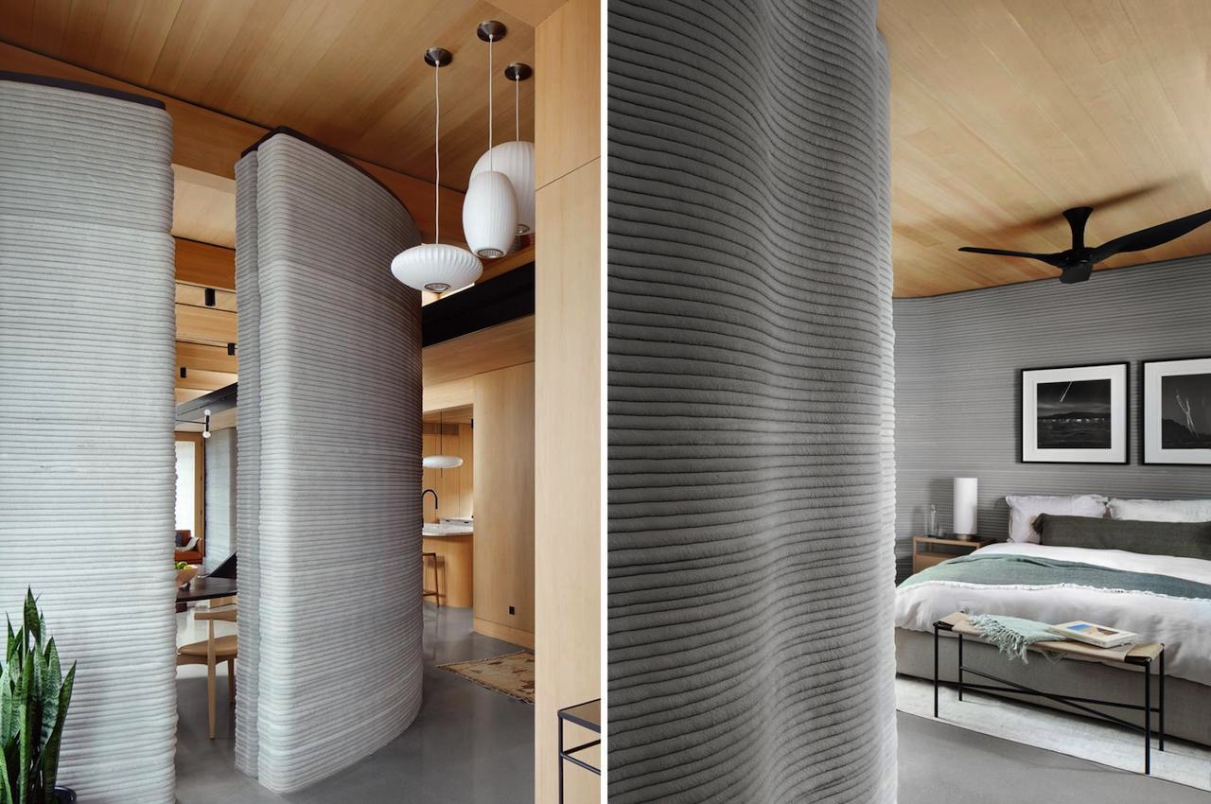
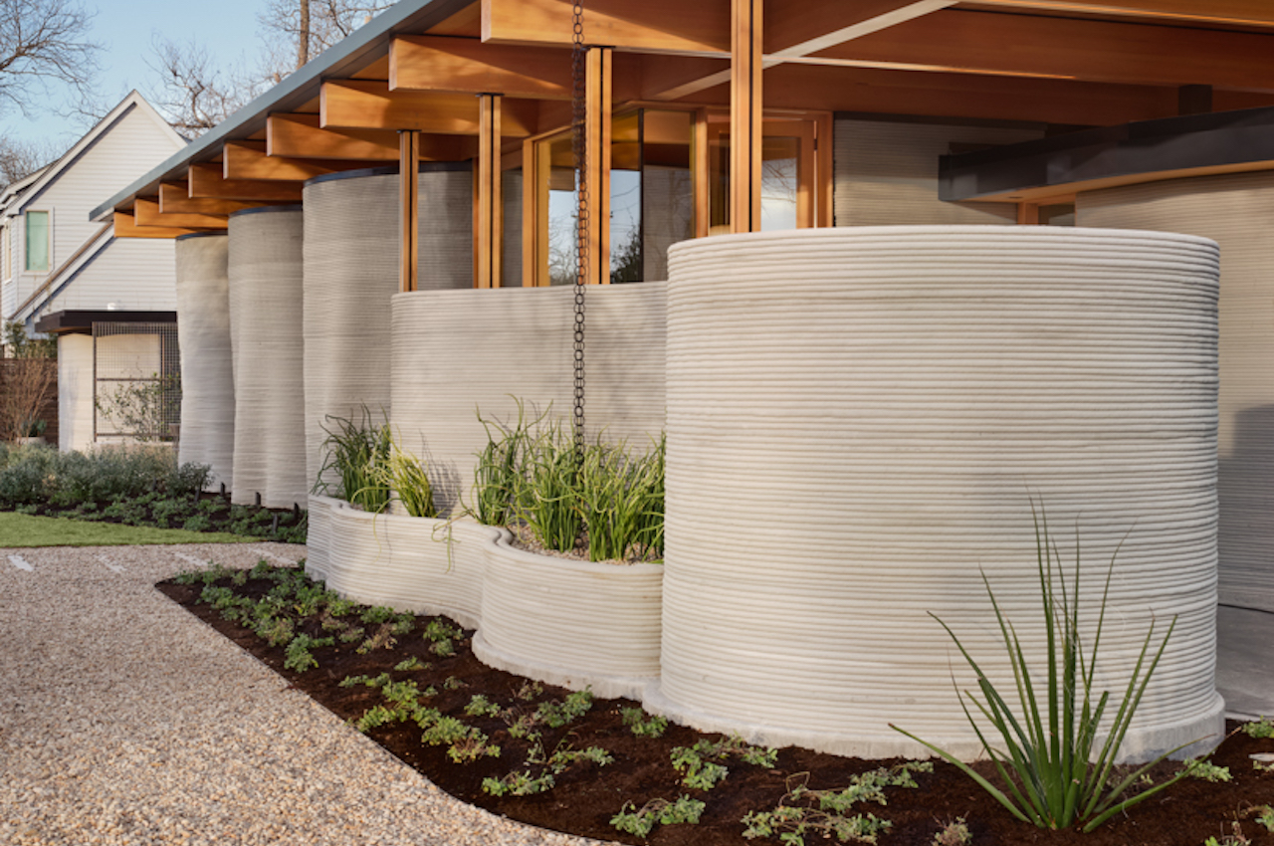
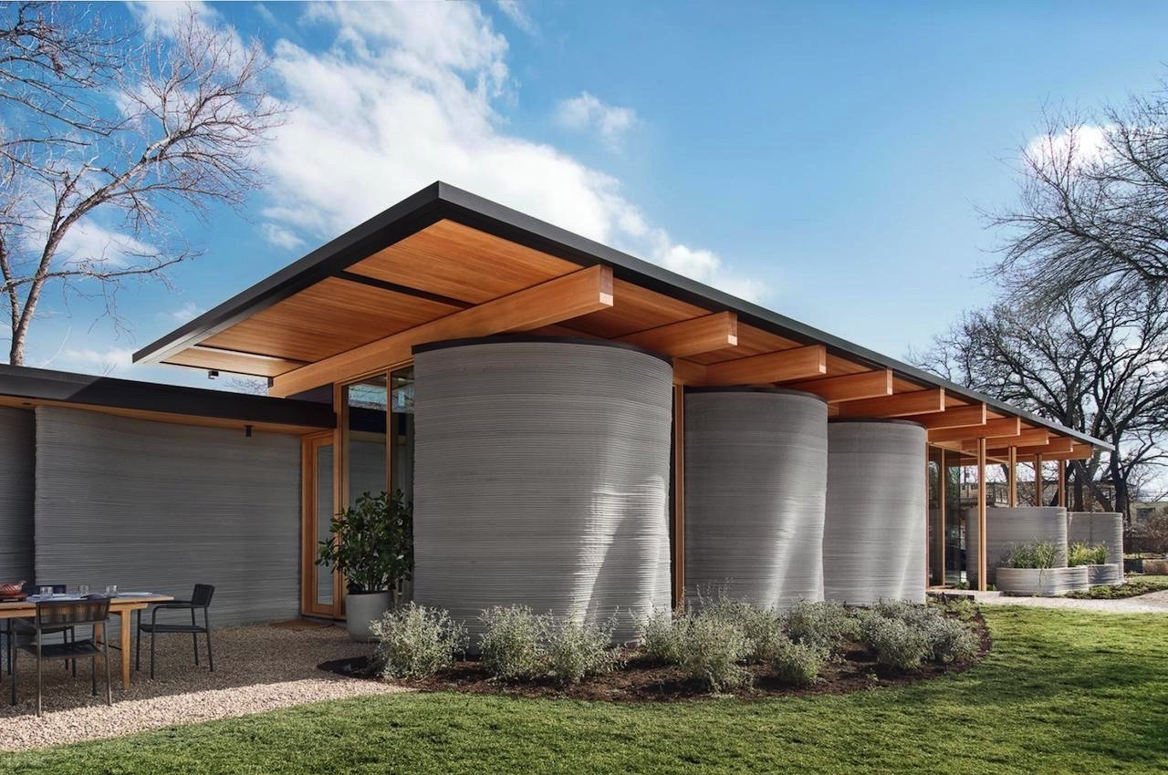
In this day and age, impossibilities are defied in ways we never imagined before. With the advent of 3d printing technology, almost anything can be done even in architecture. The idea of 3d-printed homes isn’t absurd as such is already happening. If you can 3d-print sneakers, indeed, you can print anything. we told you how 3d printing is becoming more popular and gaining momentum. Many designers have adopted the technology, and now, we’re hearing more architects are doing the same. Designers: ICON and Lake|Flato Architects

